Slide 1
Sexual Health Education
Professional Development Workshops
School Health Promotion – by VCH Public Health, for teachers in the VCH region
Public Health
Last update: Dec 5, 2024

Slide 2
Reproductive Systems &
Pregnancy Prevention
Reproductive Development (Puberty)​
Reproductive Systems ​
Pregnancy Prevention
V1 Oct 18, 2024
Public Health
Healthy Sexuality
Notes:
Script Instructions
Each slide comes with key speaking and instructional information for PHNs in the ‘presenter notes’ part of the powerpoint.
The regular, unitalicized sections are suggestions of words you could say verbally for the slide.
The font in italics include instructions and notes that are not meant to be read out loud.
Script
Hi, My name is ________. I am your school’s Public Health Nurse. My pronouns are:
I am here today because…. (in the teacher learning needs assessment you indicated this was an area you wished to learn about).
The topic of the workshop is Reproductive Health and Development & Pregnancy Prevention which contains a review of puberty, reproductive systems and contraceptive options.

Slide 3
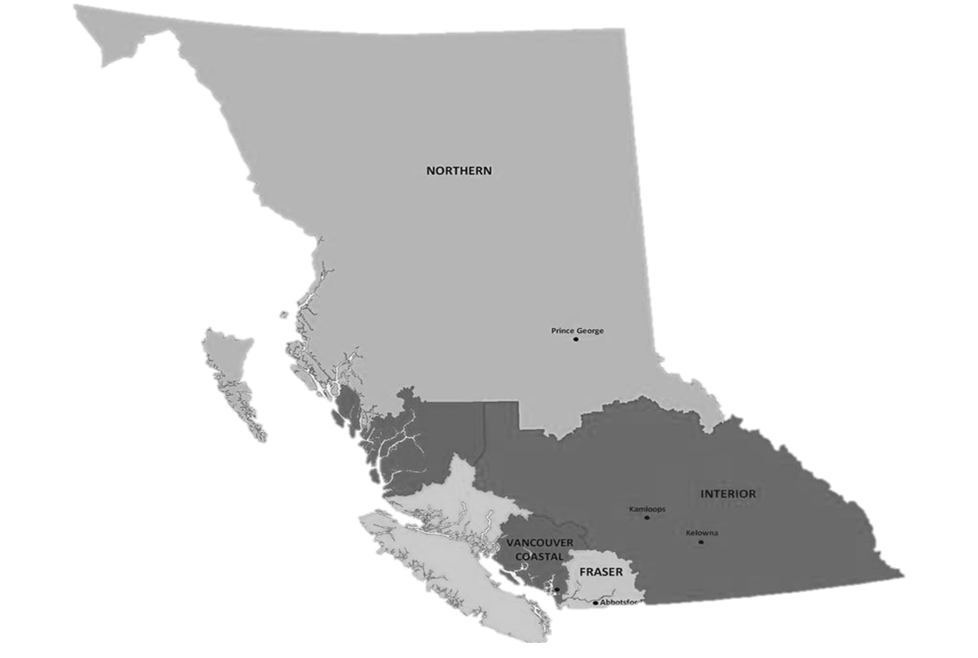

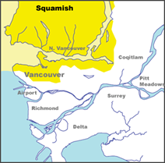
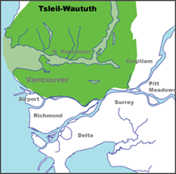
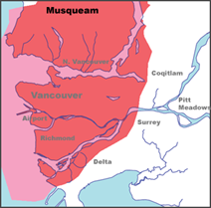

Territorial Acknowledgment
We wish to acknowledge that the land on which we gather is the traditional and unceded territory of the Coast Salish Peoples, including the Musqueam, Squamish, and Tsleil-Waututh Nations.
Vancouver Coastal Health is committed to delivering exceptional care to 1.25 million people, including the First Nations, Métis and Inuit, within the traditional territories of the Heiltsuk, Kitasoo-Xai'xais, Lil'wat, Musqueam, N'Quatqua, Nuxalk, Samahquam, shíshálh, Skatin, Squamish, Tla'amin, Tsleil-Waututh, Wuikinuxv, and Xa'xtsa.
Notes:
Script
Before we get started, I wish to acknowledge… (read slide).
Notes
If the land on which you are joining from is on the traditional and unceded territory of one of these peoples, please acknowledge those peoples directly.
If explanation is needed for teachers, advise that Territorial acknowledgements during gatherings of people are standard practice in VCH and uphold our pillar and policy of Indigenous Cultural Safety.

Slide 4


This material has been adapted from teachingsexualhealth.ca
Copyright 2023 Alberta Health Services ("AHS") with the permission of AHS.
AHS is not responsible for any inaccuracies in content different from the content of the original English edition. All acts of copyright infringement including reproduction, translation, transmission, republication, and distribution of this material without written permission of Vancouver Coastal Health and AHS are prohibited.
Public Health
Healthy Sexuality
Notes:
Script
We have adopted some of this workshop’s material with permission, from teachingsexualhealth.ca (TSH)
NOTE: VCH has a signed Permission to Use Copyright Agreement with TSH that allows us to use and adapt their material. This legal statement is intended for organizations looking at widespread distribution, not for teachers accessing and adapting materials for personal use. Teachers altering for personal use was understood by AHS to be occurring with our materials when we spoke with them. However, it does mean that if a teacher was looking at licensing the materials (e.g. starting a paid program where they created content for other teachers) they would need to seek the permission of AHS.

Slide 5
Purpose & Background
THIS PROFESSIONAL DEVELOPMENT WORKSHOP was developed by VCH Public Health to support VCH-region teachers to become more comfortable in teaching the sexual health education components of BC’s Grade 8-10 PHE Curriculum.
FOR LESSON PLANS, please use our accompanying resource Lesson Plans & Teaching Resources.
A VCH LETTER PARENT/GUARDIAN OF SUPPORT for sexual health education is available to send home before lessons with your parent/guardian notification.
I am here to help should you or your students have any questions.
Public Health
Healthy Sexuality
Notes:
Script
Read slide
After second bullet: Teaching Sexual Health is our main source of lesson plans. All TSH lesson plans are available in French. They also have a set of specialized lesson plans for students with differing abilities.
After last bullet: This professional development workshop will take After last bullet: This workshop will take approximately one hour.
Feel free to ask questions as we move along.
Notes
PHE= Physical & Health Education Curriculum

Slide 6

Learning Goals
TEACHERS WILL LEAVE TODAY’S WORKSHOP WITH
the foundational knowledge needed to teach the grades 8-10 PHE curriculum topics related to Reproductive Systems and Pregnancy Prevention.
    1 Reproductive Development: Puberty
    2 Reproductive Systems: Anatomy, conception & pregnancy
    3 Pregnancy Prevention: Contraception options
Public Health
Healthy Sexuality
Notes:
Script
Read slide
Puberty and Reproductive systems is a review of content covered in grade 5 curriculum. We feel it is necessary to review these topics in order to discuss contraception.
Let’s do a round table of introductions, starting to my (left). Please let me know your name and role in the school. If you feel comfortable to share, please also let me know how long you’ve been teaching sexual health, and how comfortable you are teaching it.

Slide 7


Reproductive systems & pregnancy prevention in the curriculum
GRADES 8–10 PHE
    Influences of physical changes (including body changes during puberty) on identities and relationships
    Strategies for managing physical changes during puberty, including growth and changing bodies
    Short- and long-term consequences of health decisions
    Making healthy sexual decisions
    Sources of health information
Public Health
Healthy Sexuality
Notes:
Script
You may be asking yourself what you need to teach, this is what the curriculum outlines
Read slide
After last slide : Students in grades 8-10 continue to experience changes of puberty and a review will allow them to make connections about the topics.
Notes
Grade 10 “evaluate”
Ref: https://curriculum.gov.bc.ca/curriculum/physical-health-education/8/core

Slide 8

Before you begin delivering content
PLEASE REVIEW
your School District’s protocols, which may include notifying your administrator, counsellor, and/or district before you begin.
PLEASE REACH OUT TO
your School District’s healthy sexuality lead and/or safe school coordinator if you have one. They can support you in the delivery of this content.
Public Health
Healthy Sexuality
Notes:
Script
Read slide
Keep in mind that today we’ll be covering information about sexual health topics, but we won’t cover any of your district’s protocols.
Do not read Is anyone aware of whether there is healthy sexuality lead or coordinator in this district?
Notes
PHNs are encouraged to find out who the healthy sexuality leads/sexual health educators are and provide this information to teachers during the workshop.

Slide 9
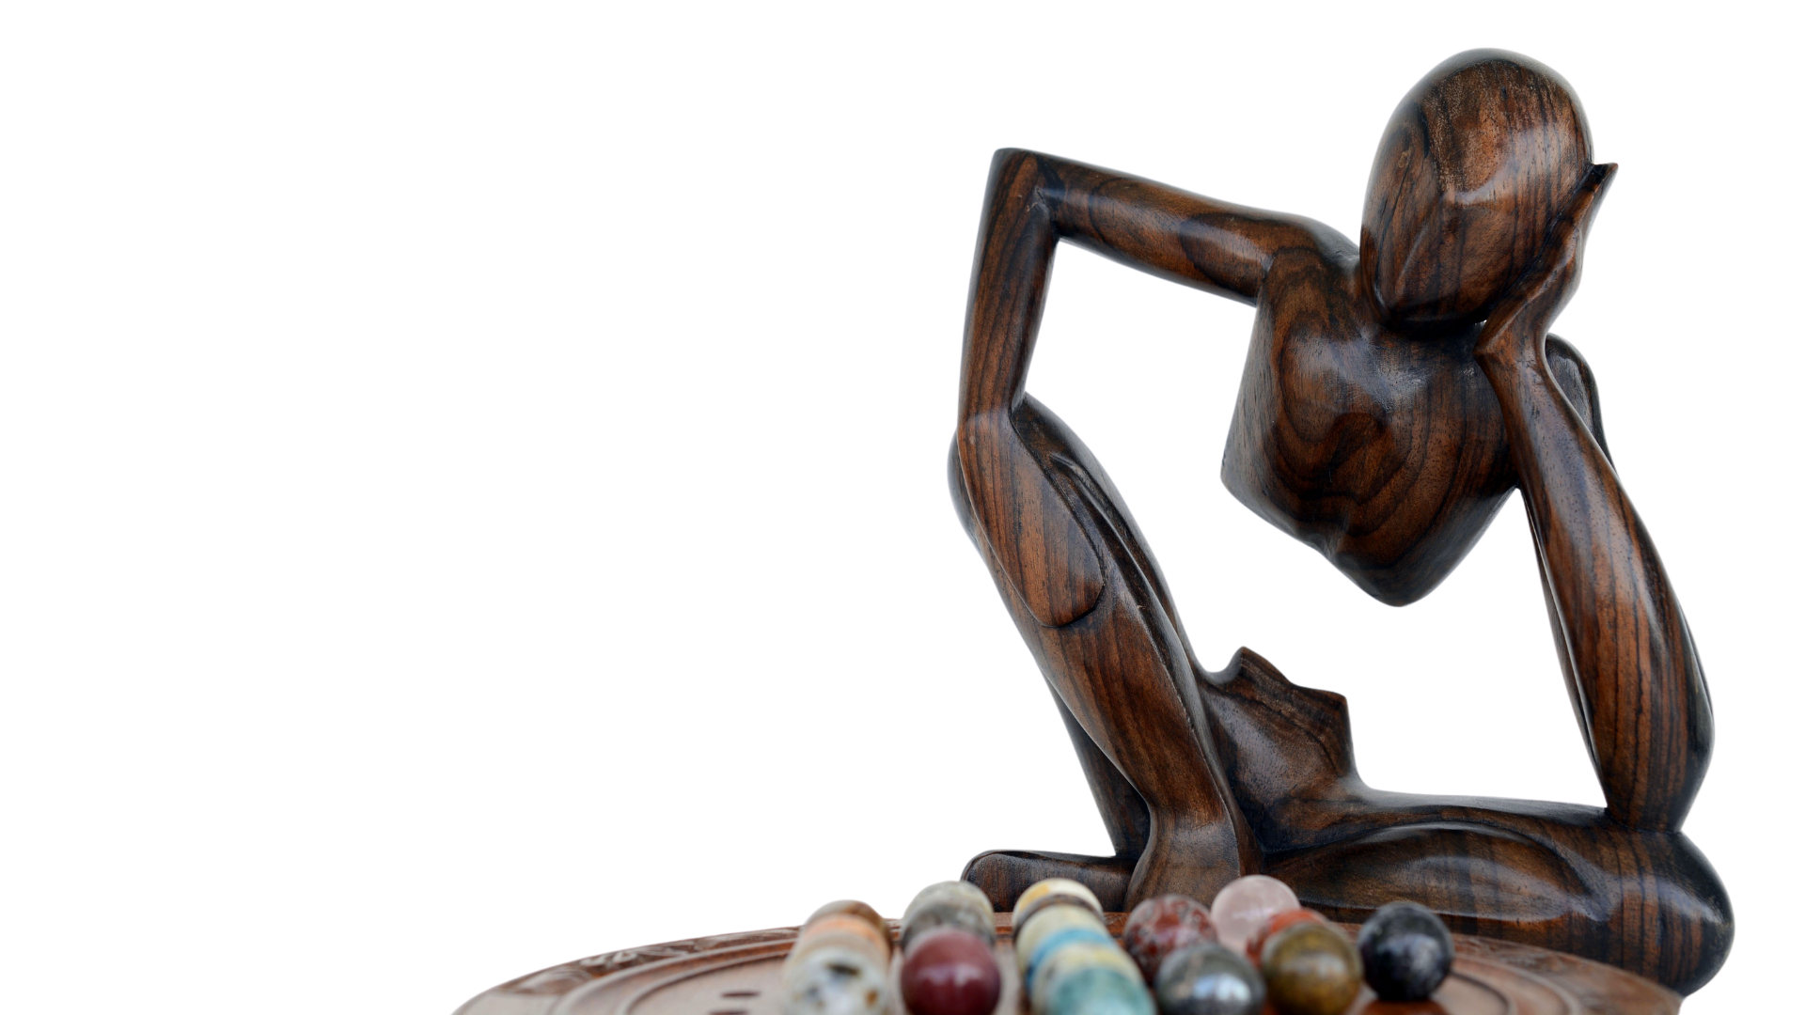
Consider…
…ways you can include sex and gender diverse students.
…how to avoid imposing your personal beliefs and values on your students
…ways you can include Indigenous and other worldviews.
…if it’s possible for to add movement breaks into your lessons
…having health clinic information readily available.
…that people who have experienced trauma may be triggered by some lessons in the Health curriculum.
Public Health
Healthy Sexuality
Notes:
Script
Read slide
1st bullet: Like using inclusive language, relationship scenarios, literature and other resources
2nd bullet: For example, E.g., people must be married to have sex and have children.
3rd bullet: Honour culture by asking questions and inviting students to share.
4th bullet: To help students physically self-regulate.
5th bullet: So students can follow up on their health care needs.
Last bullet: Be mindful that some of your students may have experienced pregnancy and termination. Provide advance notice of sensitive topics and monitor yourself and your students’ behaviour throughout the lesson. Develop a safety plan for students who may need to leave the room. For more information, refer to our Getting Started workshop.
Notes
If Trauma Informed Practice (TIP) discussed further:
Preview videos and other content before showing to your students.
If possible, try to plan your lessons before a break (recess or lunch) and not a major school break (winter, spring, summer) so students can speak to you in private or follow up with a school counsellor or other professional if needed.
Ref: Supporting Student Health Guide: https://curriculum.gov.bc.ca/sites/curriculum.gov.bc.ca/files/pdf/subject/phe/Supporting_Student_Health_Secondary.pdf

Slide 10
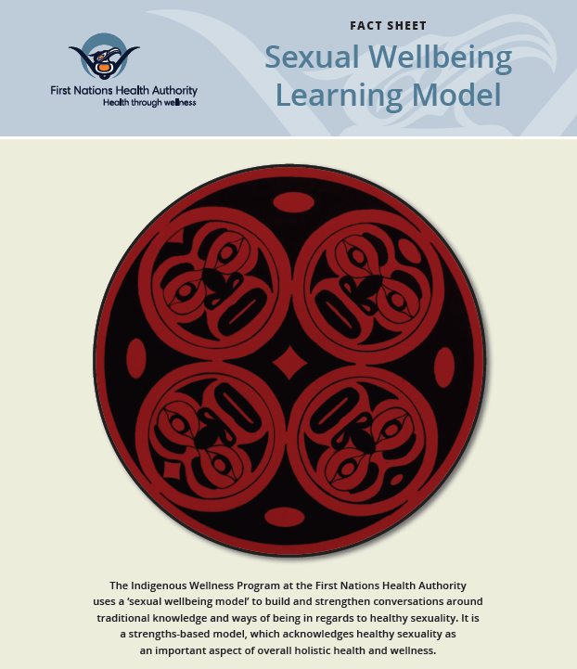
Sexual Wellbeing:
Learning from Indigenous Voices
Public Health
Healthy Sexuality
Notes:
Script:
Creating a safe(r) space includes welcoming and honouring culture by considering Indigenous and other worldviews, asking students questions, and inviting them to share as was mentioned in the previous slide.
Here is the First Nations Health Authority Sexual Wellbeing Learning Model. Our Indigenous Health team reviewed this model and feel this is an excellent framework incorporating indigenous values.
Ref:
https://www.fnha.ca/WellnessSite/WellnessDocuments/FNHA-IWP-Sexual-Wellbeing-Learning-Model-Fact-Sheet.pdf

Slide 11
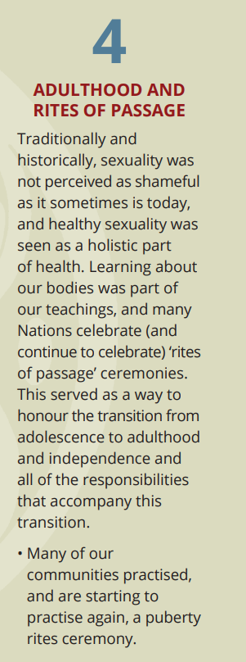
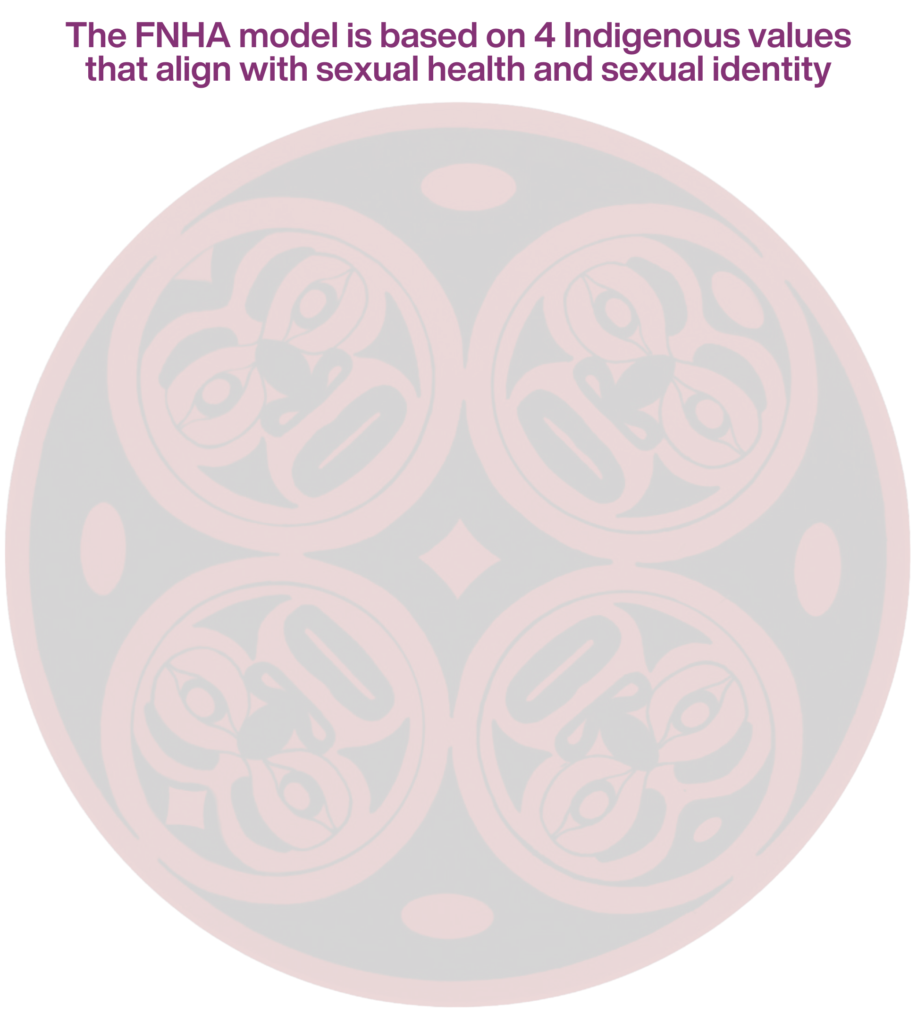
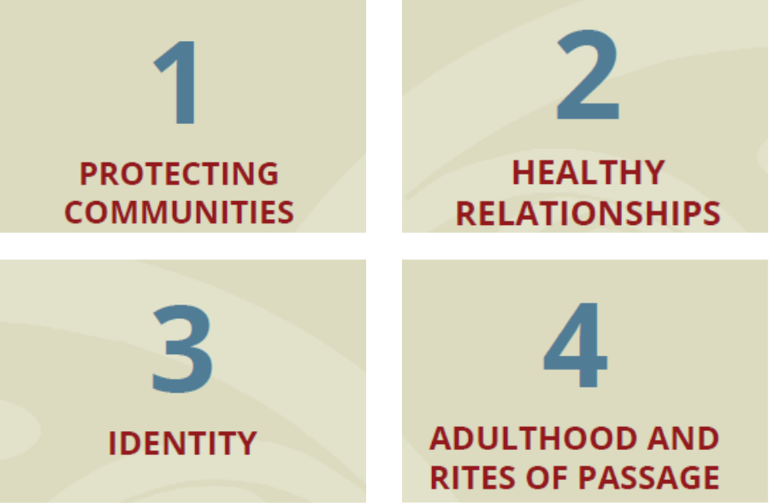
Identity within Indigenous Sexual Wellbeing
Notes:
Script
There are 4 Indigenous values identified within the model: Protecting Communities, Healthy Relationships, Adulthood, identity and Rites of Passage.
Let’s take a closer look at the value of Adulthood and Rites of Passage
It identifies that traditionally, learning about one’s body was part of the teachings and many nations continue to celebrate rites of passage ceremonies as a way to honour the transition from adolescence to adulthood.

Slide 12
Reproductive Development
Puberty
Public Health
Healthy Sexuality
Notes:
Script
Now that we have covered some of our foundations, let us get started on reproductive development, also known as puberty.

Slide 13
Words matter: Sex, gender, and sexual orientation 101
Sex
A person’s emotional and sexual attraction to others
It can change over time.
May or may not be related to sexual behaviour or activity.
Sexual orientation
How a person expresses their gender
Can include appearance, social behaviour, chosen name,
and pronouns (e.g., he, she, they).
Gender/Gender identity
A person’s internal sense of identity
As a boy/man, girl/woman, non-binary, Two-Spirit, etc.
Not necessarily related to their sex.
Gender expression
Biological assignment as male, female or
having differences in sex development (DSD)
Determined by characteristics such as sexual and
reproductive anatomy and genetic makeup.
Public Health
Healthy Sexuality
Notes:
Script
Let’s do a quick review about sex, gender identity and sexual orientation. In this activity, I will read out the definitions for each of the 4 terms on the left and ask you to match them.
Read once gender identity is defined: For many people, their gender is the same as the sex they were assigned at birth based on body parts (cisgender). For some people, their gender identity is different from the sex they were assigned at birth. They may use terms like transgender, trans, non-binary, gender fluid, gender queer, agender or others, to describe their gender identity.
Read once sex is defined: There are natural variations in bodies that don’t fit neatly into male or female categories. Some people have differences in sex development (DSD) where their reproductive sexual, or genetic biology is not exclusively male or female or otherwise does not fit within medical definitions of male or female. Some people with DSD identify as intersex and some don’t. Some people may learn they have DSD at birth or later in life.
Notes
Additional resources: Trans Care BC Glossary: https://www.transcarebc.ca/glossary
Trans Care BC Gender Diversity Resource https://www.transcarebc.ca/sites/default/files/2024-03/Exploring_Gender_Diversity.pdf
Ref: https://teachingsexualhealth.ca/parents/information-by-topic/gender-identity-and-expression/
https://www.bctf.ca/classroom-resources/details/the-gender-spectrum-what-educators-need-to-know

Slide 14

Puberty
A time of rapid physical, emotional, sexual, and social growth and development.
Puberty starts between the ages of 8-16, with most students beginning at age 10-13.
Experiences Vary
Public Health
Healthy Sexuality
Notes:
Script
Now that we have reviewed sex, gender identity and sexual orientation, let’s talk about puberty.
Read slide
Read after last bullet:
Often, the differences between students in your classroom can be remarkable.
Each individual experiences the changes of puberty at a unique rate.
It is important to help students recognize and accept that these differences are healthy and to encourage them to accept their own rate of development.
Some people may take medication that will change when or how they go through puberty. This can be due to starting puberty too early, wanting to delay or slowdown puberty to have their body change in ways that better aligns with their gender identity. Also, some people have delayed puberty and will need to seek medical care in the absence of development.
In the next few slides, I will discuss the physical changes in puberty.
Ref: https://teachingsexualhealth.ca/app/uploads/sites/4/Gr8LP1-Going-through-Puberty-ENGLISH-FINAL.pdf
https://www.healthdirect.gov.au/emotional-changes-puberty
Image: Designed by Freepik- https://www.freepik.com/free-photo/portrait-attractive-teenage-boy-his-friends-hanging-out-school_27999389.htm#fromView=search&page=2&position=12&uuid=c6678592-b71a-4147-af97-5f15136a913b

Slide 15

Physical changes of puberty
Grow taller
Acne (pimples)
Pubic hair grows on genitals
Voice changes
Sweat glands develop
Hair grows on armpits and face
Start making sex hormones
Public Health
Healthy Sexuality
Notes:
Script
After reading the title:
These are changes that happen to all bodies during puberty. The order, rate and amount of change is unique to each person.
Increases in weight, height, and body size are healthy and expected. Some bodies will experience changes in weight before changes in height.
Ref: https://teachingsexualhealth.ca/app/uploads/sites/4/Gr8LP1-Going-through-Puberty-ENGLISH-FINAL.pdf

Slide 16

Physical changes of puberty
for people with vulvas
Ovulation
Menstruation begins
Hips get wider
Vaginal discharge
Breasts develop
Public Health
Healthy Sexuality
Notes:
Script
Read this first: In this slide, we will focus on what happens to people with vulvas, ovaries and uteruses who will experience estrogen-based puberty. People with these body parts are assigned 'female' when they are born, and most identify as girls/women. But as we mentioned, gender identity is different than biological sex and people with different body parts may also identify as girls/women. We will be talking about physical changes that happen based on someone's reproductive organs, hormones and genitals so we will be using the term "people with vulvas“ as a gender inclusive term for these bodies.
We recognize and acknowledge that people come with different comfort levels based on their experiences and contexts. We encourage you to use this term with your classes to be inclusive of all students.
The bodies of people who have differences in sex development (DSD) will develop in a combination of ways that are right for them.
Definitions:
Breasts Develop: Breast tissue development is permanent.
Menstruation begins: also known as “periods”.
Ovulation: when eggs are released from the ovaries.
Ref: https://teachingsexualhealth.ca/app/uploads/sites/4/Gr8LP1-Going-through-Puberty-ENGLISH-FINAL.pdf

Slide 17
Physical changes of puberty
for people with penises
Start producing sperm
Shoulders get wider
Ejaculation
Nocturnal emissions
Penis & testicles grow bigger
Temporary breast development
Erections
Public Health
Healthy Sexuality
Notes:
Script
In this slide, we will focus on what happens to people with penises and testes who will experience testosterone-based puberty. People with these body parts are assigned 'male' when they are born, and most identify as boys/men. But as we mentioned, gender identity is different than biological sex and people with different body parts may also identify as boys/men. We will be talking about physical changes that happen based on someone's reproductive organs, hormones and genitals so we will be using the term "people with penises“ as a gender inclusive term for these bodies.
We recognize and acknowledge that people come with different comfort levels based on their experiences and contexts. We encourage you to use this term with your classes to be inclusive of all students.
The bodies of people who have differences in sex development (DSD) will develop in a combination of ways that are right for them.
Definitions:
Erections: the penis becomes erect (hard) when the spongy tissue fills with blood.
Ejaculation: sperm is released from penis.
Nocturnal emissions: refers to ejaculating while asleep. Also known as “wet dreams”.
Before we move on to Reproductive systems, what questions do you have?
Ref: https://teachingsexualhealth.ca/app/uploads/sites/4/Gr8LP1-Going-through-Puberty-ENGLISH-FINAL.pdf

Slide 18
Reproductive Systems
Anatomy
Public Health
Healthy Sexuality

Slide 19
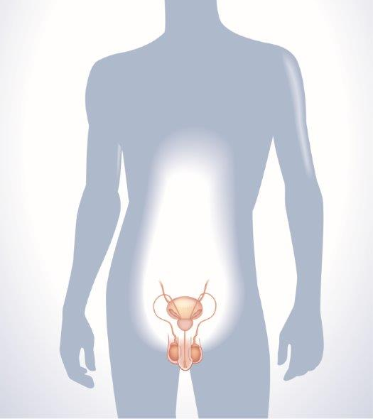
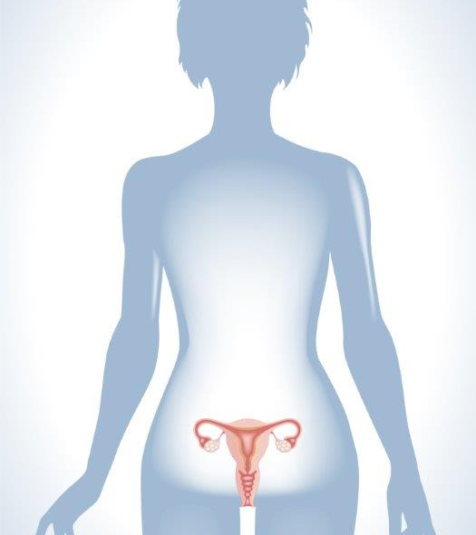

Human Reproductive Systems
Public Health
Healthy Sexuality
Notes:
Script
In this section, we will talk about external anatomy, also known as genitalia, as well as internal anatomy.
Ref: https://teachingsexualhealth.ca/parents/information-by-topic/gender-identity-and-expression/
Image: https://teachingsexualhealth.ca/app/uploads/sites/4/DA-Diagrams.pdf

Slide 20
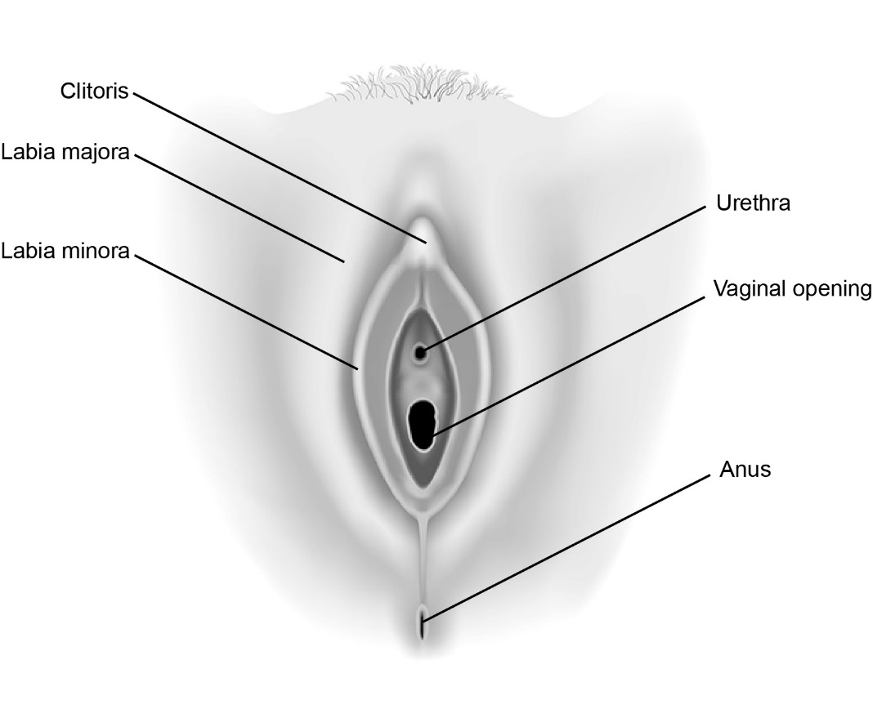
External genitals of people with vulvas
Public Health
Healthy Sexuality
Notes:
Script
Let’s review the external anatomy of people with vulvas.
Vulva
The vulva includes the labia majora, labia minora, clitoris-The sex organ that becomes larger and firmer during sexual arousal, located above the urethra, and the opening of the vagina.
The labia majora and the labia minora are the outer and inner folds of skin surrounding the vaginal opening.
Vulvas come in all shapes, sizes and colours.
Urethra
There are three openings: the urethra, vagina and anus. The vagina is the opening to the reproductive tract.
Here is the urethra- urine passes through this tube to the outside of the body.
This is often surprising even to people who have this reproductive system, who think that the urethra and the vagina are the same passageway.
Part of the urinary system, not part of the reproductive system.
Anus
The opening at the end of the digestive tract where feces or stool leaves the body.
The anus is part of the digestive system, not part of the reproductive system.
Ref: https://teachingsexualhealth.ca/app/uploads/sites/4/Gr5-LP2-Journey-of-an-Egg-ENGLISH-FINAL.pdf
Image: https://teachingsexualhealth.ca/app/uploads/sites/4/DA-Diagrams.pdf

Slide 21
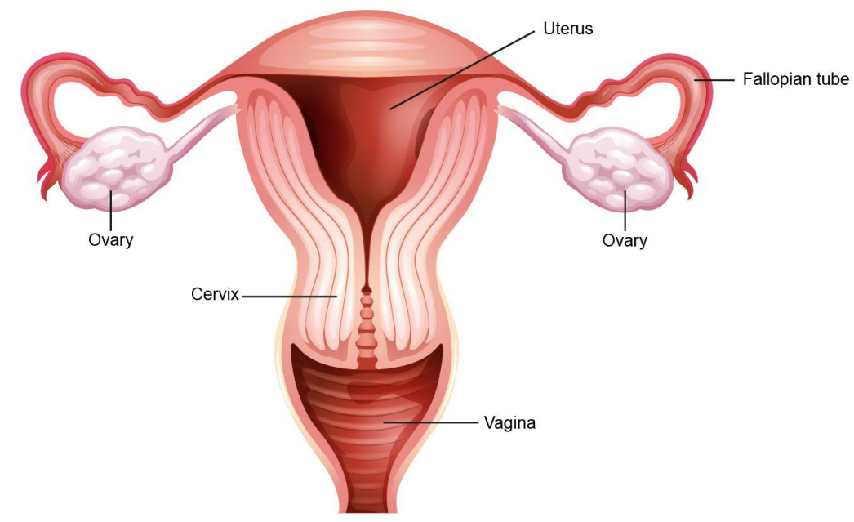
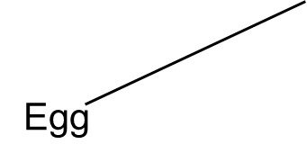
Internal anatomy of people with vulvas
Public Health
Healthy Sexuality
Notes:
Script
Let’s review the internal anatomy of people with vulvas.
Ovaries
The egg-producing glands.
These glands contain over a million egg (ova) cells present at birth, and start releasing them after puberty begins each month, this is called ovulation.
Fallopian Tubes
These are narrow tubes that connect the ovaries to the uterus.
The egg travels through one of the tubes after ovulation.
Fertilization occurs in the fallopian tubes- this is when an egg and sperm meet.
Uterus
The place where fetuses grow.
It is about the size of a fist.
During the menstrual cycle, the uterus grows a lining of blood that would nourish a growing fetus if fertilization and implantation occur. This lining sheds approximately once a month if fertilization and implantation do not occur.
Cervix
At the bottom of the uterus that opens into the vagina.
Vagina
The passageway leading from the uterus to the outside of the body.
Blood from the uterus passes through the vagina during menstruation.
Babies pass from the uterus through the vagina during vaginal childbirth.
OTHER (not visualized)
Bladder
The sac that holds the urine produced by the kidney.
The bladder is part of the urinary system, not the reproductive system.
Notes
Some may find it helpful to compare sizes of different structures in the body to fruits. Refer to this article for further information. https://commons.bcit.ca/news/2018/02/ultrasound-structures-compared-fruit/
Ref: https://teachingsexualhealth.ca/app/uploads/sites/4/Gr5-LP2-Journey-of-an-Egg-ENGLISH-FINAL.pdf
Image: https://teachingsexualhealth.ca/app/uploads/sites/4/DA-Diagrams.pdf

Slide 22
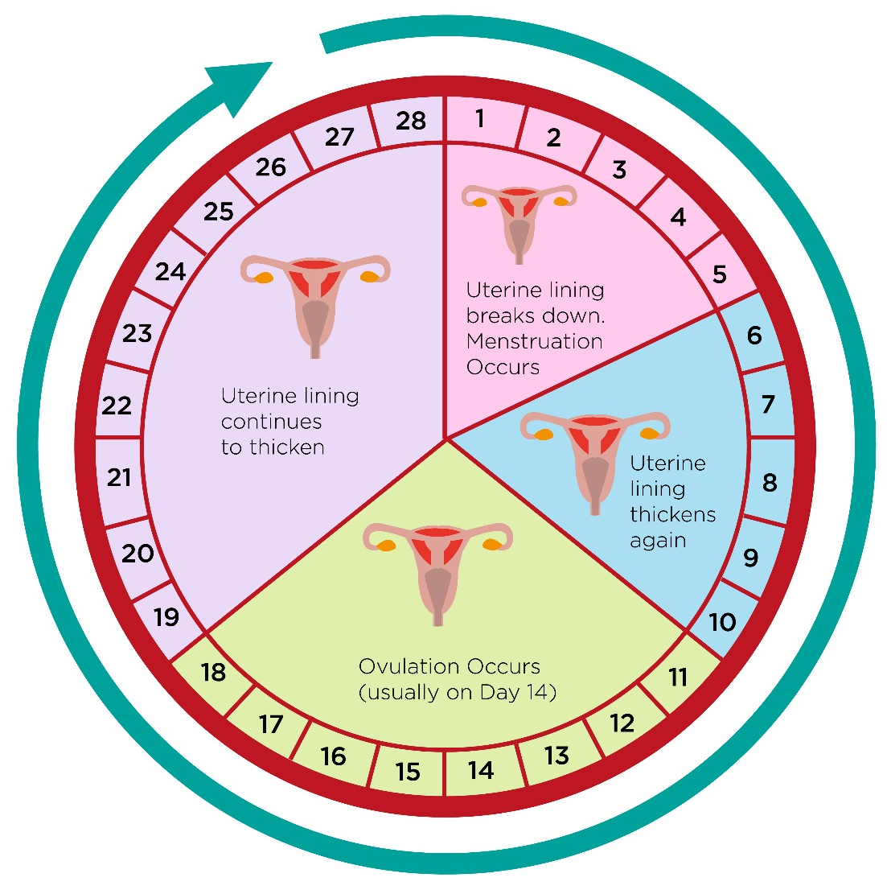
Menstruation
Each cycle:
Uterus prepares for the growth of a fetus in case fertilization occurs.
Hormones from the ovaries send a message: Grow a thick, soft lining of tissue and blood to nourish a fertilized egg.
If the egg is not fertilized:
Uterus sheds the lining through the vagina over 2-7 days.
Menstruation usually starts
between ages 9 and 15.
Monthly cycle
Public Health
Healthy Sexuality
Notes:
Script
After title: also known as a period. It begins during puberty for people with vulvas and some people with DSD.
After third bullet: Five days is the average. Once the lining is completely shed, a new lining begins to grow.
After last bullet: This diagram shows a menstrual cycle of 28 days, which is an average. Cycles can vary between 24-38 days long.
Ref: https://www.healthlinkbc.ca/pregnancy-parenting/parenting-teens-12-18-years/teen-growth-and-development/menarche
https://teachingsexualhealth.ca/app/uploads/sites/4/Gr7LP2-Reproduction-ENGLISH-FINAL.pdf
Image: https://teachingsexualhealth.ca/app/uploads/sites/4/DA-Diagrams.pdf

Slide 23
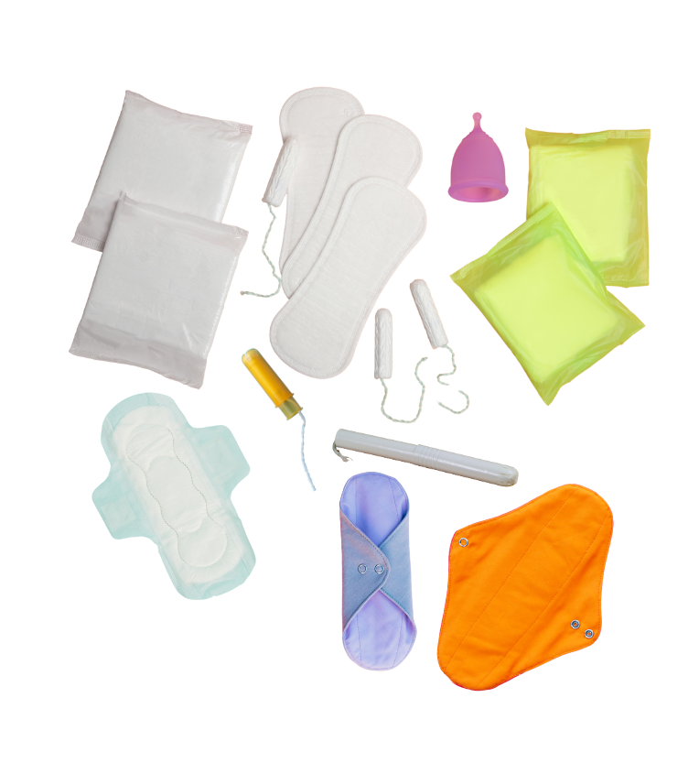
Menstruation experiences Vary
First 1-2 years:
periods can be very irregular
Products that absorb menstrual fluid:
pads, tampons, menstrual cups, etc.
Pain and cramping:
experienced by some people
Periods continue until menopause:
usually until 40s or 50s
Public Health
Healthy Sexuality
Notes:
Script
After first bullet: The average amount of menstrual fluid during a period is about 2-3 tablespoons.
After third bullet: Can be relieved using a hot water bottle, mild to moderate exercise, or over the-counter pain medication. Menstruation is not a sickness. People can generally participate in their regular daily activities such as physical education class and extra-curricular activities. Students should seek care at a sexual health clinic or primary care provider when experiencing more or less frequent periods, periods lasting more than 7 days, heavy bleeding (soaking through pads or tampons several times a day), bleeding between periods, ongoing pelvic pain or any other period related symptom that significantly disrupts their daily lives.
After last bullet: After menopause, eggs are no longer released and periods end.
Ref: https://teachingsexualhealth.ca/app/uploads/sites/4/DA-Diagrams.pdf
https://www.healthlinkbc.ca/pregnancy-parenting/parenting-teens-12-18-years/teen-growth-and-development/menarche
https://www.healthlinkbc.ca/illnesses-conditions/sexual-reproductive-health/normal-menstrual-cycle#:~:text=by%20hormonal%20changes.-,Menstrual%20period,during%20the%20first%203%20days.
https://www.yourperiod.ca/abnormal-pain-and-menstrual-bleeding/is-my-bleeding-normal/#:~:text=Normal%20menstrual%20bleeding%20has%20the,tablespoons%20(30%2D50%20mL)
https://teachingsexualhealth.ca/app/uploads/sites/4/Gr5-LP2-Journey-of-an-Egg-ENGLISH-FINAL.pdf
Image: Canva pro

Slide 24
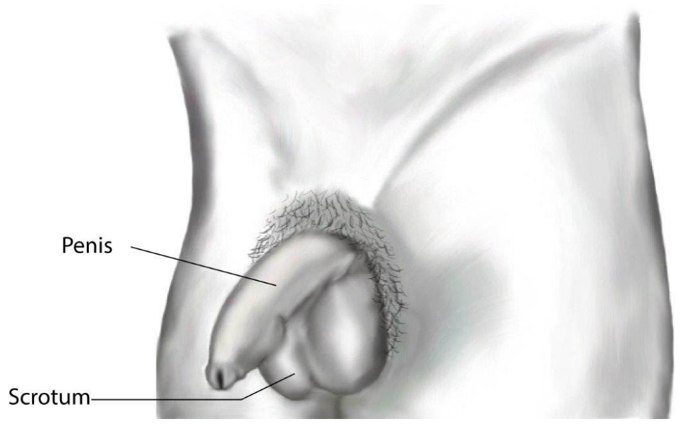
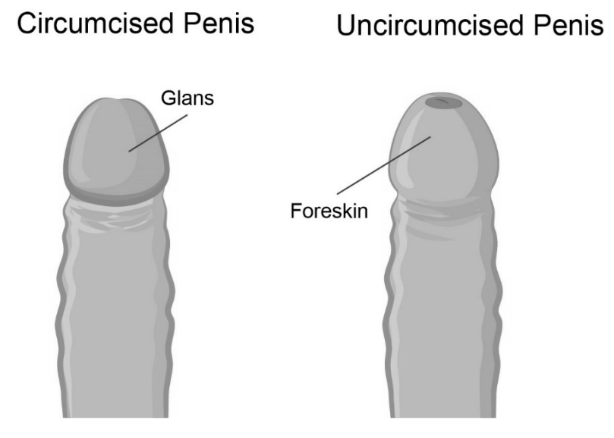
External genitals of people with penises
Public Health
Healthy Sexuality
Notes:
Script
Let’s review the external anatomy of people with penises.
Penis
An external sex organ.
Semen and urine are released from the penis.
It is made up of spongy material that fills up with extra blood (becomes erect and gets hard) when sexually aroused.
During puberty, the penis grows as does the rest of the body. Size varies from person to person.
Scrotum
The sac that holds the testicles.
Testicles are the sex glands that produce sperm and testosterone.
Sperm is the reproductive cells that, if it fertilizes an egg, can create a fetus.
The testicles are kept just below body temperature in order to produce healthy sperm.
The scrotum pulls the testicles closer to the body if it is cold and away from the body if it is hot.
Foreskin
The skin on the end of the penis that retracts during an erection.
This skin may be partially removed in a procedure called circumcision. It is usually done soon after birth by a doctor or trained religious person. Some people are circumcised and some are not. It doesn’t affect the function of the penis.
There is not usually a medical or health reason for circumcision. It is currently not recommended as a routine procedure.
People who are uncircumcised gently pull back the foreskin to clean around the head of the penis on a regular basis.
This is an image of a circumcised and uncircumcised penis.
Anus – not visualized
The opening at the end of the digestive tract where feces leaves the body.
The anus is part of the digestive system, not part of the reproductive system.
Ref: https://teachingsexualhealth.ca/app/uploads/sites/4/Gr5-LP3-Journey-of-a-Sperm-ENGLISH-FINAL.pdf
https://www.healthlinkbc.ca/pregnancy-parenting/parenting-babies-0-12-months/baby-care/circumcision
Image: https://teachingsexualhealth.ca/app/uploads/sites/4/DA-Diagrams.pdf

Slide 25
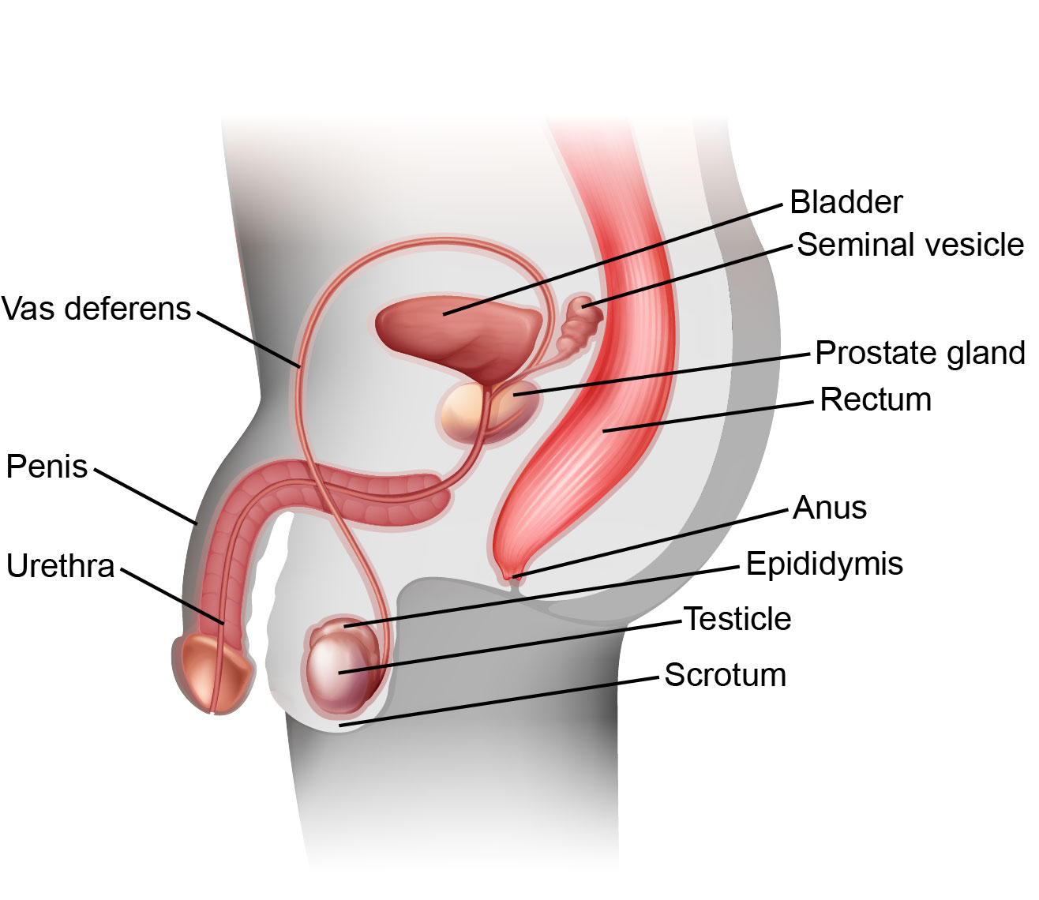
Internal anatomy of people with penises
Public Health
Healthy Sexuality
Notes:
Script
Let’s review the internal anatomy of people with penises.
Epididymis
A long coiled tube that connects a testicle to a vas deferens.
Where sperm matures and are stored.
Vas Deferens
A narrow tube that carries sperm from the testicles to the urethra.
Seminal Vesicles
Two small pouches behind the bladder that produce and store seminal fluid.
This fluid mixes with sperm and other fluid to produce semen.
Prostate Gland
Produces fluid that is part of semen. The fluid feeds and protects sperm when they are ejaculated.
Urethra
Allows for urine and semen to pass through to the outside of the body.
When a person is sexually aroused, the penis becomes erect. During vaginal intercourse, the erect penis is inserted into the vagina.
If ejaculation occurs, sperm travel through the vas deferens, mix with fluids to become semen, and
are released into the vagina through the urethra. Urine and semen cannot come out at the same time. There are two branches to the urethra, one from the bladder and the other from the vas deferens. When the penis is ready to release semen, a valve blocks off the branch to the bladder so urine cannot come out. The prostate also enlarges to block urine from leaving the bladder when sperm is ejaculated.
Bladder
The sac that holds the urine produced by the kidneys.
The bladder is part of the urinary system, not the reproductive system.
Before we move on to conception and pregnancy, what questions do you have about anatomy?
Ref: https://teachingsexualhealth.ca/app/uploads/sites/4/Gr5-LP3-Journey-of-a-Sperm-ENGLISH-FINAL.pdf
Image: https://teachingsexualhealth.ca/app/uploads/sites/4/DA-Diagrams.pdf

Slide 26
Reproductive Systems
Conception & pregnancy
Public Health
Healthy Sexuality
Notes:
Script
Let’s move on to….

Slide 27
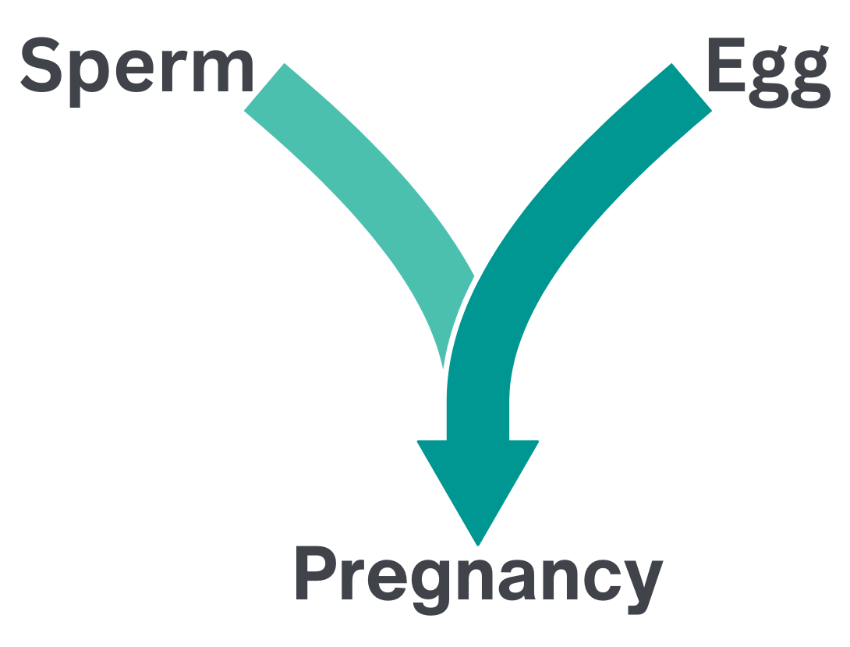
Public Health
Healthy Sexuality
Notes:
Script
There are two important cells, the sperm and the egg. The sperm cells are made in testicles. The egg is stored in the ovary.
Usually, the sperm and egg meet during vaginal intercourse (sex where the penis enters the vagina and ejaculation takes place). But of course, there are other ways the sperm and egg can meet.
It is also possible but uncommon to get pregnant when sperm is present close to the vagina and enters.
When people are trying to get pregnant, there are other ways to bring the egg and sperm together that don’t involve any sexual activity.
Ref: https://teachingsexualhealth.ca/app/uploads/sites/4/Gr7LP2-Reproduction-ENGLISH-FINAL.pdf (image as well)
https://www.healthlinkbc.ca/pregnancy-parenting/planning-your-pregnancy/fertility/vitro-fertilization-infertility

Slide 28
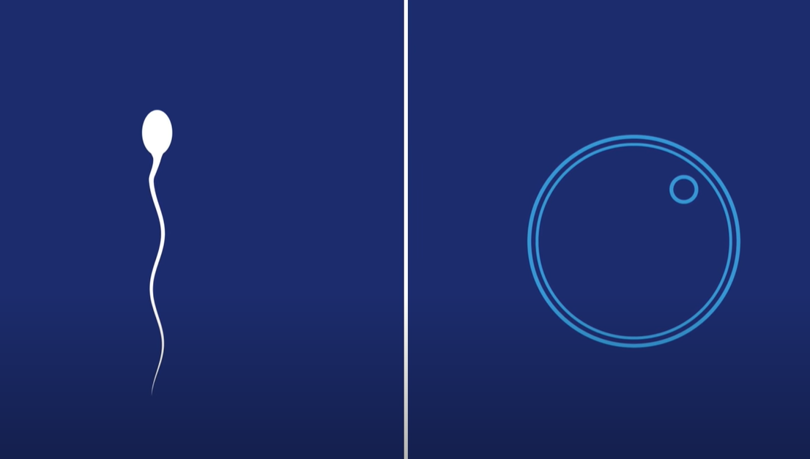

Notes:
Script
This is a 2 minute video on pregnancy from planned parenthood (will require internet connection to view)
Notes
If you do not have access to the internet, the video wont play. Please read the next two slides instead.
Ref: https://www.youtube.com/watch?v=n04NPtZI4QQ

Slide 29
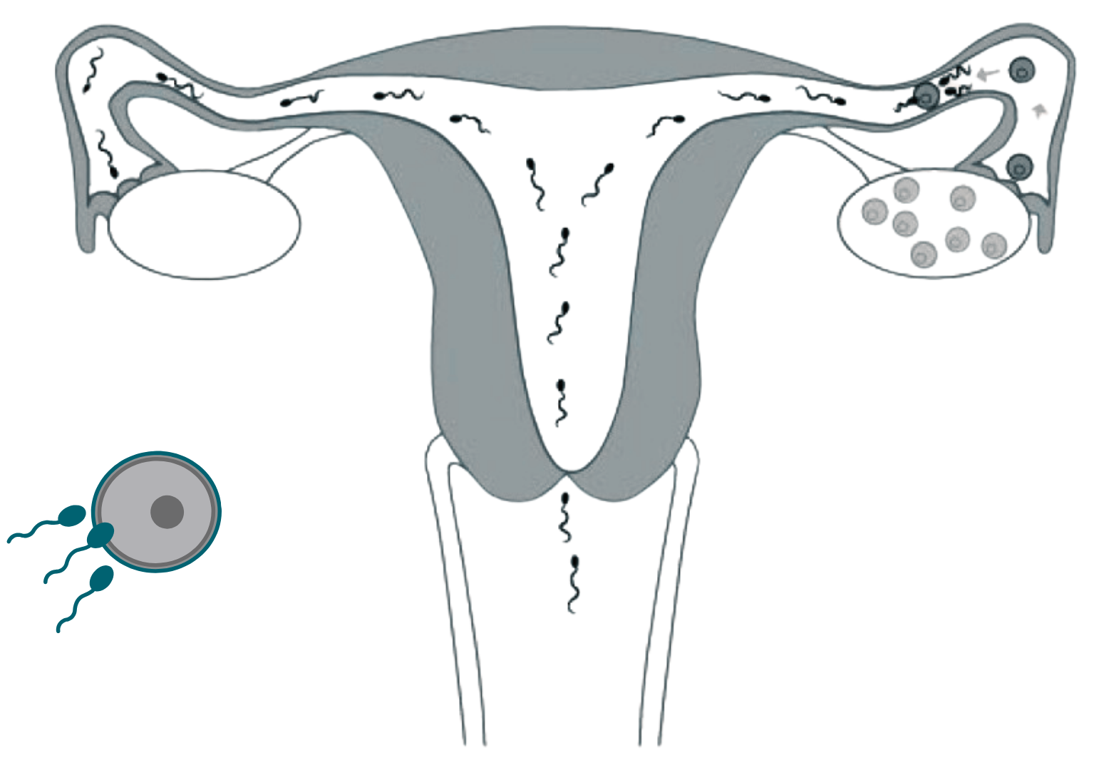
Fertilization happens when sperm and egg join
Sperm swim
through the uterus and fallopian tubes, looking for an egg to fertilize.
The tail of each sperm cell acts as a propeller to move the sperm forward.
If an egg is present,
the sperm and egg could join which would result in fertilization.
Public Health
Healthy Sexuality
Notes:
Skip this slide if able to watch video on the previous slide.
Script
Read slide
The uterus enlarges as the zygote begins to divide and becomes an embryo and then a fetus.
Ref: https://www.healthlinkbc.ca/pregnancy-parenting/birth-control/how-pregnancy-conception-occurs
https://teachingsexualhealth.ca/app/uploads/sites/4/Gr6LP3-Growing-Baby-ENGLISH-FINAL.pdf
https://teachingsexualhealth.ca/app/uploads/sites/4/DA-Diagrams.pdf (image as well)
https://teachingsexualhealth.ca/app/uploads/sites/4/Birth-Contol-Kit-ENGLISH-FINAL.pdf (image)

Slide 30
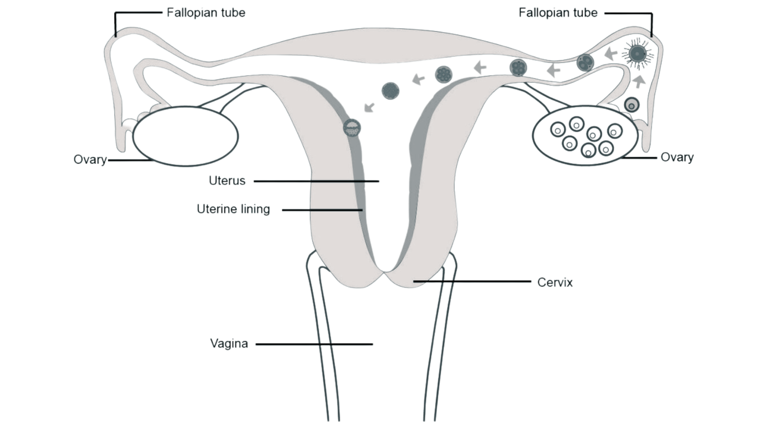
Implantation leads to new growth
The fertilized egg
implants into the uterine lining.
The cells
rapidly divide and grow.
Public Health
Healthy Sexuality
Notes:
Skip this slide if able to watch video on the previous slide.
Script
Read slide
Ref: https://teachingsexualhealth.ca/app/uploads/sites/4/Gr7LP2-Reproduction-ENGLISH-FINAL.pdf
Image: https://teachingsexualhealth.ca/app/uploads/sites/4/DA-Diagrams.pdf

Slide 31
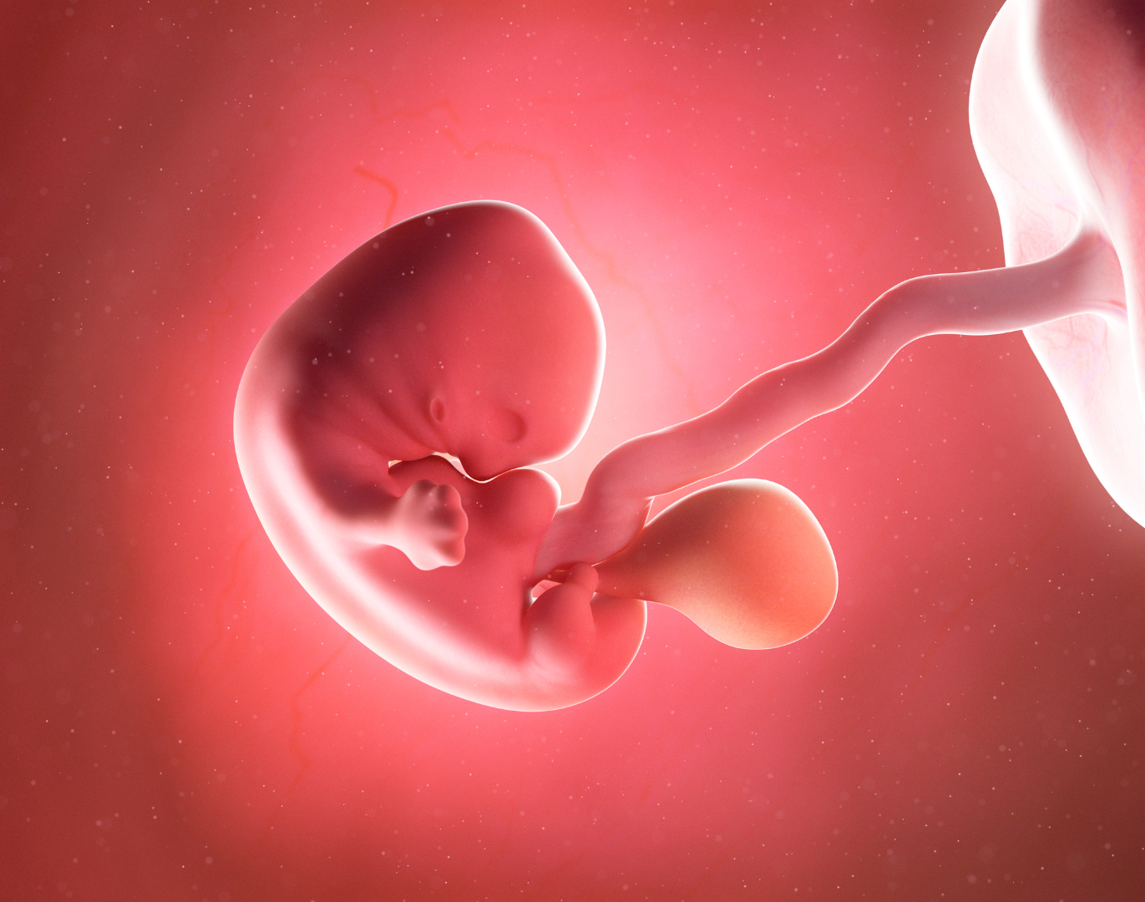
Pregnancy
During pregnancy,
a fertilized egg will turn into a developing fetus.
The fetus grows
for approximately 9 months before a baby is born.
Public Health
Healthy Sexuality
Notes:
Script
Read slide
What questions do you have?
Let’s move on to pregnancy prevention.
Ref: Canva pro image

Slide 32
There are a lot of different reasons why people choose to have sex, including close relationships, readiness and pleasure. If you are looking for more information on this, please see our Growing Up workshop.
Public Health
Healthy Sexuality

Slide 33

There are a lot of different reasons why people choose to have sex, including close relationships, readiness and pleasure. If you are looking for more information on this, please see our Growing Up workshop.
Public Health
Healthy Sexuality

Slide 34
Pregnancy Prevention
Contraception options
Public Health
Healthy Sexuality
Notes:
Script
Preventing unintended pregnancies is a priority for many for a variety of reasons.
Teaching pregnancy prevention is not just about discussing contraceptive options, but also about helping students reflect upon their values and having a child as an important decision.
With that in mind, this section will review a variety of birth control methods to help prevent pregnancy.

Slide 35
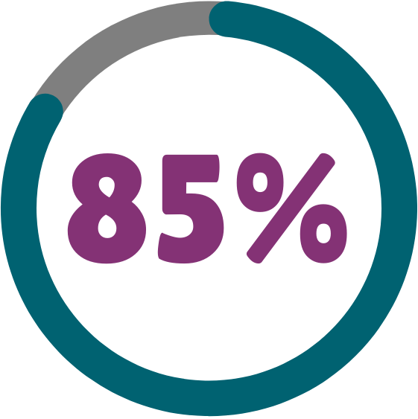
Chance of getting pregnant after 1 year
if no birth control is used
Public Health
Healthy Sexuality
Notes:
Script
Read slide
When engaging in any activity where a penis or semen are near the vagina.
Ref: https://teachingsexualhealth.ca/app/uploads/sites/4/Birth-Contol-Kit-ENGLISH-FINAL.pdf

Slide 36
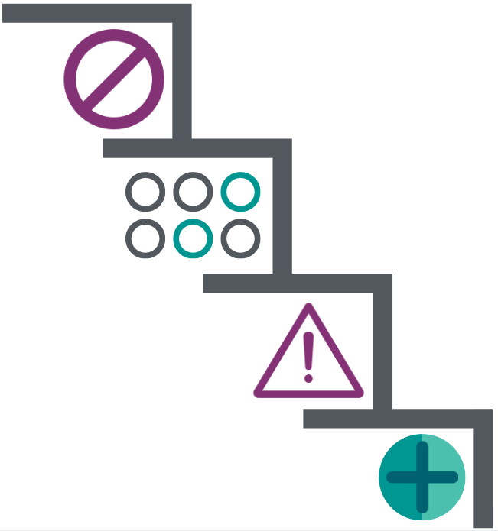
Strategies and approaches for pregnancy prevention
Not engaging
in any sexual activity
Choosing sexual activities
that cannot lead to pregnancy
Clear communication with partners about
intentions, limits/boundaries, and safer sex
Dual protection: Correctly and consistently using two methods of birth control (condoms + another form of birth control)
Public Health
Healthy Sexuality
Notes:
Script
After title: There are many strategies to eliminate or reduce the chance of pregnancy. The first way is to (read all sections)
After second square: such as kissing, massage, masturbation and oral sex. Keep in mind that some of these activities can spread sexually transmitted infections (STI) or as they are now known as STBBIs. Refer to the STBBI workshop for further information.
Ref: https://teachingsexualhealth.ca/app/uploads/sites/4/Gr8LP3-Birth-Control-ENGLISH-FINAL.pdf

Slide 37

Many people have questions about getting pregnant
Can people get pregnant
…prior to experiencing their first period?
…during their period?
…if experiencing irregular periods?
…the first time they have vaginal intercourse?
…while taking hormone replacement therapy?
YES
Public Health
Healthy Sexuality
Notes:
Script
After reading title: Youths have many questions about becoming pregnant. They wonder if pregnancy can occur under various circumstances such as the ones below. Read questions.
After last question: as mentioned earlier, some youths take medications to help better align with their gender identity
The answer to all these questions is YES.

Slide 38
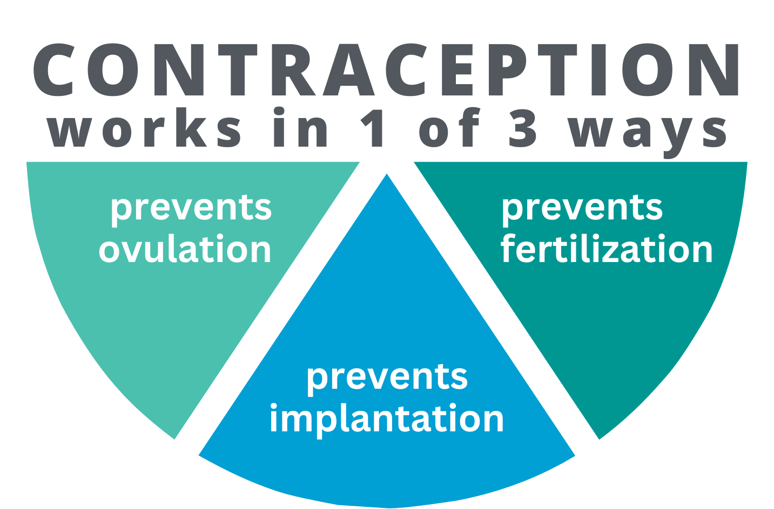
Public Health
Healthy Sexuality
Notes:
Script
After title: All birth control methods work by preventing either ovulation- to review, this means preventing the ovaries from releasing eggs, fertilization- which means preventing the sperm from meeting the egg, or implantation, which means preventing the fertilized egg from travelling to the uterus and attaching itself to the wall.
Ref: https://teachingsexualhealth.ca/app/uploads/sites/4/CALM-LP4-Birth-Control-ENGLISH-FINAL.pdf

Slide 39
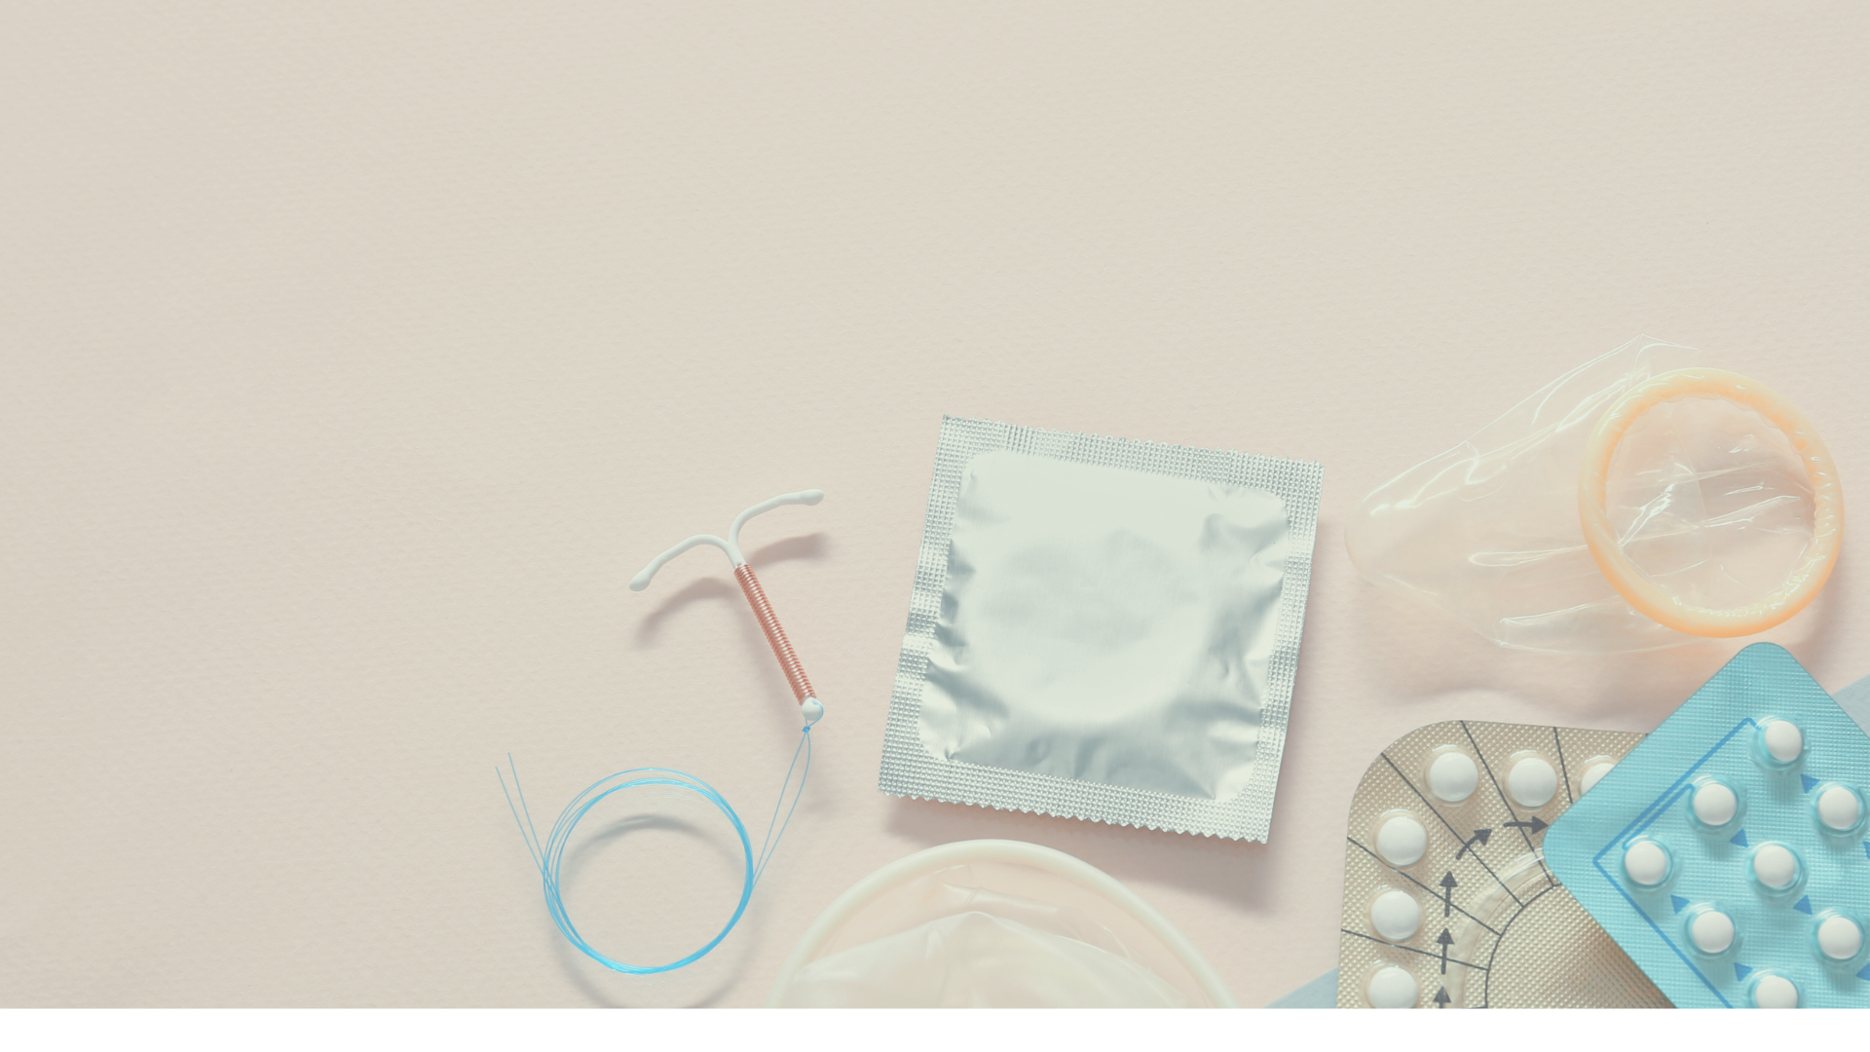
Birth control methods
Long-acting reversible contraceptives (LARCs)
Implant
Copper IUD
Hormonal IUD
Short-acting reversible contraceptives (SARCs)
Injection
Ring
Patch
Pill
In the moment
Not having certain types of sex
External condom
Internal condom
Withdrawal (pulling out)
Fertility awareness
Emergency contraception
Emergency contraception pill
IUD
Permanent
Tubal Ligation
Vasectomy
work on different time scales
Public Health
Healthy Sexuality
Notes:
Script
There are “long acting”, “short acting”, “used in the moment” methods as well as some permanent types of birth control.
Long acting can last for several years or more and include: read column
IUD stands for intrauterine device- this means they go in the uterus.
Short acting can last for up to 12 weeks and includes: read column.
Birth control used in the moment is what it sounds like and includes: read column
Emergency contraception (EC) is also available for the prevention of pregnancy after engaging in any activities where a penis or semen are near the vagina and a reliable method of birth control was not used/used incorrectly.
Permanent methods have a very high rate of effectiveness
Ref: https://teachingsexualhealth.ca/app/uploads/sites/4/Gr8LP3-Birth-Control-ENGLISH-FINAL.pdf

Slide 40


Birth control methods vary in effectiveness
STBBI protection
Pregnancy prevention
(typical use)
Condom (external/male)
Emergency contraception
Fertility awareness
Injection
Internal condom
Implant
IUD
Pill/Patch/Ring
Withdrawal (pulling out)
No method
Depends on type & time
Public Health
Healthy Sexuality
None Fair Good Excellent
Notes:
Script
I would like to review this table with you and show you the different types of birth control available and their effectiveness based on typical use.
Effectiveness rate for typical use refers to how effective each method is at preventing pregnancy during actual use including incorrect or inconsistent use.
Discuss legend at the bottom.
Go through table.
**the contraceptive effectiveness rate for emergency contraception depends on what kind is used and how soon after unprotected sex the method is used.
As you can see, condoms are “good” at STI protection but they don’t protect against pregnancy as well as other methods. The most effective forms of birth control “excellent” are the long acting methods such as IUDs and implants. Used in combination with condoms, long acting methods would have most effective pregnancy prevention and include STI prevention.
Birth control methods other than condoms, do not prevent STIs.
Let’s discuss each birth control method in detail in the next activity
Ref: https://teachingsexualhealth.ca/app/uploads/sites/4/CALM-Diagrams-ENGLISH-FINAL.pdf

Slide 41

Matching activity
Birth Control Methods
Public Health
Healthy Sexuality
Notes:
NOTE:
This activity can either be completed using the following “hidden” slides or by using printed cards from the accompanying Birth Control Methods Matching Activity (a separate file with instructions for this is available on the school health intranet page). We recommend using the printed cards if presenting in person, and the hidden slides if presenting online. The slides are animated: the information will “fly-in” first – to allow time for thinking and guessing – followed by the method. You can also provide teachers the Matching Activity electronic file for them to print and use in their classrooms with their students.
The matching activity was adapted from Teaching Sexual Health’s (TSH) birth control lesson plan -Birth Control Kit. Teachers can choose to do the TSH activity or use our updated version.
Script
•We are going to complete a matching activity where we match Birth Control Methods to information related to them. This is to help build your familiarity with different types of methods.
•If presenting online: I’ll post a list of methods in the chat, then read out the information related to it, and you can guess the method that matches.

Slide 42

No method
What is it?
Birth control is not used.
Pregnancy prevention:
None
There is about an 85% chance of getting pregnant after 1 year if no method of birth control is used when engaging in any activity where a penis or semen are near the vagina.
STI protection:
No
Public Health
Healthy Sexuality

Slide 43
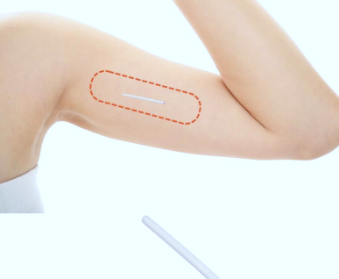
Birth Control Implant
What is it?
A thin plastic rod that releases hormone (progestin). Inserted into the upper arm by health care provider.
Can stay in for up to 3 years.
Pregnancy prevention:
99.9% (with typical use)
STI protection:
No
Public Health
Healthy Sexuality
Notes:
Script
Read after second bullet: A small cut in the inner upper arm is made with numbing and the implant is inserted. It is 4 cm or 1.6 inches in length. Similar to a sewing pin.
Ref: https://teachingsexualhealth.ca/app/uploads/sites/4/Birth-Contol-Kit-ENGLISH-FINAL.pdf (image as well)
https://www.nexplanon.com/what-is-nexplanon/

Slide 44
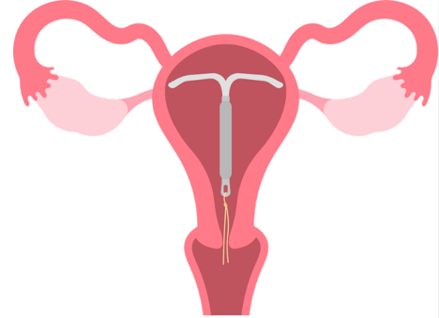
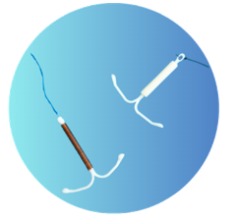
Intrauterine device (IUD)
What is it?
A small soft T-shaped device that is put in the uterus by a health care provider.
Can be copper or hormonal (progestin). ​
Long acting, reversible contraceptive (lasts 3-10 years).
Pregnancy prevention:
99.9% (with typical use)
STI protection:
No
Notes:
Script
Read after last bullet:
It takes very little time to complete insertion of an IUD.
Some IUDs stop periods while others don’t.
Ref: https://teachingsexualhealth.ca/app/uploads/sites/4/Birth-Contol-Kit-ENGLISH-FINAL.pdf
Image: Canva pro

Slide 45
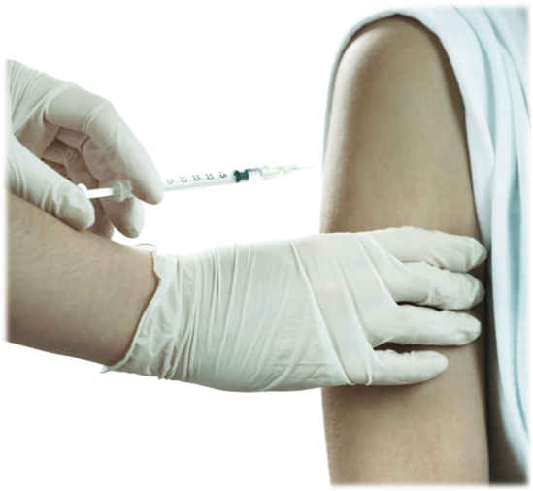
Birth Control Injection
What is it?
A hormone (progestin) given through a shot.​
Given by health care provider every 12 weeks.
​Pregnancy prevention:
94% (with typical use)
STI protection:
No
Notes:
Script
Read after last bullet:
Periods may stop completely.
Ref: https://teachingsexualhealth.ca/app/uploads/sites/4/Birth-Contol-Kit-ENGLISH-FINAL.pdf
Image: Canva Pro

Slide 46
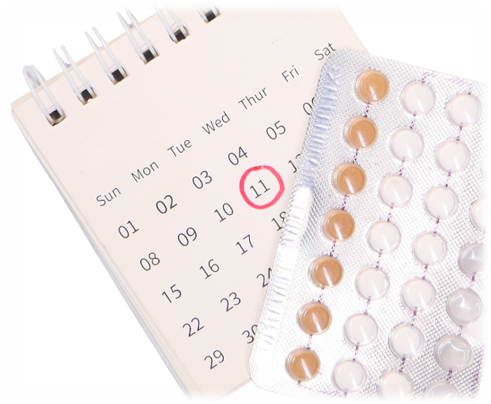
Birth Control Pill
What is it?
A combined hormone tablet taken at the same time every day.​
​Pregnancy prevention:
91% (with typical use)
STI protection:
No
Notes:
Script
Read after first bullet:
A new pack starts every 28 days.
Those on the pill can have a period monthly or skip it all together.
Ref: https://teachingsexualhealth.ca/app/uploads/sites/4/Birth-Contol-Kit-ENGLISH-FINAL.pdf
Image: Canva Pro

Slide 47
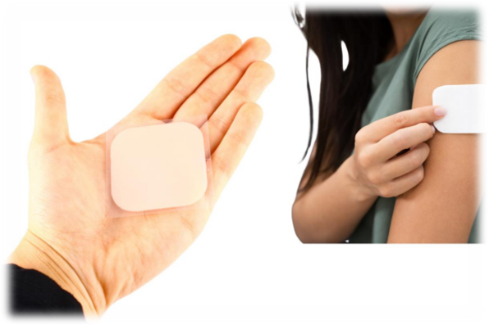
Birth Control Patch
What is it?
A type of combined hormonal birth control worn on the skin. ​
Replaced once a week.
​Pregnancy prevention:
91% (with typical use)
STI protection:
No
Notes:
Script
After last bullet:
Those on the patch can have a period monthly or skip it all together.
Ref: https://teachingsexualhealth.ca/app/uploads/sites/4/Birth-Contol-Kit-ENGLISH-FINAL.pdf (image as well)

Slide 48
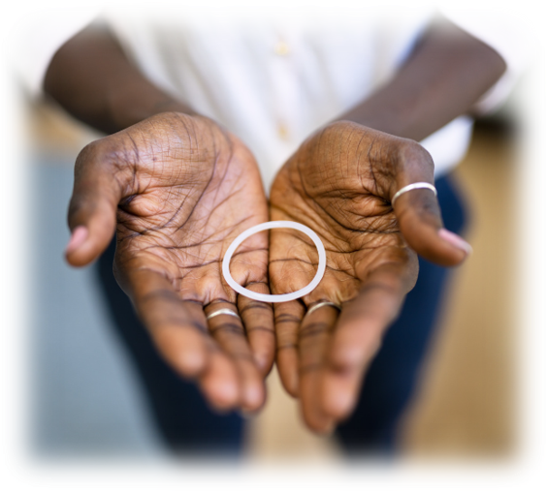
Birth Control Ring
What is it?
A clear plastic device with combined hormones that is put in the vagina.​
Changed once a month.
​Pregnancy prevention:
91% (with typical use)
STI protection:
No
Notes:
Script
After last bullet:
Users of this method can have sex with the device inside the vagina.
Periods occur every month or can be skipped.
Ref: https://teachingsexualhealth.ca/app/uploads/sites/4/Birth-Contol-Kit-ENGLISH-FINAL.pdf
Image: Canva Pro

Slide 49
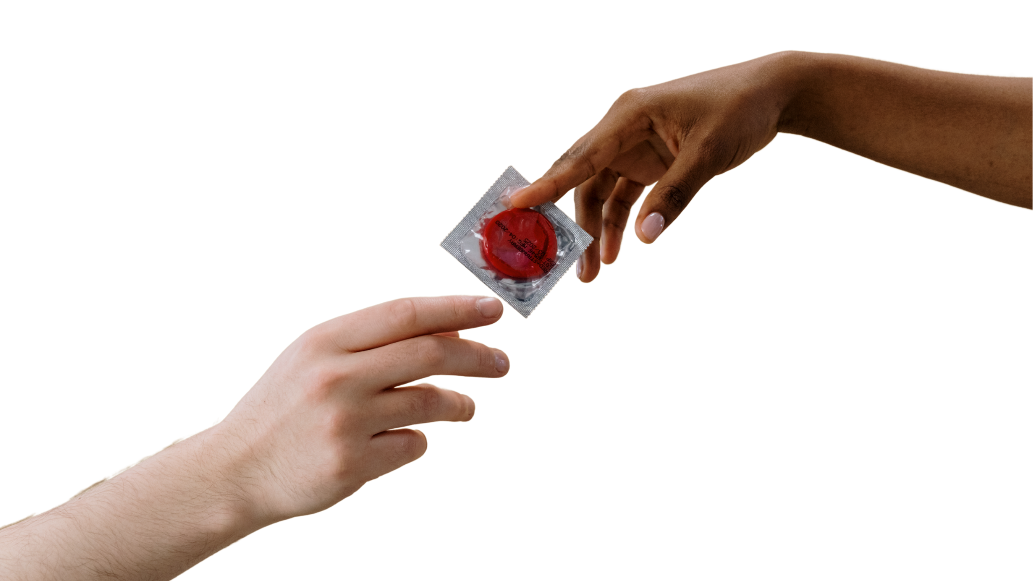
External Condom
What is it?
A thin covering that fits over the hard (erect) penis.
A new one is to be used every time penetrative sex occurs.
​Pregnancy prevention:
82% (with typical use)
STI protection:
Yes, lowers the risk of STIs
Notes:
Script
After title:
Also known as a type of barrier, sometimes called a “male” condom.
Most are made out of latex. Some are made with polyurethane plastic.
This method can be used during penis-vagina (vaginal intercourse), penis-anus (anal sex), penis-mouth (oral sex) and on sex toys.
Ref: https://teachingsexualhealth.ca/app/uploads/sites/4/Birth-Contol-Kit-ENGLISH-FINAL.pdf
Image: Canva Pro

Slide 50
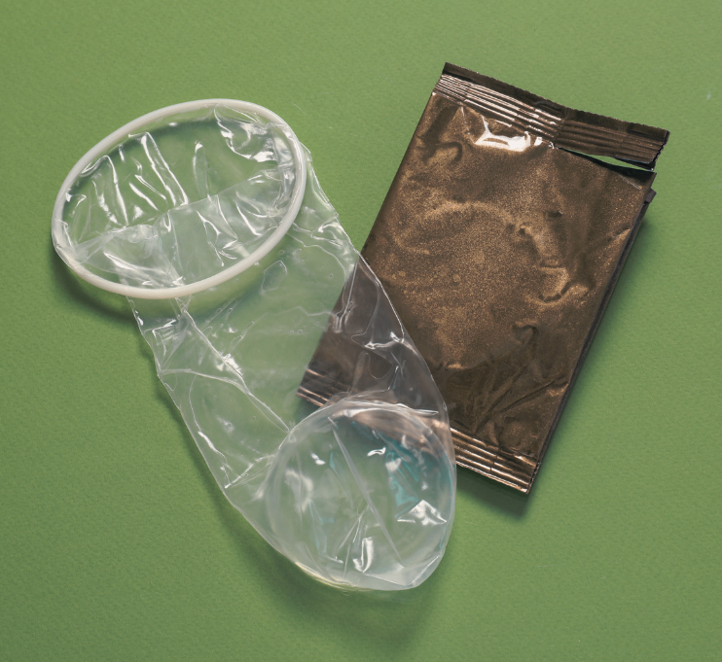
Internal Condom
What is it?
A soft plastic (non-latex) sleeve with two flexible rings, one on each end.
Use every time insertive sex occurs.
​Pregnancy prevention:
79% (with typical use)
STI protection:
Yes, lowers the risk of STIs
Notes:
Script
After title:
Also known as a type of barrier, sometimes called a vaginal or female condom.
This method can be used during penis-vagina (vaginal intercourse), penis-anus (anal sex), and on sex toys.
After first bullet:
The closed inner ring goes inside the vagina. The outer ring stays outside to cover part of the vulva.
Ref: https://teachingsexualhealth.ca/app/uploads/sites/4/Birth-Contol-Kit-ENGLISH-FINAL.pdf
Image: Canva Pro

Slide 51
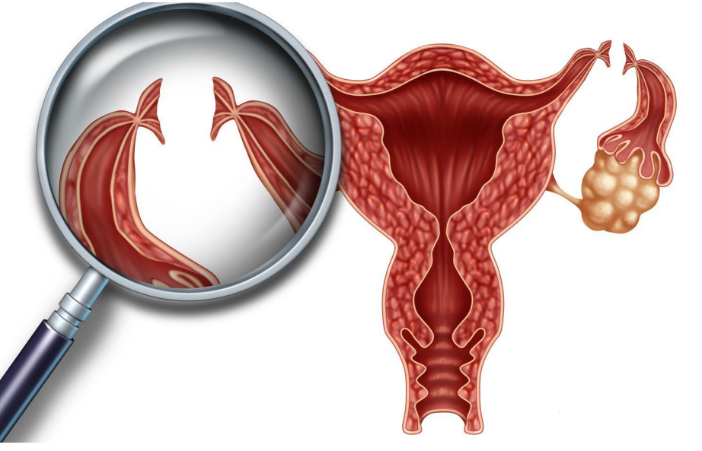
Tubal Ligation
What is it?
A surgery that closes the fallopian tubes and block an egg and sperm from meeting.
Meant to be permanent.
​Pregnancy prevention:
99.5%
STI protection:
No
Notes:
Script
Now we will talk about a couple of permanent methods of contraception.
After first bullet:
If you recall from our discussion about anatomy, the fallopian tubes connect the ovaries to the uterus.
An egg travels through one of the tubes after ovulation.
Fertilization occurs in the fallopian tubes.
After second bullet: At times, it is possible for a tubal ligation to be reversed to restore fertility. Many factors affect whether a reversal is successful at achieving pregnancy.
Ref: https://teachingsexualhealth.ca/app/uploads/sites/4/Birth-Contol-Kit-ENGLISH-FINAL.pdf (image as well)

Slide 52
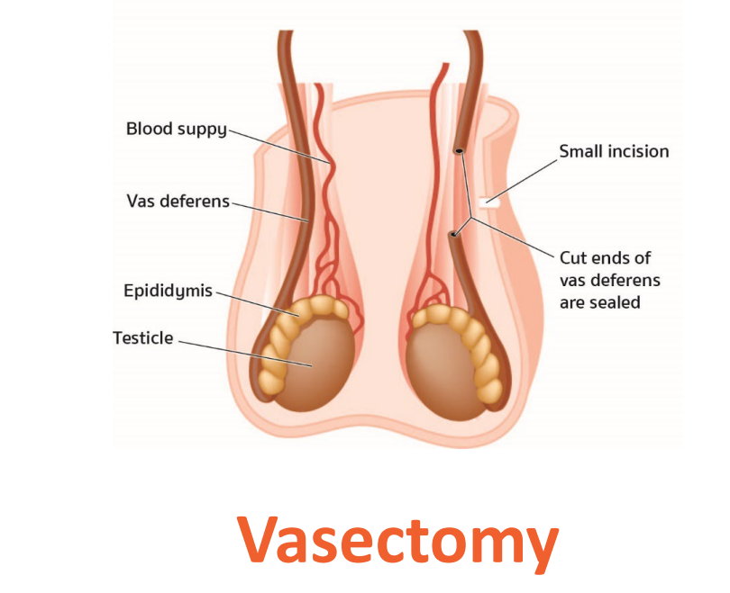
Vasectomy
What is it?
A surgery that closes the vas deferens and blocks sperm from getting into semen.
A permanent method of birth control.
​Pregnancy prevention:
99%
STI protection:
No
Notes:
Script
After first bullet:
If you recall from our discussion about anatomy, the vas deferens is a narrow tube that carries sperm from the testicles to the urethra.
After second bullet: Vasectomies can be reversed to restore fertility. Many factors affect whether a reversal is successful at achieving pregnancy.
Ref: https://teachingsexualhealth.ca/app/uploads/sites/4/Birth-Contol-Kit-ENGLISH-FINAL.pdf (image as well)

Slide 53
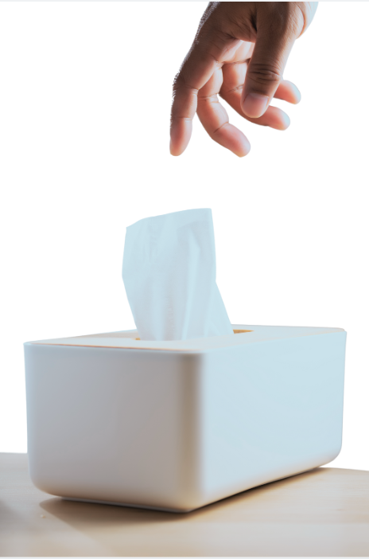
Withdrawal
What is it?
The penis is pulled out of the vagina before ejaculation.
Requires behaviour to take place every time sexual intercourse occurs.
​Pregnancy prevention:
78% (with typical use)
STI protection:
No
Notes:
Script
Let’s move on to two less effective methods of birth control.
Read title. Also known as pulling out
Not a high effectiveness method.
There can be sperm cells in pre-ejaculate creating risk of unintended pregnancy.
Ref: https://teachingsexualhealth.ca/app/uploads/sites/4/Birth-Contol-Kit-ENGLISH-FINAL.pdf
Image: Designed by Freepik-https://www.freepik.com/free-photo/person-holding-white-nasal-handkerchief_18037074.htm#fromView=search&page=1&position=24&uuid=9728715e-d547-4c5d-bb95-f669f473d305

Slide 54

Fertility Awareness (FAB)
What is it?
Involves identifying the most likely time to get pregnant (fertile time).
Requires ongoing observations and changes in sexual activity.
​Pregnancy prevention:
76% (with typical use)
STI protection:
No
Notes:
Script
After first bullet:
Works by observing fertility signs such as body temperature, cervical secretions or monitoring cycle days.
Allows people to choose not to have sex or use another type of birth control during that time.
FAB methods may not work and aren’t recommended if individuals have periods that aren’t regular and aren’t comfortable with the higher risk of unintended pregnancy.
Some individuals use digital apps to aid in identifying their fertility window.
Ref: https://teachingsexualhealth.ca/app/uploads/sites/4/Birth-Contol-Kit-ENGLISH-FINAL.pdf

Slide 55

Not Having Certain Types of Sex
What is it?
Not engaging in any activity where a penis or semen are near the vagina.
​Pregnancy prevention:
100% (with perfect use)
STI protection:
It depends
Notes:
Script
After title: Sometimes referred to as abstinence.
After first bullet:
Including anal and/or penis/vaginal touching.
Can be chosen at any time and can last as long as a person wants it to.
Ref: https://teachingsexualhealth.ca/app/uploads/sites/4/Gr7LP4-Abstinence-ENGLISH-FINAL.pdf
Image: Vie studio- https://www.pexels.com/photo/person-holding-letters-4439421/

Slide 56
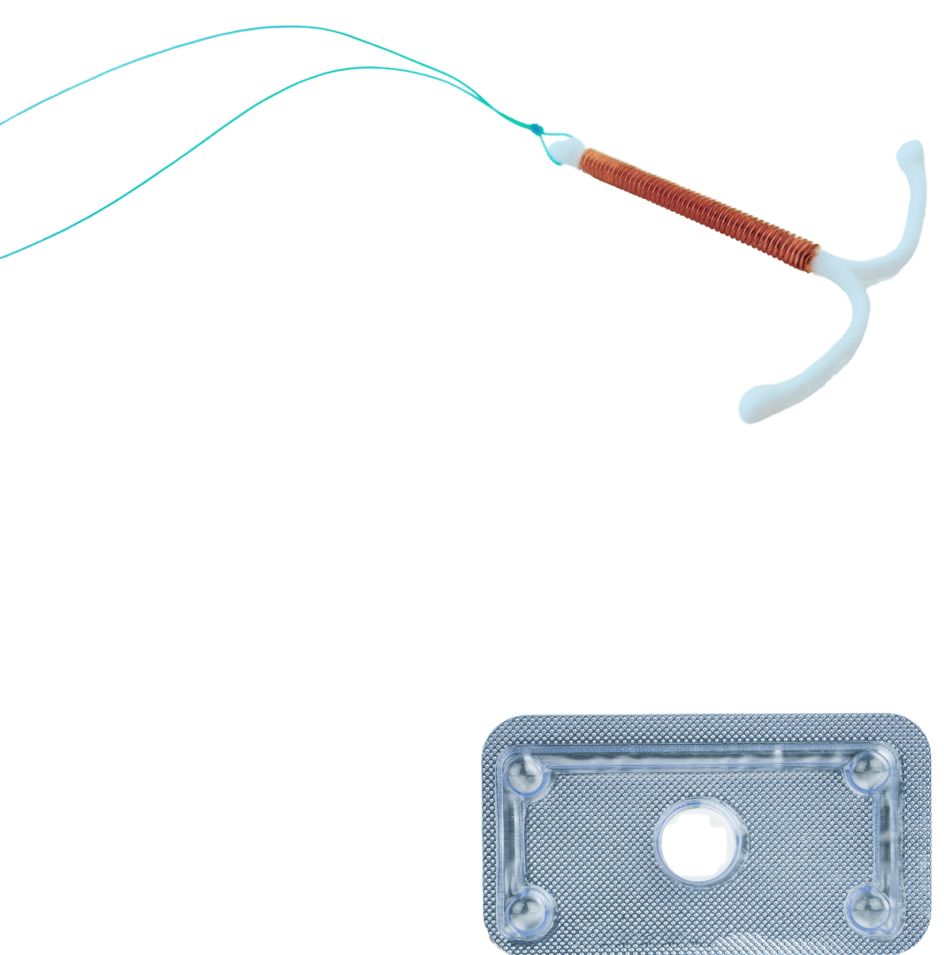
Emergency Contraception
What is it?
Used after engaging in any activities where a penis or semen are near the vagina that occurred without a condom or other type of birth control, or if an individual is not sure they are protected against pregnancy.
Can be a pill (e.g., Plan B) or IUD (hormonal or copper).
​Pregnancy prevention:
50-90% for the pill (more effective if used sooner)
99.9% for IUD (with typical use)
STI protection:
No
Notes:
Script
After last bullet:
Emergency contraception pill is intended for occasional use only and not as a regular method of birth control.
Needs to be used as soon as possible after unprotected sex.
Some of the reasons that a person may consider using emergency contraception include:
Missed birth control pill, patch, or injection
No contraception was used
Non-consensual sexual intercourse (sexual assault)
The condom slipped, broke, or leaked
Error in the calculation of the fertility period
Ref: https://teachingsexualhealth.ca/app/uploads/sites/4/Birth-Contol-Kit-ENGLISH-FINAL.pdf (image as well)
https://www.optionsforsexualhealth.org/facts/emergency-contraception/
https://www.sexandu.ca/contraception/emergency-contraception/ - for write up (slightly modified)

Slide 57
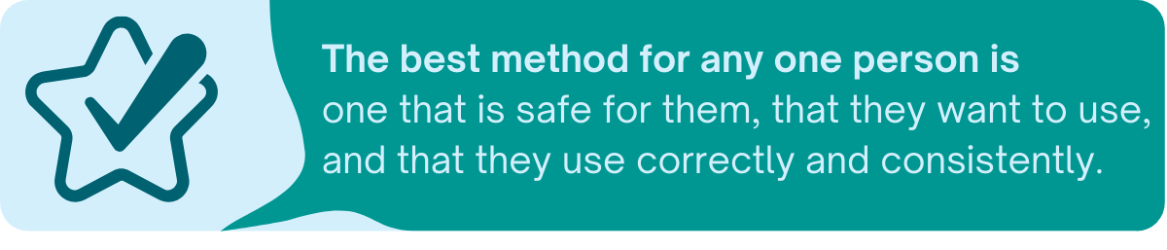
Public Health
Healthy Sexuality
Notes:
Script
After first bullet: There is not one method that is best for everyone.
Ref: https://teachingsexualhealth.ca/app/uploads/sites/4/CALM-LP4-Birth-Control-ENGLISH-FINAL.pdf

Slide 58
Overcoming obstacles to using birth control
Forget to take
a pill daily
Concerns about potential side effects
Afraid of losing sensation during sex
Consider alternatives to the pill:
shot, IUD, ring, patch
Use a reminder app.
Talk to a health care provider.
Side effects are usually mild and likely lessen with time (if they occur).
It is important to remember that there are many types and brands of condom.
Trying out different types to see what works best
Use lubricant.
Public Health
Healthy Sexuality
Notes:
Script
Let’s talk about some potential barriers to using birth control.
Notes (if asked about side effects)
Some methods actually help control acne.
Also, some people believe that certain types of birth control will cause weight gain. Rigorous medical studies do not show any significant weight gain with hormonal contraception.
Ref: https://teachingsexualhealth.ca/app/uploads/sites/4/CALM-LP4-Birth-Control-ENGLISH-FINAL.pdf
https://flo.health/menstrual-cycle/sex/birth-control/does-birth-control-make-you-gain-weight
Additional resources:
Itsaplan.ca (from SOGC) doesn’t have the most inclusive terms i.e. “male condom” “female condom”

Slide 59
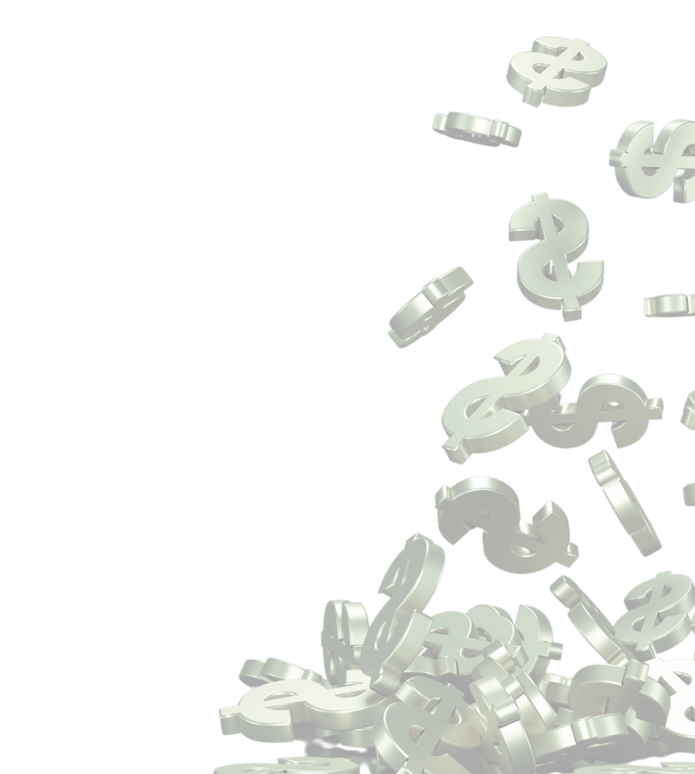
Types of birth control covered
Birth control costs
Most types of birth control
are fully covered in BC.
Requirements for coverage:
Be enrolled in the Medical Services Plan (MSP) for BC residents, or have applied
Oral contraceptives
IUDs (hormonal or copper)
Hormonal implant
Vaginal ring
Injection
Emergency oral contraception
Public Health
Healthy Sexuality
Notes:
Script
Read after requirements bullet:
Youths can access free of charge birth control by getting a prescription from a health care provider or visiting a pharmacy. Patches are the only method not covered.
Emergency contraceptive pill can be purchased over the counter without getting a prescription or seeing a pharmacist.
If youths experience other barriers, they can receive free of charge contraception without a prescription through any VCH sexual health clinic.
Ref: https://www2.gov.bc.ca/gov/content/health/practitioner-professional-resources/pharmacare/contraceptives

Slide 60
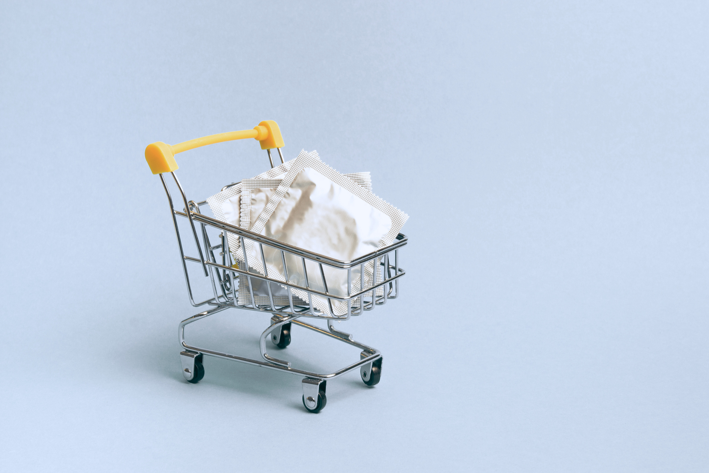
Where to get barriers
Condoms are available free of charge at sexual health clinics
Condoms and dental dams can also be purchased at drugstores, grocery stores, convenience stores and online
Public Health
Healthy Sexuality
Notes:
Script
Read slide
Youth may not be keen on using condoms or barriers for oral sex due to taste – flavoured condoms are available and often more appealing to youth!

Slide 61
Video: How to use a condom
Using an external condom
https://teachingsexualhealth.ca/teachers/resource/using-a-vaginal-condom/
Public Health
Healthy Sexuality
Notes:
Script
This slide contains the link to a condom demonstration video from teaching sexual health
Show external condom video demo-3:30 minutes (will require internet connection to view)
The videos can be accessed through the link or embedded on the next slide
Notes
If you do not have access to the internet, the video wont play. Proceed with condom demo found on slide 64
Ref: https://teachingsexualhealth.ca/teachers/lesson-plans-resources/videos/

Slide 62
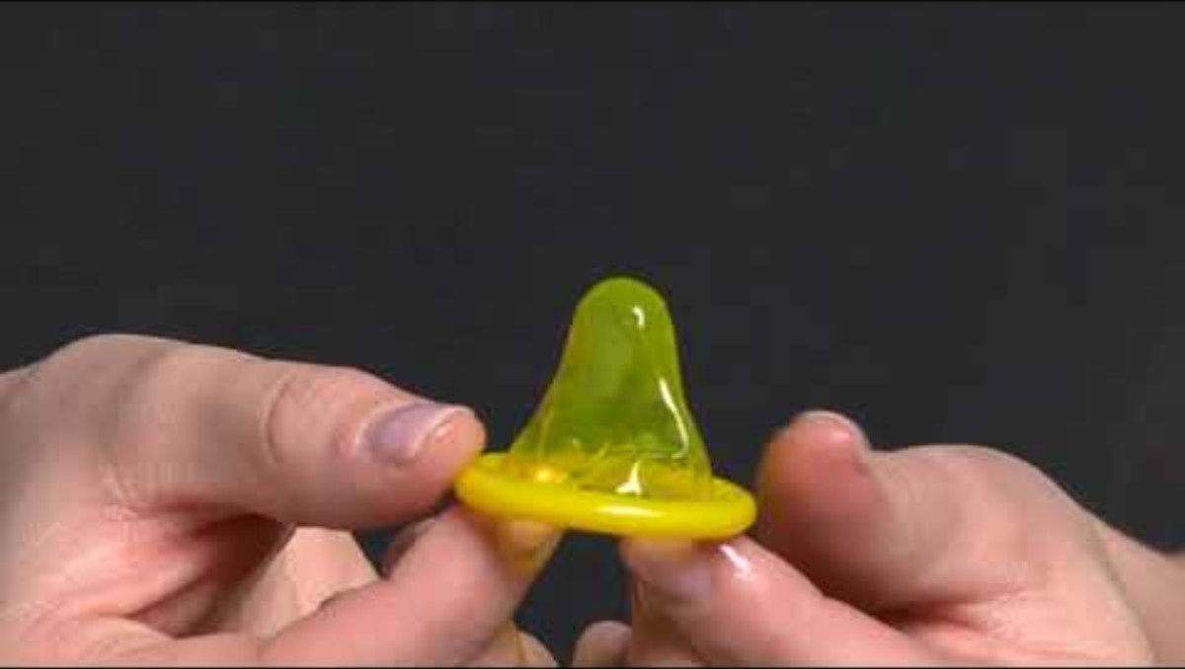
Public Health
Healthy Sexuality
Notes:
Ref: https://teachingsexualhealth.ca/teachers/lesson-plans-resources/videos/

Slide 63
Video: How to use a condom
Using an internal condom
https://teachingsexualhealth.ca/teachers/resource/using-a-vaginal-condom/
Public Health
Healthy Sexuality
Notes:
Script
This slide contains the link to a condom demonstration video from teaching sexual health
Show internal condom video demo-3:15 minutes (will require internet connection to view)
The videos can be accessed through the link or embedded in the next slide
Notes
If you do not have access to the internet, the video wont play. Proceed with condom demo found slide 64
Ref: https://teachingsexualhealth.ca/teachers/lesson-plans-resources/videos/

Slide 64
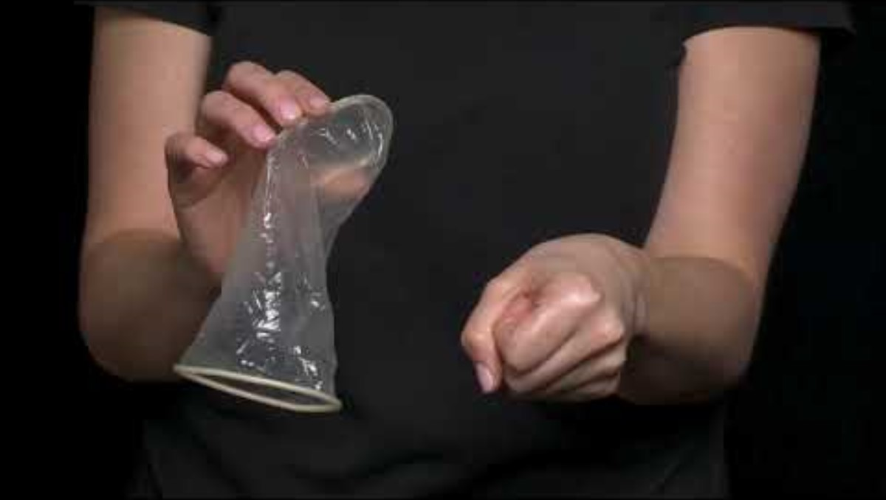
Public Health
Healthy Sexuality
Notes:
Ref: https://teachingsexualhealth.ca/teachers/lesson-plans-resources/videos/

Slide 65
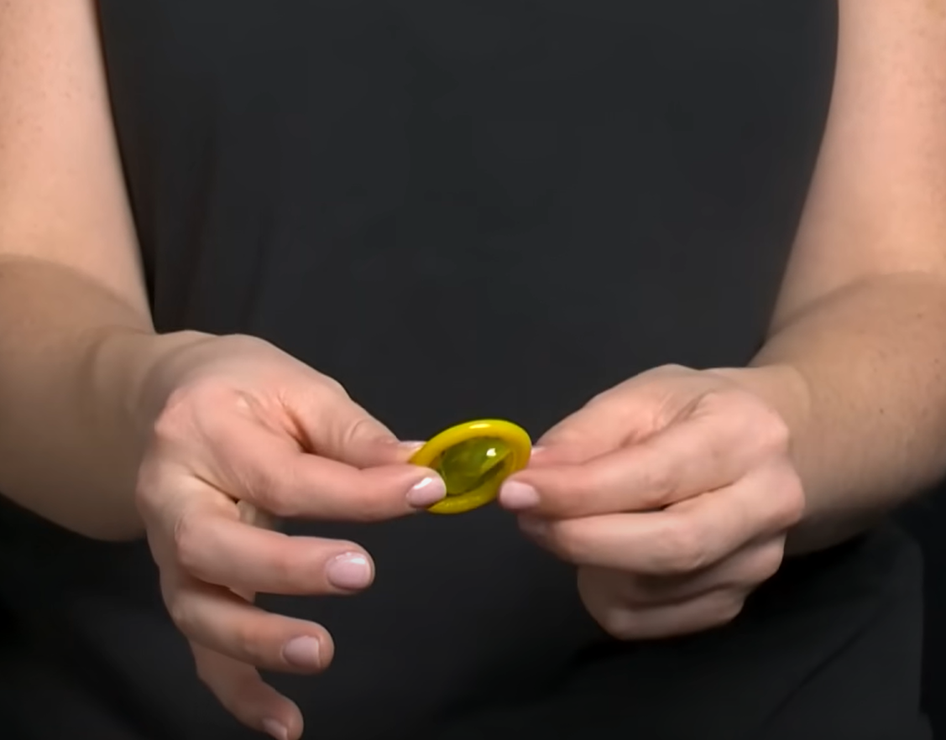
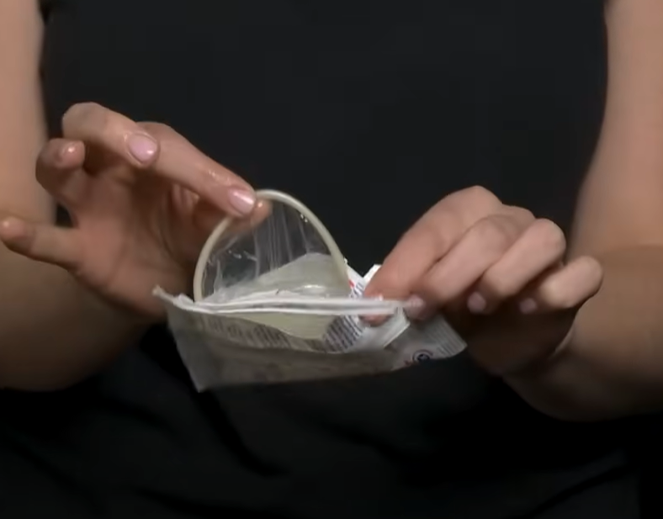
Demonstration: How to use a condom
Using an external condom
Using an internal condom
Public Health
Healthy Sexuality
Notes:
Script
When doing a condom demo in the classroom, the following points are usually discussed:
“Look at the expiry date”
“What is an expiry date?”
“It is typically written as EXP”
“Does the package have a pocket of air? Gently squeeze to ensure there are no holes”
For external condom: “Open the condom package carefully and take the condom out. The condom should resemble a sombrero. If the condom is inside out and came into contact with the penis, discard and grab a new one. Gently pinch the tip of the condom and roll over the erect (hard) penis”
For internal condom: “A brand available in BC is labelled as a “female” condom”, “Open the package carefully and take the condom out. The closed end of the condom should go inside the vagina or anus”
Store condoms at room temperature.
When removing a condom, do so carefully and avoid spilling, external condoms should be removed. while penis is still erect.
Make a knot in the condom when it is out and throw out in the garbage.
A reminder to never use more than one condom at a time! (i.e. an internal and external condom or double up). The friction makes the material weaker/break or slip.
Ref: https://teachingsexualhealth.ca/app/uploads/sites/4/Birth-Contol-Kit-ENGLISH-FINAL.pdf
Image: Cottonbro Studio-https://www.pexels.com/photo/person-opening-a-plastic-3923170/ and https://www.pexels.com/photo/person-holding-white-plastic-pack-3923177/

Slide 66
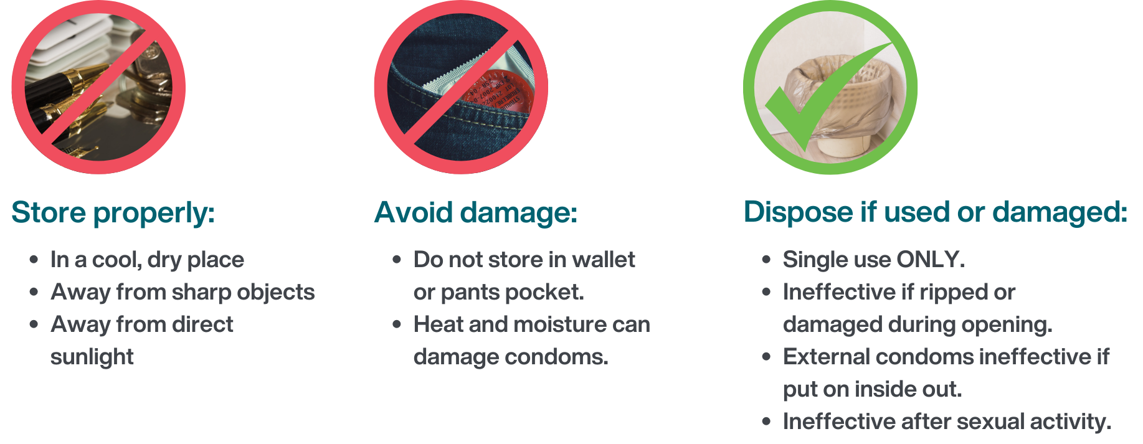
Taking care of condoms
Public Health
Healthy Sexuality
Notes:
Ref: VCH BLUSH

Slide 67


Birth control Kahoot! quiz
https://create.kahoot.it/details/d7f482cf-f9b1-46de-b8bf-03f1b46c683b
Public Health
Healthy Sexuality
Notes:
Script
Let’s move on to a kahoot birth control quiz from teaching sexual health. Kahoot is an online-based learning platform. If internet access is available, pull up the kahoot quiz, pick “play solo”, then “classic mode” and have teacher (s) answer the questions out loud. Computer generated players will come up. Note that when multiple answers are correct, picking one will automatically pick all the correct ones. Some terminology is gendered. Quiz takes about 6 minutes.
Ref: https://teachingsexualhealth.ca/app/uploads/sites/4/CALM-LP4-Birth-Control-ENGLISH-FINAL.pdf (lesson plan)

Slide 68
Pregnancy Testing
It is important to test for pregnancy when a youth thinks they are at risk due to having unprotected sex or a missed period.
Tests are most accurate when done two weeks after the last sex a person is concerned about.
Easy to do at home or at a clinic with immediate results.
Public Health
Healthy Sexuality
Notes:
Script ​
After second bullet: If pregnancy tests are done too early, it may give a false negative result. ​
After last bullet: Pregnancy tests can be purchased at drug stores or done a youth sexual health clinics free of charge. ​
We recommend any youth who thinks they may be pregnant or is pregnant to go to any VCH sexual health clinic.

Slide 69

Pregnancy Decision Making
Unintended pregnancies are
unwanted,
mistimed, or
unplanned
Pregnant individuals have options.
Decision-making is highly personal.
Public Health
Healthy Sexuality
Notes:
Script
Read after first sentence:
Most unintended pregnancies result from not using contraception or from not using it consistently or correctly.
Ref:
https://www.cdc.gov/reproductivehealth/contraception/unintendedpregnancy/index.htm#:~:text=An%20unintended%20pregnancy%20is%20a,pregnancy%20occurred%20earlier%20than%20desired.
https://www.optionsforsexualhealth.org/facts/pregn
https://teachingsexualhealth.ca/app/uploads/sites/4/2019-CALM-LP6-Pregnancy-Options-Nov7.pdfancy/options/

Slide 70
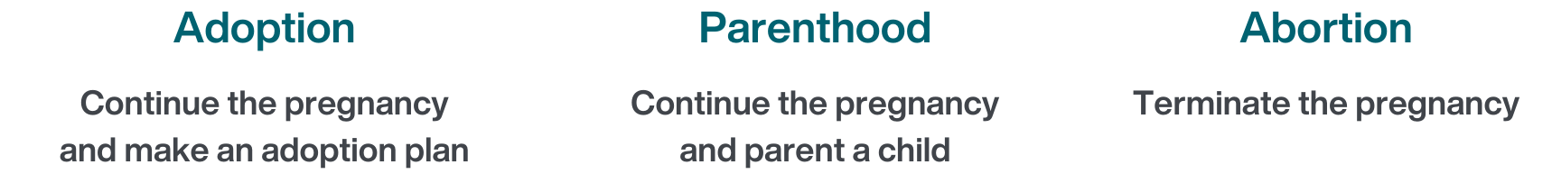
Pregnancy Options
Public Health
Healthy Sexuality
Notes:
Script
After title: There are three main options for those who are experiencing an unintended pregnancy that would be discussed at a clinic.
Read all three
Confidential and supportive care is available.
More information on how to access services will be discussed soon.
Ref: https://www.optionsforsexualhealth.org/facts/pregn
https://teachingsexualhealth.ca/app/uploads/sites/4/2019-CALM-LP6-Pregnancy-Options-Nov7.pdfancy/options/

Slide 71

Public Health
Healthy Sexuality
Notes:
Script
Youths should be encouraged to seek reproductive health care for: read slide
After reading slide: STI testing is another reason why youths would seek care. Please refer to the STBBI workshop for further information.

Slide 72

Public Health
Healthy Sexuality
Notes:
Script
Let us understand the reasons why youths may avoid seeking reproductive health care.
Discomfort: Students may feel uncomfortable discussing their reproductive anatomy. Remind them that many health care providers are specifically trained to provide these services and see individuals regularly with these concerns.
Embarrassed to have a physical examination- same as above. The need for physical examinations is determined during the visit based on the clinical assessment. Many types of visits do not require physical examinations. Youths can always decline a physical exam when recommended.
Worried about what they might find out. It is important for youths to know that options are available to them and that health care providers are there to support them.
Confidentiality: Youth may worry that their visit will be reported to their parents/guardians. Unsure if they can stay anonymous. Visits are confidential unless it is identified that a youth is at risk of (or currently) being harmed, harming themselves or others.
Accessibility: Pertaining to hours of service, transportation and money to pay for transportation. Also pertaining to lack of doctors taking new patients. Sexual health clinics take place at times of day that are meant to be accessible to youths (i.e.. after school, etc.) and if funding transportation is an issue, could discuss with school counsellors to come up with solutions.
Preferences: Some youths may feel uncomfortable with health care providers of certain genders. Youths have the option to request seeing a health care provider they feel safe with.
Unsure what to expect, youths may have never sought care in this context before and may not know what the visit would entail, what would be discussed and what would be provided. They may be unsure whether their needs will be met. Providing a list of services offered at clinics may provide clarity around what services to expect during a visit.
The following slides will touch on where youths can seek sexual health care, types of services offered as well as resources.

Slide 73




Youth-friendly health clinics
Youth and Sexual Health clinics
vch.ca/en/health-topics/sexual-health
getcheckedonline.com
foundrybc.ca
optionsforsexualhealth.org/care/
Public Health
Healthy Sexuality
Notes:
Script
• Here are a few youth-friendly health clinics for you to discuss with your class. We also suggest you post this page in your class or in the school!
• VCH Youth and Sexual Health clinics (across the VCH region) and Options for Sexual Health clinics offer sexual and reproductive health care services, including STI testing and contraception.
• Foundry offers primary care and mental health counselling services for youth aged 12-24.
• Get Checked Online is an easy way to test for STBBIs without visiting a health care provider.

Slide 74
Free of charge services at VCH sexual health clinics
Emergency contraception
Sexual health related immunizations
Most clinics offer contraception
Free condoms
STBBI testing and treatment
Harm reduction supplies
Some clinics may offer:
Pregnancy testing and next steps counselling
Non-urgent sexual assault support and follow-up
Intrauterine Device (IUDs), PrEP

Slide 75


Youth-friendly sexual health information sources
SEX SENSE
1-800-739-7367
optionsforsexualhealth.org/sex-sense
smartsexresource.com
Public Health
Healthy Sexuality
Notes:
Script
• And here are two youth-friendly online and telephone sources of health information.
• Sex Sense is a resource from Options for Sexual Health. They have great evidence-based information on their website. They also take questions by phone or online. Individuals can call and ask questions or submit a question online.
• Smart Sex Resource was developed by the BC Centre for Disease Control. It provides comprehensive sexual health information and links to services for British Columbians of all ages. They have a large library with more than 1000 questions from the public on various sexual health related topics.

Slide 76

Public Health
Healthy Sexuality

Slide 77

Public Health
Healthy Sexuality

