Slide 1
Sexual Health Education
Professional Development Workshops
School Health Promotion – by VCH Public Health, for teachers in the VCH region
Public Health
Last update: Dec 5, 2024

Slide 2

Getting Started
V1 Oct 18, 2024
Public Health
Healthy Sexuality
Notes:
Script Instructions
Each slide comes with key speaking and instructional information for PHNs in the ‘presenter notes’ part of the powerpoint.
The regular, unitalicized sections are suggestions of words you could say verbally for the slide.
The font in italics include instructions and notes that are not meant to be read out loud.
Script
Hi, my name is ______, I use pronouns _______. I am your school’s Public Health Nurse.
I am here today because… (e.g. healthy sexuality was identified as this year’s school health promotion priority and, when we completed the learning needs assessment together, you indicated Getting Started teaching sexual health was an area you wished to learn about).

Slide 3
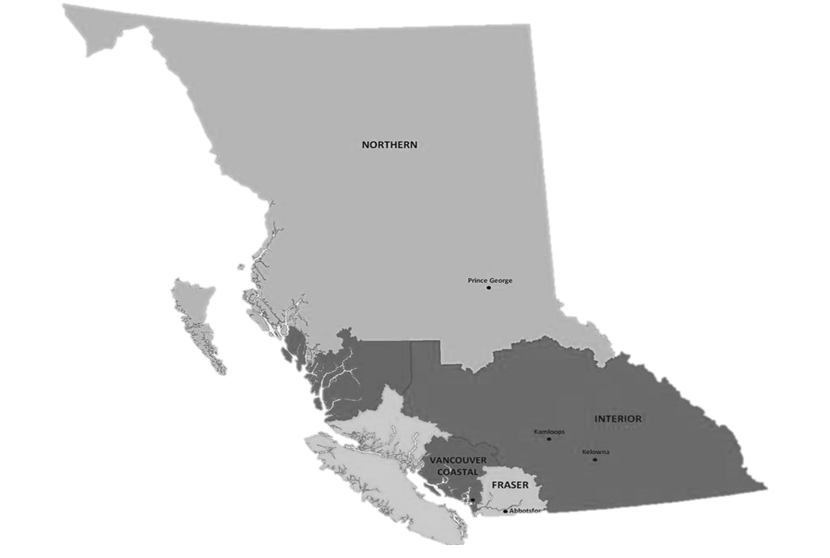



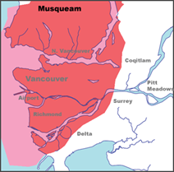

Territorial Acknowledgment
We wish to acknowledge that the land on which we gather is the traditional and unceded territory of the Coast Salish Peoples, including the Musqueam, Squamish, and Tsleil-Waututh Nations.
Vancouver Coastal Health is committed to delivering exceptional care to 1.25 million people, including the First Nations, Métis and Inuit, within the traditional territories of the Heiltsuk, Kitasoo-Xai'xais, Lil'wat, Musqueam, N'Quatqua, Nuxalk, Samahquam, shíshálh, Skatin, Squamish, Tla'amin, Tsleil-Waututh, Wuikinuxv, and Xa'xtsa.
Notes:
Script
Before we get started, I wish to acknowledge… (read slide).
Notes
If the land on which you are joining from is on the traditional and unceded territory of one of these peoples, please acknowledge those peoples directly.
If explanation is needed for teachers, advise that Territorial acknowledgements during gatherings of people are standard practice in VCH and uphold our pillar and policy of Indigenous Cultural Safety.

Slide 4
Purpose & Background
THIS PROFESSIONAL DEVELOPMENT WORKSHOP was developed by VCH Public Health to support VCH-region teachers become more comfortable in teaching the sexual health education components of BC’s Grade 8-10 PHE Curriculum.
FOR LESSON PLANS, please use our accompanying Lesson Plans & Teaching Resources
A VCH PARENT/GUARDIAN LETTER OF SUPPORT for sexual health education is available to send home before lessons with your parent/guardian notification.
I am here to help should you or your students have any questions.
Public Health
Healthy Sexuality
Notes:
Script
Read slide
After second bullet: Teaching Sexual Health is our main source of lesson plans. All TSH lesson plans are available in French. They also have a set of specialized lesson plans for students with differing abilities.
After last bullet: This workshop will take approximately one hour.
Feel free to ask questions as we move along.
Notes
PHE= Physical & Health Education Curriculum

Slide 5
Today you will learn how to get started
TEACHERS WILL LEAVE TODAY’S WORKSHOP WITH
the foundational knowledge and strategies needed to get started teaching
sexual health content of the Grade 8-10 PHE Curriculum.
    1 Key sexual health education resources
    2 What is comprehensive sexual health education and why teach it?
    3 Values
    4 Creating a safe(r) space
    5 Instructional methods & question boxes
    6 Choosing guest speakers
    6 Student disclosures
    8 Parent notification & alternative delivery policy
Public Health
Healthy Sexuality
Notes:
Script
Read slide
Let’s do a round table of introductions, starting to my (left). Please share your name and the grades and subjects you teach, your experience with teaching sexual health, and what you hope to get out of today’s workshop.
Note: PHE = Physical & Health Education Curriculum

Slide 6


Before you begin delivering content
PLEASE REVIEW
your School District’s protocols, which may include notifying your administrator, counsellor, and/or district before you begin.
PLEASE REACH OUT TO
your School District’s healthy sexuality lead and/or safe school coordinator, if you have one. They can support you in the delivery of this content.
Public Health
Healthy Sexuality
Notes:
Script
Read slide
Keep in mind that today we’ll be covering information about sexual health topics, but we won’t cover any of your district’s specific protocols.
Is anyone aware of whether there is healthy sexuality lead or coordinator in your district?

Slide 7
Key Sexual Health Education Resources
Public Health
Healthy Sexuality
Notes:
Script
To start, I will outline some of the key sexual health education resources that will be helpful to you. They are also the main resources these slides are based on.

Slide 8
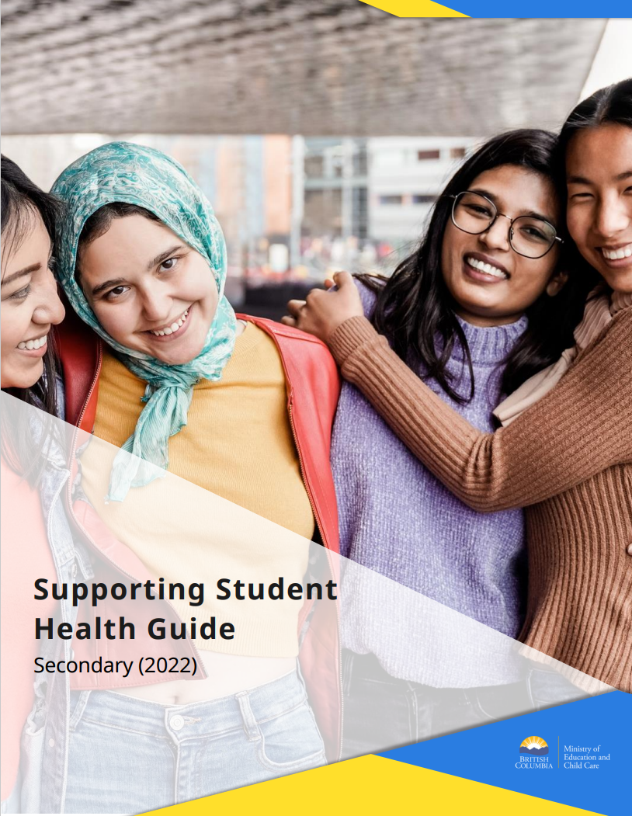
Supporting Student Health Guide
Secondary (2022)
curriculum.gov.bc.ca/curriculum/
physical-health-education
Notes:
Script
This is the Supporting Student Health Guide. Is anyone here already familiar with it?
It was released by the Ministry of Education in 2022-2023 school year to help flesh out the content to cover when teaching topics from the Gr 8-10 PHE Curriculum.
It contains useful suggestions and guidance, including: suggestions for integrating PHE Curriculum into the school year, gender inclusive language resources, consent modelling, managing student disclosures, what you need to know about the alternate delivery policy, a sample parent notification letter, and etc.
In our workshop today we’ll delve into the content in this resource, and also expand on it, so you have all the information you need to get started teaching sexual health.
Ref
Supporting_Student_Health_Secondary.pdf (gov.bc.ca)

Slide 9
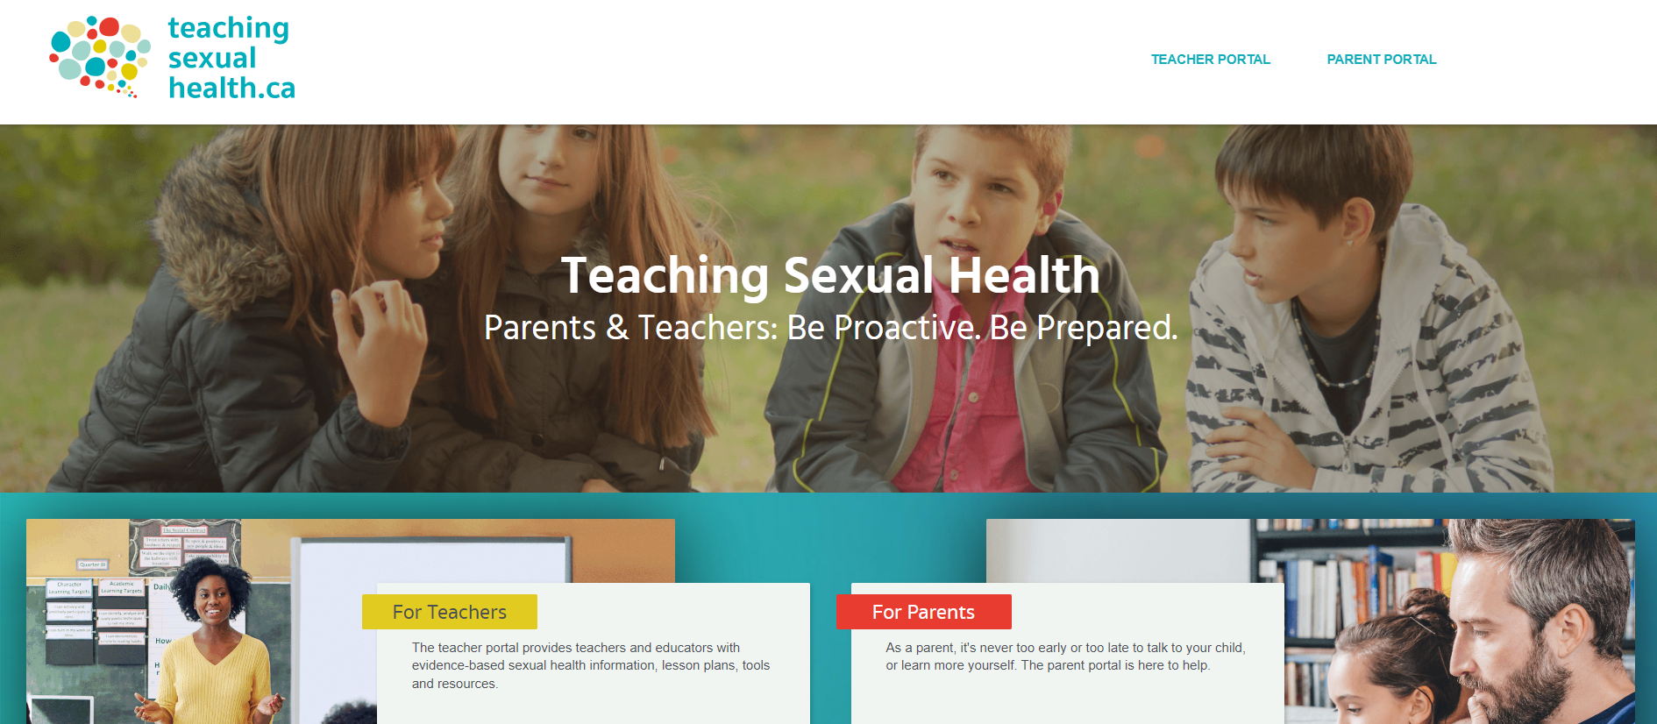
Public Health
Healthy Sexuality
Notes:
Script
This is teachingsexualhealth.ca – it is an amazing sexual health teaching website built by teachers in partnership with health experts in Alberta. Is anyone here already familiar with it?
It has evidence-based, up-to-date lesson plans and learning activities for each grade, starting in Grade 4. It has a great section on foundational sexual health information; an answer guide you can consult for responding to student questions; parent resources, and much more.
If you are looking for sample lesson plans, we highly recommend those from teachingsexualhealth.ca – and you will see them in our teaching resources that accompany our workshops. Their lesson plans cover almost all competencies in the BC PHE Curriculum, with the exception of SOGI and internet safety. In our workshops covering those topics, we include lesson plans from other sources.
Note: TSH was selected as a key resource for our toolkit because it is a Canadian resource developed by educators specifically to support educators, its content is easily accessible, lesson plans have been piloted in many classrooms, and continually updated in partnership with health experts, ensuring health information is up-to-date.

Slide 10

This material has been adapted from teachingsexualhealth.ca
Copyright 2023 Alberta Health Services ("AHS") with the permission of AHS.
AHS is not responsible for any inaccuracies in content different from the content of the original English edition. All acts of copyright infringement including reproduction, translation, transmission, republication, and distribution of this material without written permission of Vancouver Coastal Health and AHS are prohibited.
Public Health
Healthy Sexuality
Notes:
Script
With permission from Alberta Health Services, we have adopted and adapted a lot of our workshop content from teachingsexualhealth.ca – I’ll discuss this more in a few slides.
NOTE: VCH has a signed Permission to Use Copyright Agreement with TSH that allows us to use and adapt their material. This legal statement is intended for organizations looking at widespread distribution, not for teachers accessing and adapting materials for personal use. Teachers altering for personal use was understood by AHS to be occurring with our materials when we spoke with them. However, it does mean that if a teacher was looking at licensing the materials (e.g. starting a paid program where they created content for other teachers) they would need to seek the permission of AHS.

Slide 11
What is Comprehensive
Sexual Health Education (CSHE)?
…And why teach it?
Public Health
Healthy Sexuality
Notes:
Script
Now that we’ve covered some key resources, let’s talk about comprehensive sexual health education – what is it and why teach it? Do you have any thoughts on this? (Great, thank you for these great ideas and suggestions!)
Let’s start with a definition (turn to next slide).

Slide 12
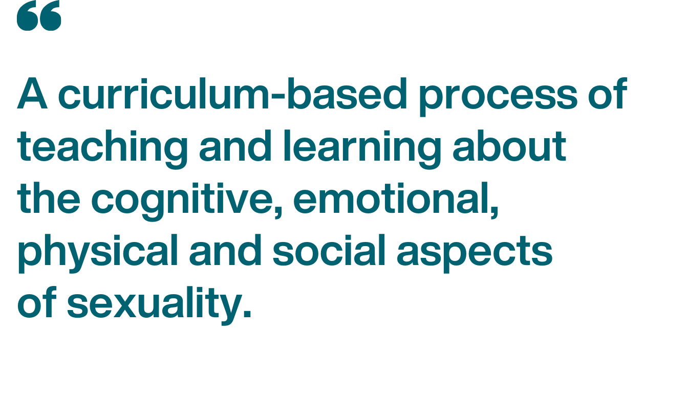

What is Comprehensive Sexual Health Education?
Public Health
Healthy Sexuality
Notes:
Script
Read slide
Notice that this definition is much more than simply reproductive anatomy and biology. It also includes the journey of growing from a child into an adult, and how this impacts your identity, relationships, and decision-making.
Reference: Title (teachingsexualhealth.ca)

Slide 13
Comprehensive Sexual Health Education aims to empower
CSHE provides young people with the knowledge, skills, attitudes, and values to…
realize their health, wellbeing and dignity
develop respectful social and sexual relationships
consider how their choices affect their own well-being and that of others
understand and ensure the protection of their rights throughout their lives
Public Health
Healthy Sexuality
Notes:
Script
Read slide and each bullet point as they “fly in” (as you advance the slides)

Slide 14
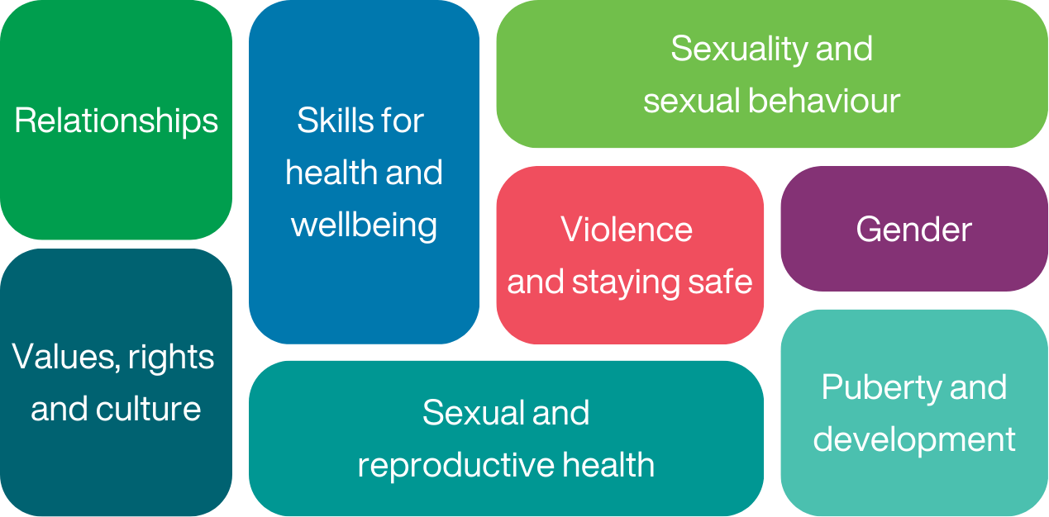
CSHE covers a broad range of topics
Public Health
Healthy Sexuality
Notes:
Script
These are the key concepts of comprehensive sexual health education.
Read circles out loud
Are there any topics here that surprise you? Why? It may feel surprising as we often we think of sexual health education as being about the act of sex, contraception, and preventing infections. These are incredibly important AND - they are influenced by and related to personal skills, and social and safety factors.
There are sexual health education programs in use by some US States that lean away from CSHE to focus on abstinence. However, per the WHO, “There is clear evidence that abstinence-only programmes – which instruct young people to not have sex outside of marriage – are ineffective in preventing early sexual activity and risk-taking behaviour, and potentially harmful to young people’s sexual and reproductive health.” Fortunately, our BC PHE Curriculum is aligned with CSHE.
Notice also that this broad range of topics is not able to be addressed within a single lesson or a one-time presentation by a guest speaker. We support the Supporting Student Health Guide’s recommendation to include the the PHE curriculum as an ongoing, regular area of study, similar to teaching other subjects.
Ref: Title (teachingsexualhealth.ca)
https://curriculum.gov.bc.ca/sites/curriculum.gov.bc.ca/files/pdf/subject/phe/Supporting_Student_Health_Secondary.pdf

Slide 15

Comprehensive Sexual Health Education has health benefits
Less
Unprotected sex
Unintended pregnancies and STIs
Sexual and gender-based
bullying and violence
More
Appreciation of sexual diversity
Knowledge, attitudes, and skills in healthy relationships
Social-emotional learning
Prevention of child sex abuse
Media literacy
Use of condoms and contraception
Communication with parents about sex and relationships
Knowledge of one’s rights within a sexual relationship
Self efficacy to manage situations involving risk
Connection to health services
Public Health
Healthy Sexuality
Notes:
Script
As VCH Public Health, we strongly support comprehensive sexual health education in schools because of its strong connection to positive health outcomes for youth, including…
Read slide
The concern we sometimes hear about sexual health education – that teaching youth about sexual health will encourage sexual activity – is not supported by evidence. Whether it is provided in or out of schools, sexual health education does not increase sexual activity, sexual risk-taking behaviour, or STI infection rates. Rather, it is associated with a delay in onset of sexual activity and a lower number of sexual partners.
Ref:
UNESCO, Joint United Nations Programme on HIV/AIDS, United Nations Population Fund, United Nations Children’s Fund, United Nations Entity for Gender Equality and the Empowerment of Women, World Health Organization (2018). International technical guidance on sexuality education: an evidence-informed approach (2nd ref ed.) https://doi.org/10.54675/UQRM6395
Teaching Sexual Health https://teachingsexualhealth.ca/app/uploads/sites/4/2023-FALL-Webinar-Series_What-is-CSHE.pdf
Goldfarb, E. S., & Lieberman, L. D. (2021). Three Decades of Research: The Case for Comprehensive Sex Education. The Journal of adolescent health : official publication of the Society for Adolescent Medicine, 68(1), 13–27. https://doi.org/10.1016/j.jadohealth.2020.07.036

Slide 16
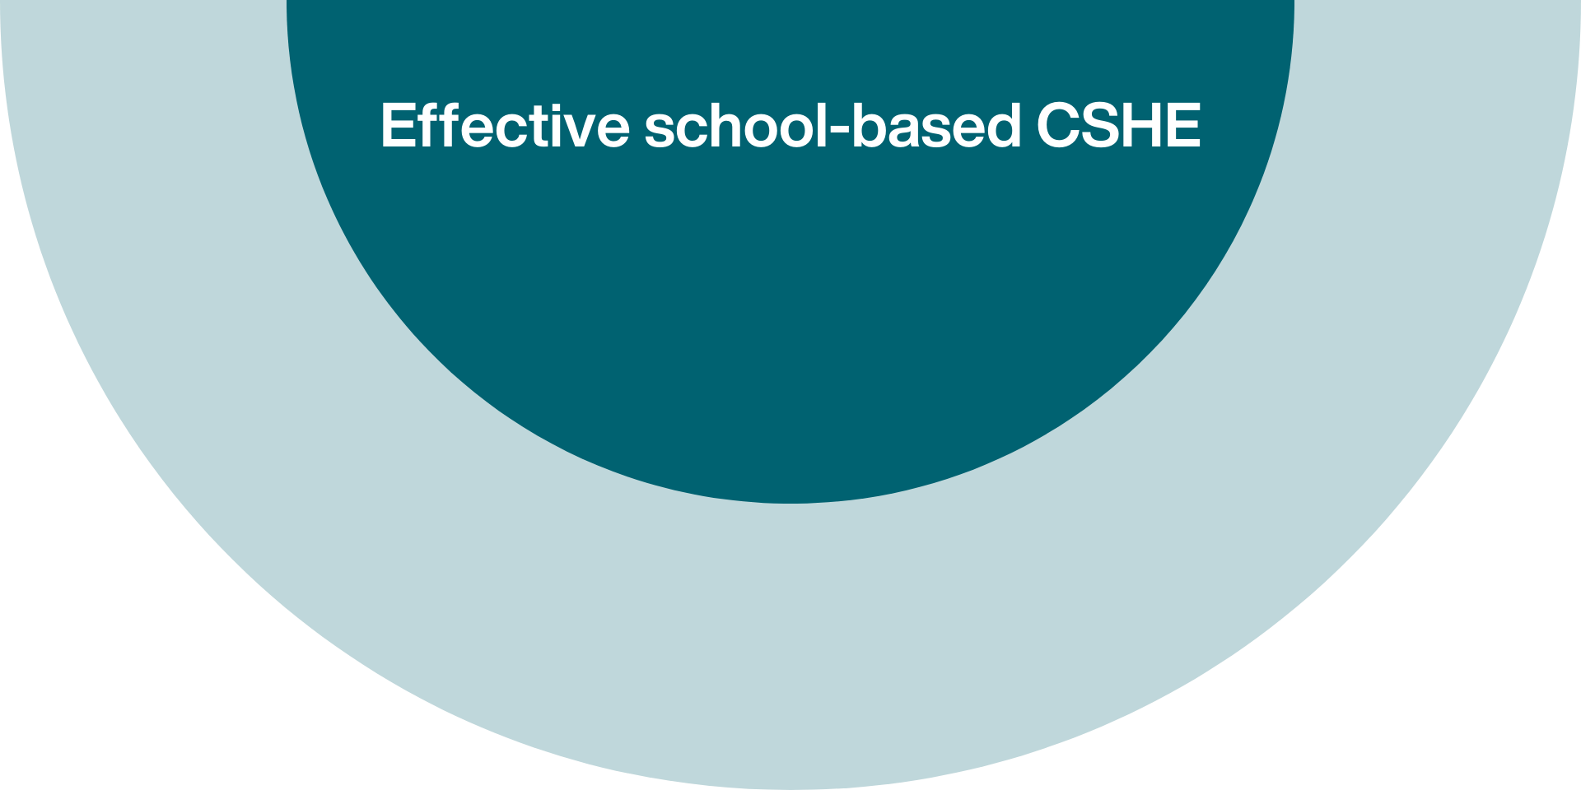
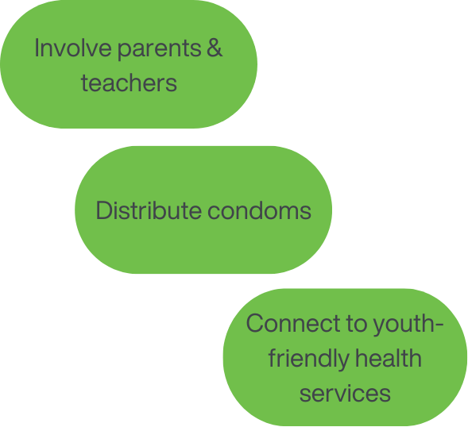
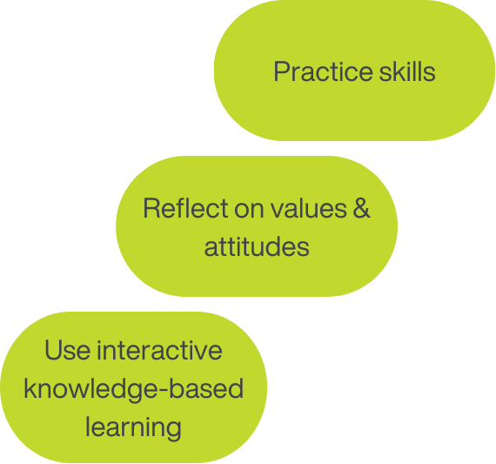
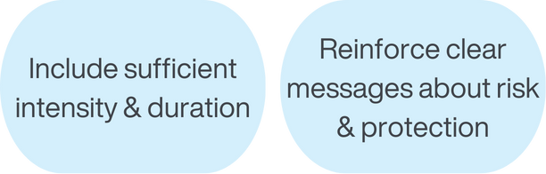
Public Health
Healthy Sexuality
Notes:
Script:
According to UNESCO, the United Nations, and the World Health Organization, school-based CSHE programs are more effective on improving health outcomes if they:
Read bubbles as they fly in
After 2nd set of bubbles: Sufficient intensity and duration of education is a critical factor. Studies to date have found positive impacts with 12+ X 50 minute lessons. They also reinforce clear messages over several years. Specifically:
1) It is OK not to have sex
2) If you have sex, use a condom/barrier and contraception (if needed)
3) Gender-based violence and discrimination against women and gender diverse people is wrong. A note on this – the evidence shows that sexuality education that supports students to question social and cultural norms around gender, and to develop gender equitable attitudes, are substantially more effective than ‘gender-blind’ programs at reducing rates of unintended pregnancy or STIs.
After last set bubbles: You’ll find teachingsexualhealth.ca lesson plans and learning activities include options for all of these types of learning
Ref: UNESCO, Joint United Nations Programme on HIV/AIDS, United Nations Population Fund, United Nations Children’s Fund, United Nations Entity for Gender Equality and the Empowerment of Women, World Health Organization (2018). International technical guidance on sexuality education: an evidence-informed approach (2nd ref ed.) https://doi.org/10.54675/UQRM6395

Slide 17
Reflecting on Values
Public Health
Healthy Sexuality
Notes:
Script
Providing opportunities for students to reflect on their values is the starting point of many effective CSHE programs. Students who have time to reflect on and understand their values – family, cultural, and personal – are better equipped to apply those values to their sexual decision-making.
But before we can help students reflect on their values, it’s important we reflect on own.

Slide 18

Let’s reflect to better understand our values and biases
teachingsexualhealth.ca/teachers/sexual-health-education/understanding-your-role/your-values/
Public Health
Healthy Sexuality
Notes:
Script:
We are going to complete a values activity for teachers and sexual health educators created by teachingsexualhealth.ca.
“Before you teach human sexuality, you need to understand your own values and biases... because you don’t want to project your personal values upon your students. The way you teach sexual health is as important as the information itself… Remember, there is no ‘perfect’ way to approach sexuality education. You won’t know all the answers, but you do need to know where to get the answers. If, after this activity, you feel you aren’t able to teach the sexual health education curriculum because of ethical, moral or religious differences, please speak with your school administration.”
Let’s start the activity – it will take about 5-10 minutes. Over the next few slides, I will present some questions. I will give you a minute to reflect quietly about each one, and I will then explain what the research says.
Ref: Your Values - Teachers | Teaching Sexual Health

Slide 19
Who is responsible
for teaching healthy sexuality
to children and youth?
Public Health
Healthy Sexuality
Notes:
Script
Read slide then give teachers a minute to reflect on the question quietly to themselves. Do not ask them to share their answer. Then share:
Some people believe that only parents are responsible for teaching sex.
It’s true that parents and guardians are an important source of sexual health education for children and teens. They lay the basis for a child’s attitude, morals and values. However, 72% of boys and 66% of girls say they first learned about sex from someone other than their parents.
In Canadian research surveys, teens state that friends, siblings and the media are the most common sources of sexual health information. These may not be accurate or comprehensive sources of information. Survey results consistently show that Canadian parents and students want schools to offer sexual health education.
Ref
Your Values - Teachers | Teaching Sexual Health

Slide 20
How does a youth’s knowledge about sexuality affect their decisions about sex?
Public Health
Healthy Sexuality
Notes:
Script
Read slide then give teachers a minute to reflect on the question quietly to themselves. Do not ask them to share their answer. Then share:
Some people believe the more a child knows about sexuality, the more likely they are to experiment.
However, programs that teach about contraception and safer sex DO NOT make teens have sex earlier or more often. Comprehensive sexual health education is designed to give students the skills to make responsible sexual decisions. In fact, research shows that teens who receive comprehensive sexual health education programs postpone sex to a later age, have fewer partners, and use condoms much more than teens that don’t receive education.
Ref
Your Values - Teachers | Teaching Sexual Health

Slide 21
How might my awareness of my own sexual attitudes and beliefs influence how I talk about sexual behaviour with my students?
Public Health
Healthy Sexuality
Notes:
Script
Read slide then give teachers a minute to reflect on the question quietly to themselves. Do not ask them to share their answer. Then share:
Students are better able to succeed and develop a positive sense of self when they feel they belong, and their schools feel inclusive, welcoming, caring, respectful and safe.” Your values could influence your teaching style and whether your students feel included, welcomed, respected, and safe in your class.
Don’t assume that all students:
Would rather learn about sexuality from health professionals
Come from traditional nuclear families
Are heterosexual
Are cisgender (their gender matches their assigned sex)
Are sexually active
Are not sexually active
Who are sexually active, are having intercourse
Have the same knowledge base
Have the same cultural and religious beliefs
Express the sexual behaviour that matches their sexual orientation
Express their gender in ways that match their gender identity
Ref
Your Values - Teachers | Teaching Sexual Health

Slide 22
What if students sense that I’m uncomfortable with some sexuality issues or that I don’t know all the answers?
Public Health
Healthy Sexuality
Notes:
Script
Read slide then give teachers a minute to reflect on the question quietly to themselves. Do not ask them to share their answer. Then share:
Sexual health can be hard to talk about. It’s normal and common to feel nervous talking about certain sexuality topics in the classroom. Let your class know that you’re uncomfortable—being honest can help everyone feel more comfortable. Talking about facts rather than trying to impart values helps. Knowing where to look for information is an important part of feeling comfortable. If you’re unsure about a question, tell your students this and be sure to find the correct answer and get back to your students. No one knows all the answers. The TSH Responding to Student Questions page has information to help you answer your student’s questions with confidence. As your Public Health Nurse, I can also help.
Ref
Your Values - Teachers | Teaching Sexual Health

Slide 23
Creating a Safe(r) Space
Public Health
Healthy Sexuality
Notes:
Script
Now let’s move on to classroom strategies
First let’s talk about how to create a safe(r) space

Slide 24

Notes:
NOTE: The full video is 12 minutes long and requires internet access. We recommend playing until the end of the first youth clip - the first 3 minutes. This includes a youth explaining what a safe(r) space looks and feels like for them. However, feel free to skip this video if needed, as the majority of content is covered in the next few slides.
Script:
This is a video developed by the Students Commission of Canada – it was commissioned by the BC Ministry of Health in 2023 to support the new BC PHE Curriculum. Let’s hear in their own words how a youth feels a space can be made safer for them when learning about sexual health.

Slide 25
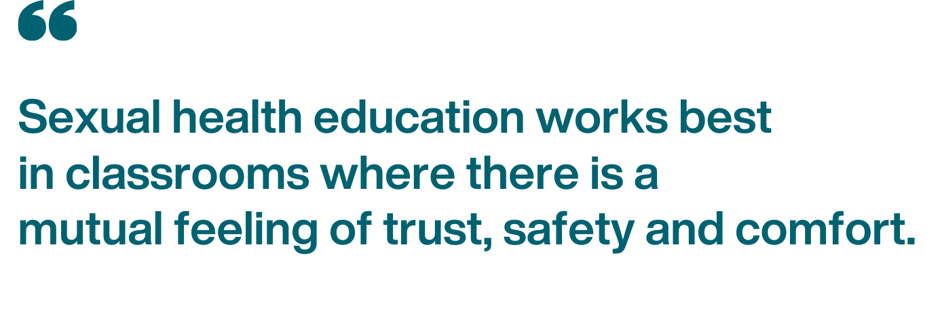
Why create a safe(r) space?
Public Health
Healthy Sexuality
Notes:
Script
Read slide
Research shows a safer space is an environment where a student’s abilities, experiences, and perspectives are heard, explored and celebrated. So – how do we create a safer space?
Ref:
Teachingsexualhealth.ca: Ground Rules https://teachingsexualhealth.ca/teachers/sexual-health-education/understanding-your-role/get-prepared/ground-rules/
Students Commission of Canada Beyond the Birds and the Bees: Supporting Sexual & Health Education in BC: Creating a Safe(r) Space

Slide 26

Create a safe(r) space with ground rules or group agreements
Public Health
Healthy Sexuality
Notes:
Script:
A good first way to help create trust, safety, and comfort from the start is setting ground rules with your class.
Ground rules are also known as group agreements. They are used to agree on expected behaviour that helps everyone to feel safe and heard.

Slide 27





Ground rules that work are:
Appropriate for age / development
Agreed upon by everyone
Explained well so students are clear about what’s expected
Posted clearly in your classroom
Referred to at the beginning and throughout sexual health lessons
Public Health
Healthy Sexuality
Notes:
Script
Read slide
I want to go back to “agreed upon by everyone” for a moment - ground rules work best if students are engaged in creating them, since they then feel a sense of ownership and engagement in the group agreement.
If students don’t follow ground rules, you can remind them about the ground rules everyone agreed to before the curriculum delivery started. It’s a good way to level-set expectations.
Note: Appropriate for age/development – examples appropriate for Grades 5+ on the next page
Ref: Ground Rules - Teachers | Teaching Sexual Health

Slide 28
…for the sexual health curriculum
Example ground rules …for your classroom
Classroom discussions are confidential
Questions are welcome
Use scientific terms for body parts and activities
It’s ok to pass
Use inclusive language
Respect personal boundaries
Be sensitive to diversity and careless remarks
It’s okay to have fun
No put downs
Respect each other
Speak for yourself
No personal questions
Listen when others are speaking
Public Health
Healthy Sexuality
Notes:
Script
Ground rules don’t have to be long – 5-10 bullet points work.
How many of you already use ground rules with your class? If so, they may already apply well to the sexual health curriculum. Review them before you start the sexual health curriculum to refresh and remind the students that those ground rules apply.
Here are some examples we have found that work well for teaching sexual health. On the left are ground rules that apply to all classroom content. On the right are ground rules that are more specific to sexual health.
Read slide
For “Classroom discussions are confidential” you may want to clarify “what is shared here, stays here, what is learned here, leaves here.” With the exception that if a student tells you they are being harmed or could harm others – in that case you’ll need to involve other adults.
What ground rules have you found that worked well for you when teaching sexual health in the past?
Ref: Ground Rules - Teachers | Teaching Sexual Health

Slide 29

Create a safe(r) space for students with diverse learning needs
Students have different levels of knowledge on sexuality and health topics
Students have diverse learning needs such as learning English, special learning needs, etc.
teachingsexualhealth.ca resource:
Teaching Human Sexuality to Students with Differing Abilities
SIECCAN resource:
Sexual Health Promotion: A Service Provider Guide for Working with Autistic Youth
Student health is impacted by racism and discrimination
Source: Supporting_Student_Health_Secondary.pdf (gov.bc.ca)
Public Health
Healthy Sexuality
Notes:
Script
Students have different levels of knowledge on sexuality and health topics – make sure to clearly explain the basics, and review fundamentals – don’t assume.
Student learning diversity – may include English language learners, special learning needs, etc. We recommend teachingsexualhealth.ca’s Teaching Human Sexuality to Students with Differing Abilities lesson plans for students with cognitive or physical disabilities, or complex medical, hearing, vision, or behavioural needs. For neurodiverse students, we recommend the Guide for working with Autistic Youth from SIECCAN (Sex Information & Education Council of Canada).
Student health is impacted by racism and discrimination - we know racism and discrimination result in poorer health outcomes, as a result of structural barriers and lack of access to health care, among other issues.
Ref: Supporting_Student_Health_Secondary.pdf (gov.bc.ca)

Slide 30



Create a safe(r) space with trauma informed practice
Preview all content
Provide advance notice of sensitive topics
Monitor for signs of distress during lessons
Use a safety plan if students need to leave
Try to plan lessons before recess or lunch
Avoid lessons just before a major school break
Source: Supporting_Student_Health_Secondary.pdf (gov.bc.ca)
Public Health
Healthy Sexuality
Notes:
Script
Some sexuality lessons may trigger those who have experienced trauma – this includes both students AND teachers
Trauma informed practice (TIP) is part of the Ministry of Education’s Mental Health in Schools Strategy.
The key goal of TIP is to ensure emotional and physical safety for everyone through trust, connection, and inclusion.
When teaching sexual health content, keep in mind:
BEFORE lessons: Preview videos and other content before showing to your students and provide advance notice of sensitive topics
DURING lessons: Monitor you and your students’ behaviour – particularly for signs of distress. If you notice signs of distress, bring the lesson to a close, take a break, and, in private, check in with the distressed student. Develop a safety plan for students who may need to leave the room – for example, this might include establishing a code word to leave the room without disclosing why, identifying a safe space in the school for them to go, and a check in with you or other trusted adult in the school.
Lastly, if possible, try to plan your lessons before a recess or lunch break, and not before a major school break (winter, spring, summer), so that AFTER lessons, students can speak to you in private or follow up with a school counsellor or other professional if needed.
Ref & resources:
Supporting_Student_Health_Secondary.pdf (gov.bc.ca)
trauma-informed_practice_guide.pdf (gov.bc.ca)

Slide 31
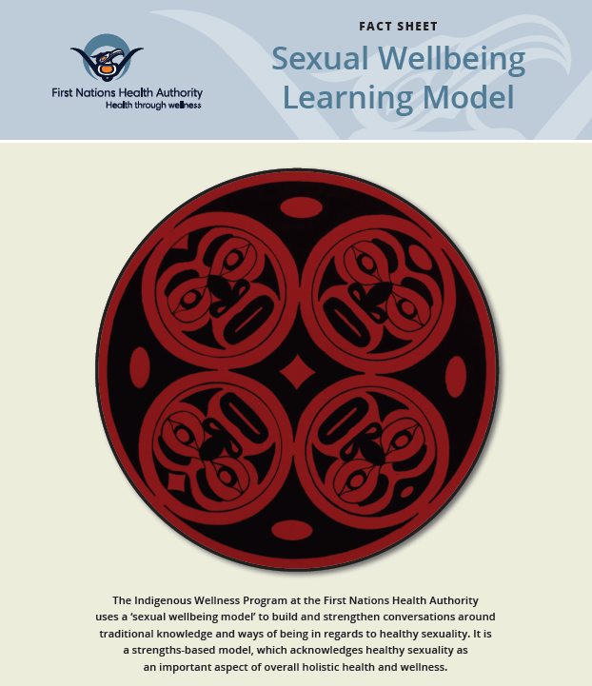
Create a safe(r) space by centering Indigenous voices
Public Health
Healthy Sexuality
Notes:
Script:
Creating a safe(r) space includes welcoming, considering, and honouring culture by considering Indigenous and other worldviews, asking students questions, and inviting them to share.
Here is the First Nations Health Authority Sexual Wellbeing Learning Model. Our VCH Indigenous Health team feels this is an excellent framework incorporating indigenous perspectives and values into sexual health education.
Ref:
https://www.fnha.ca/WellnessSite/WellnessDocuments/FNHA-IWP-Sexual-Wellbeing-Learning-Model-Fact-Sheet.pdf

Slide 32
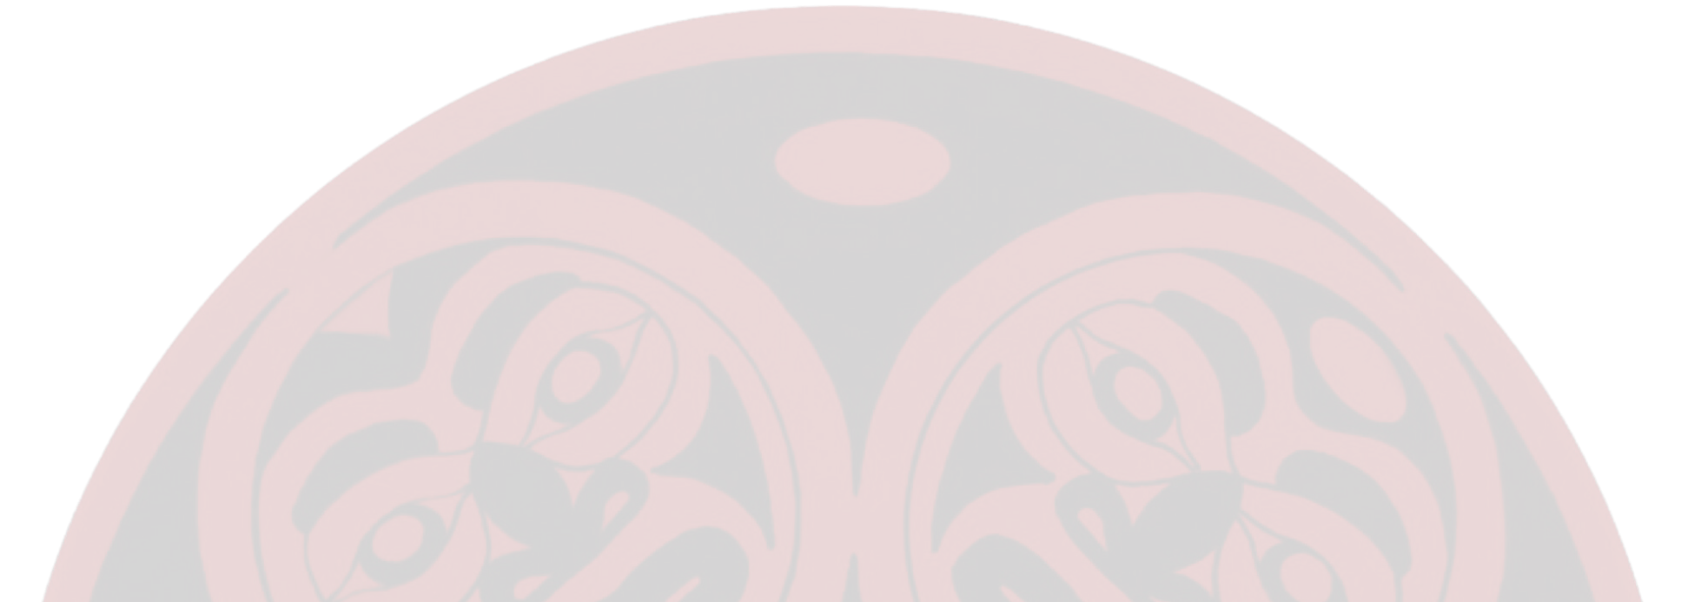
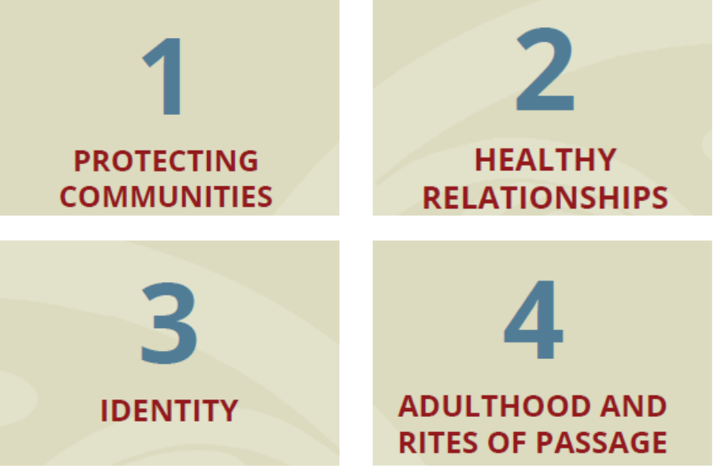
4 Indigenous values that align with healthy sexuality
Source: FNHA Sexual Wellbeing Learning Model
Public Health
Healthy Sexuality
Notes:
Script:
This model includes 4 Indigenous values that align with healthy sexuality. The full model is available as a handout at the link on bottom right of the slide.
1 Protecting Communities – this value recognizes that cooperation and respect are essential to protecting our communities for future generations, and that protecting one’s community means protecting oneself. In a sexual health context, this means protecting oneself and one’s community from STI transmission.
2 Healthy Relationships – This value identifies that kindness and balance are fundamental First Nations’ teachings for living life in a good way; this value includes healthy relationships with others as well as ourselves.
3 Identity – This value recognizes that colonization has impacted the identities of indigenous people socially, culturally, and sexually, and that loving ourselves and having patience while exploring one’s sexual and gender identity is important to maintaining wellness.
4 Adulthood and rites of passage – This value recognizes that traditionally and historically, First Nations people did not perceive sexuality as shameful, and was seen as a holistic part of health. Many nations celebrate rites of passage ceremonies to honor transition from adolescence to adulthood, and the independence and responsibilities, including in relationships, that accompany this transition.
Ref:
https://www.fnha.ca/WellnessSite/WellnessDocuments/FNHA-IWP-Sexual-Wellbeing-Learning-Model-Fact-Sheet.pdf

Slide 33
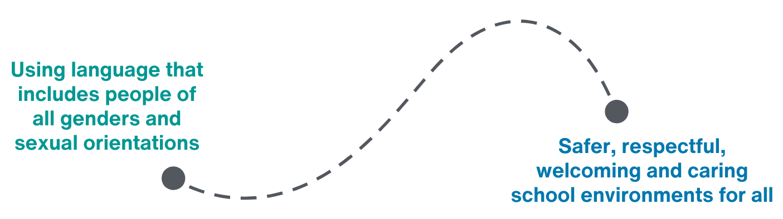
Create a safe(r) space with inclusive language
Source: Inclusive Language - Teachers | Teaching Sexual Health
Public Health
Healthy Sexuality
Notes:
Script
In the latest Adolescent Health Survey (2023 McCreary Centre Society), 5% of youth identified their gender as non-Binary and 1% as transgender. 25% identified their sexual orientation as gay, lesbian, bisexual or another sexual minority. This is not a small issue – a lot of people are impacted!
Using inclusive language, which means, to use language that includes people of all genders and sexual orientations, creates a safer, more welcoming and respectful school environment for students, families, and staff.
Using inclusive language is also:
More accurate
Makes learning more accessible to all students, and
Leads to better learning and social outcomes for all students
Ref: Inclusive Language - Teachers | Teaching Sexual

Slide 34
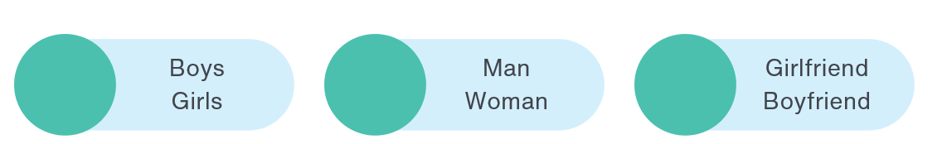
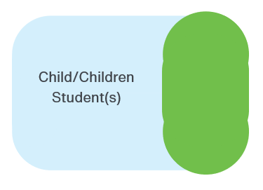
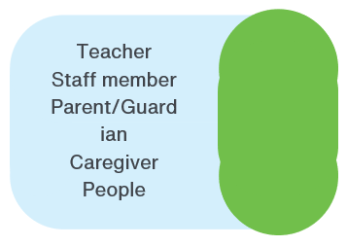
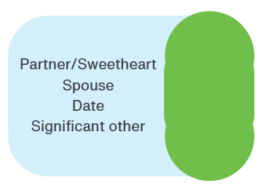
Gender neutral language is more inclusive
Public Health
Healthy Sexuality
Notes:
Script
NOTE: This is an animated slide
Before we get started on this slide, I just want to highlight that this is a safe space and this is a learning activity. It’s ok not to know all the answers.
With that in mind, let’s brainstorm.
The words boys and girls are terms that refer to a child by their gender.
Read alternative options as they fly in
The words man and woman are terms that refer to an adult by their gender. Can anyone think of a possible gender-neutral alternative for these words?
Read alternative options as they fly in
A note here – male/female are terms that refer to a person’s biological sex characteristics, rather than gender, and assigned at birth based on reproductive body parts. However, they are frequently mis-used interchangeably with gender, and therefore, often experienced as gendered terms. We recommend using “Person with a penis/vulva” as inclusive words to use when discussing puberty and changes to bodies within sexual health education. We cover this in more detail in our Reproductive Systems and Pregnancy Prevention Workshop.
And lastly, can anyone think of gender-neutral terms for the words girlfriend and boyfriend?
Read alternative options as they fly in
Refs:
Beyond the Birds and the Bees: Supporting Sexual Education in BC_PDF Guide.pdf - Google Drive (page 10).
https://www.transcarebc.ca/sites/default/files/2024-03/Gender_Inclusive_Language_General.pdf

Slide 35
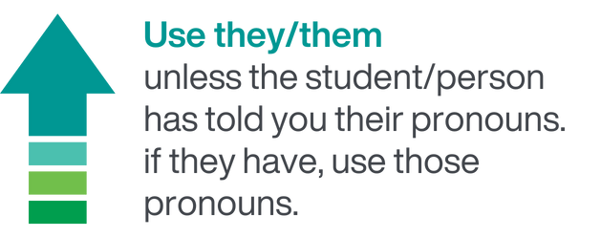
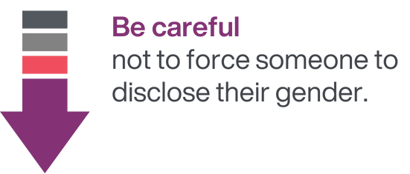
Avoid assuming someone’s gender
Public Health
Healthy Sexuality
Notes:
Script
Read slide
Forcing someone to disclose their gender means, for example, asking them their pronouns in front of others. They may still be exploring their gender or not ready to share their pronouns with others.
Ref:
Beyond the Birds and the Bees: Supporting Sexual Education in BC_PDF Guide.pdf - Google Drive

Slide 36

Introducing yourself
Public Health
Healthy Sexuality
Notes:
Script
One way to help students, families, and staff know you are welcoming and gender-inclusive is to introduce yourself using your pronouns. This not only models inclusivity for all students, but also helps gender diverse students understand that you are a person they can feel safe with.
While we recommend you offer your pronouns, avoid setting up situations where students feel they need to disclose their pronouns in front of others if they aren’t ready (e.g. going around a circle with everyone identifying their pronouns).
Ref:
https://www.transcarebc.ca/sites/default/files/2024-03/Gender_Inclusive_Language_General.pdf
Parker Hewes, VCH Prism Coordinator, Personal Communication, Sept 2024

Slide 37
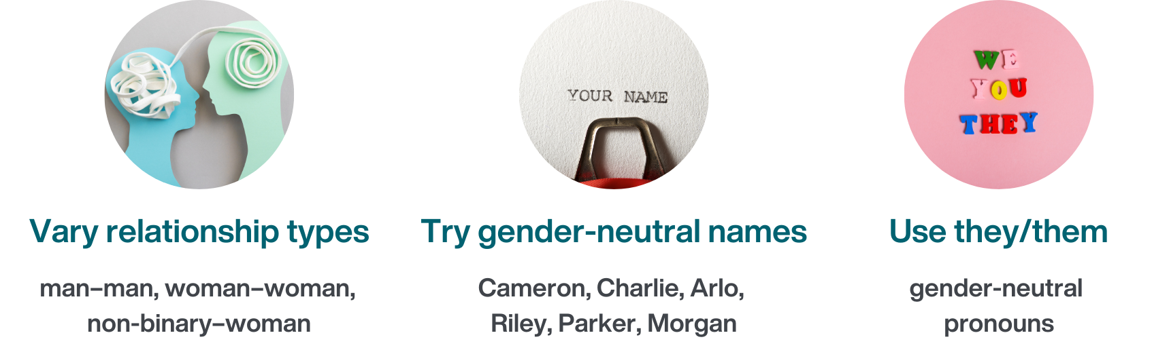
Use diverse examples
Public Health
Healthy Sexuality
Notes:
Script
Read slide
Ref:
Beyond the Birds and the Bees: Supporting Sexual Education in BC_PDF Guide.pdf - Google Drive

Slide 38
Using they/them
They
Subject
Object
Possessive adjective
Possessive pronoun
Reflexive
are waiting in the office.
The report card is for .
I checked assignment an hour ago.
They said the skateboard is not .
They walked here .
them
their
theirs
themself
Public Health
Healthy Sexuality
Notes:
Script
Ok, let’s practice using they/them. I’ll give you a minute – please silently read each sentence and reflect on how you might use they/them in each, and then we’ll complete the sentences together.
Read each sentence highlighting the word as each flies in”.
English teachers – a great cross-curricular activity!
Ref:
https://www.transcarebc.ca/sites/default/files/2024-03/Gender_Inclusive_Language_General.pdf

Slide 39
Instructional Methods
Source: teachingsexualhealth.ca | Instructional Methods
Public Health
Healthy Sexuality
Notes:
Script:
Let’s shift gears now, and go over some instructional methods and considerations when using them to teach sexual health education

Slide 40
Rationale
Keep all students together
Students of all genders should learn about sexual health together
Greater understanding and respect for different perspectives
Help develop skills & knowledge for healthy relationships
Safer and more inclusive for gender diverse students
Public Health
Healthy Sexuality
Notes:
Script
In the past it was common to separate students by gender, but we now recommend keeping students of all genders together to learn sexual health education.
Rationale
In mixed gender groups, students hear and gain a greater understanding and respect for different perspectives and experiences. This promotes empathy and reduces potential for teasing and discrimination. Students also gain skills and knowledge for developing healthy relationships - e.g. practicing sexual health communication skills within mixed-gender groups helps prepare them for future conversations with partners, health care providers, and even their own children. Keeping all genders together is also more inclusive for gender diverse students.
Note: if students are reluctant to ask questions in a mixed gender group, we recommend using an anonymous Question Box for safe opportunity to ask questions.
Ref:
https://teachingsexualhealth.ca/teachers/sexual-health-education/understanding-your-role/get-prepared/instructional-methods/

Slide 41
Tips
Use role play
Key to developing decision-making and practical skills and self-confidence
Some students may feel threatened or self-conscious – Use role-play humour to break the ice ☺
Introduce the skills through readings
Demonstrate or have students watch a successful skill performance
Public Health
Healthy Sexuality
Notes:
Script:
Role plays are key to practicing and developing decision-making and practical skills and self-confidence in using those skills.
Tips:
Some students may feel threatened or self-conscious in role plays - using humor can help break the ice and make students more comfortable. For example, you can use role plays that exaggerate weak responses and demonstrate what not to do!
Introduce the skills through readings first, and before letting students try, demonstrate (or watch role models perform) the skills successfully, so the skills are clear.
Ref:
https://teachingsexualhealth.ca/teachers/sexual-health-education/understanding-your-role/get-prepared/instructional-methods/

Slide 42

Tips
Show videos or media
Entertaining way to introduce content and raise issues
Preview all video/media content
Have school administration approve
Option: Mute the sound and narrate based on your students’ needs
Not all content is appropriate for the classroom
Public Health
Healthy Sexuality
Notes:
Script:
Videos and media can be an entertaining way to introduce content and raise issues in the sexual health classroom, but not all content is appropriate for the classroom. Before you use any media, ask: What do you know about the source organization’s mandate and values? What are their credentials and are they appropriate to the topic? Does it align with the PHE curriculum and provincial health messaging? Has the content accuracy been verified with administrators and curriculum specialists? Does it fit within your school’s policies, e.g. is it inclusive and show respect for diversity?
Tips:
Always preview media to ensure it is appropriate for age and grade, and only use the parts that match your lesson’s objectives.
Ask your school administration to review and approve. You could also consider asking parents to preview it.
You can try turning off the sound and narrating yourself – this way you can focus the media on your students’ needs. And remember that all media comes with a stop button!
Ref:
https://teachingsexualhealth.ca/teachers/sexual-health-education/understanding-your-role/get-prepared/instructional-methods/

Slide 43
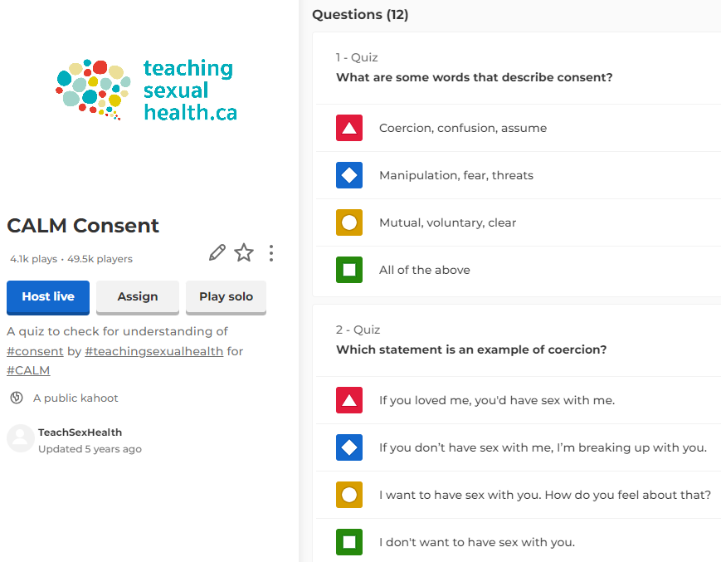
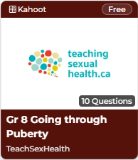
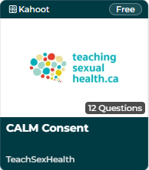
Media option: Kahoot! quizzes
teachingsexualhealth.ca/teachers/type/kahoot-quizzes/
Public Health
Healthy Sexuality
Notes:
Script
One fun and free option is Kahoot! Quizzes – we recommend the ones from teachingsexualhealth.ca
If you have a computer with internet and a projector, you can display the questions in class. You can form student teams and provide the team access to a wi-fi connected device (computer, tablet, or phone), to input their answers.
You can choose to have the students download the Kahoot! app directly onto their devices, or play from the website Kahoot.it
Ref:
https://teachingsexualhealth.ca/teachers/sexual-health-education/understanding-your-role/get-prepared/instructional-methods/

Slide 44
Tips
Interact in small groups
A powerful learning tool that promotes cooperation, problem-solving, critical thinking skills.
Students may cover their embarrassment about content by
acting out poor social skills
Reinforce ground rules
Make time for feedback and reflection at the end of each session.
Public Health
Healthy Sexuality
Notes:
Script
Small groups are a powerful learning tool that promotes cooperation, problem-solving, negotiation, and critical thinking skills. Students learn faster, remember what they’ve learned better and tend to be more positive about the lesson. They require students to listen to one another, ask questions, clarify issues and re-state their point of view. They also require students to practice social skills, including listening when others speak, maintaining eye contact and positive body language, encouraging and showing respect, and speaking quietly and without hostility.
Tips:
Students may cover their embarrassment about the content by acting out poor social skills. Make sure to reinforce clear and direct ground rules to help students remember to use their social skills when working in their small group.
Make sure to give enough time for feedback and reflection with the larger class at the end of each session.
Ref:
https://teachingsexualhealth.ca/teachers/sexual-health-education/understanding-your-role/get-prepared/instructional-methods/

Slide 45
Tips
Discuss as a class
Open conversations let students express opinions and exchange information safely within the classroom
Talking about sexual health may elicit feelings of privacy and vulnerability
Use class discussions after you cover material (more effective)
Remind students of ground rules
Introduce facts, correct misinformation, and help students use proper terminology.
Public Health
Healthy Sexuality
Notes:
Script
Open conversations let students express opinions and exchange information safely within the classroom. They also let students practice healthy communication skills, such as respect for other people’s feelings, asking questions when they feel vulnerable, or sharing their views.
Tips:
Students may feel vulnerable when talking about sexual health. Class discussions will likely be more effective if they take place after you’ve given the material through a lecture, video or reading. Make sure to remind students of the ground rules at the beginning of each class discussion to make sure all students feel safe and respected during the activity.
During a class discussion, introduce facts, correct any misinformation, and help students use proper terminology instead of slang. It’s important to do this without causing the student to feel ashamed. For example, you could say, “Many people think that…” or “It’s common to hear people say that… however, here is what the science says.”
Ref:
https://teachingsexualhealth.ca/teachers/sexual-health-education/understanding-your-role/get-prepared/instructional-methods/

Slide 46
Tips
Use question boxes
Allows students to ask questions anonymously
Allows you to consider or research your answer
Do not read out loud or answer questions that cross ground rules
Remind students of ground rules if
you receive questions that breach ground rules
Responding to Student Questions - Teachers | Teaching Sexual Health
Public Health
Healthy Sexuality
Notes:
Script
Responding to student questions is an important part of sexual health education. We recommend using a “Question box” to allow students to ask questions privately and anonymously. You can create the box in a voting ballot box style, so that papers cannot be easily retrieved or seen from above. You could consider asking all students to submit a paper to the question box, even if blank, as an extra layer of confidentiality.
Question boxes allow you to defer your answer, so you can research your answer.
You can theme questions together and respond to similar questions simultaneously.
A good place to research age-appropriate and evidence-based answers to student questions is teachingsexualhealth.ca’s “Responding to Student Questions” page for teachers. They have an “Ask a question” function where you can submit questions they will answer. I am also available to help you with answering student questions either in class or from the Question Box.
Tips
Do not read out loud or answer questions that cross ground rules, for example, questions about your personal sexual health and experiences – instead, remind students of the ground rules.
Ref:
Supporting_Student_Health_Secondary.pdf (gov.bc.ca) – see pg. 8 “Daily classroom practices”
Responding to Student Questions - Teachers | Teaching Sexual Health
Personal Communication, Jessy Wollen, Teacher and Certified Sexual Health Educator, Aug 20, 2024

Slide 47

Responding to questions
Information requests
Give information within curriculum guidelines.
It’s okay to say “I don’t know.”
Find out the answer or refer the student to an appropriate source.
Validate concerns (e.g. “Many people worry that …”).
Give information about what they can expect to happen.
Be cautious of using the word normal.
Respond in the 3rd person.
Give facts about what is known (medical, legal, risks, consequences).
Reinforce that looking for information and talking about issues helps students learn about making healthy decisions.
Am I normal?
Permission seeking
Is it normal to…?
Did you…when you were growing up?
Source: Responding to Student Questions - Teachers | Teaching Sexual Health
Public Health
Healthy Sexuality
Notes:
Script
Here are some common types of questions you might get, and tips on how to respond. Remember, you can always refer them to a health care provider, parent/guardian, or other resources.
Information Requests – Students are looking for facts. If you know the answer, give the information within curriculum guidelines. If you don’t know the answer, it’s okay to say “I don’t know”! You can either find out the answer or refer the student to an appropriate source.
Am I Normal? questions - Students are concerned about emotional and physical changes they are going through. Validate their concern (e.g., “Many people worry that …”) and give information about what they can expect to happen. Be cautious of using the word ‘normal’, because normal for some might not be normal for others.
Permission Seeking Questions - Students may ask “Is it normal to …?” or “Did you… when you were growing up?” Do not ever give personal information. Respond to the question in the 3rd person (e.g. “Many people/some people…”, “Research says…”). Give medical and legal facts, risk factors, and consequences. And always give positive reinforcement that looking for more information and talking about issues is an important way for youth to learn about making healthy decisions!
Ref:
https://teachingsexualhealth.ca/teachers/sexual-health-education/responding-to-student-questions/#requests-for-information

Slide 48



Responding to student questions – Information sources
A list of common student questions with answers
teachingsexualhealth.ca/teachers/sexual-health-education/student-faqs/
SEX SENSE
1-800-739-7367
optionsforsexualhealth.org/sex-sense
sexandu.ca
Public Health
Healthy Sexuality
Notes:
Script
Here are three reliable resources of information you can use for researching common student questions or referring students.
When you don’t know an answer, it can be a great opportunity to model accessing recommended sexual health resources to find out the answer. For example, you could demonstrate to the class how to search for the answer on sex&u.ca or call the Sex Sense Line on speakerphone (please call the Sex Sense line first to let them know you will be calling!).
Ref:
https://www.optionsforsexualhealth.org/sex-sense/
https://teachingsexualhealth.ca/teachers/sexual-health-education/responding-to-student-questions/#requests-for-information

Slide 49
Responding to questions
Shock questions
Assume positive intent.
Answer the question matter-of-factly.
Remind students of the ground rules.
Re-word slang.
Address the underlying concern.
Defer the question so you can think about how to address or reword it.
Source: Responding to Student Questions - Teachers | Teaching Sexual Health
Public Health
Healthy Sexuality
Notes:
Script
Shock questions may be a result of embarrassment, an underlying concern, or simply a way to divert attention from the topic. Assume positive intent – it is most likely a real request for information using the only language the student knows. Answer the question matter-of-factly. Remind students of the ground rules related to appropriate questions for classroom discussion (e.g. respect, using scientific terms). Re-word slang or inappropriate language to focus on the question. For example, if a students asks, “Should your balls hurt for days after being hit?” you could say, “Balls is a slang word for testicles. Testicles are very sensitive, and do hurt when hit. If your testicles are sore for more than a day, you should see your doctor to rule out any problems.” Try to identify and address the underlying concern. For example, “It sounds like you are asking a question about respect in a relationship”. If you are uncomfortable, defer the question until you have time to think about how to address or re-word it.
A last note on questions before we move on. Responding to questions takes time to build skill in. One of the most important things to remember is to not answer questions by telling personal stories – e.g. “when I first got my period”, “when I first had sex…”. Lessons can be disarming and there is a natural reaction to want to share. However, the teacher’s role is to create and hold a safe container for students to share with their peers. It important to maintain a clear boundary that we are a teacher/facilitator, and not a peer. Oversharing personal information blurs the line between student and teacher and can be experienced as unsafe by students. Always externalize your answers by using the 3rd person.

Slide 50
Guest Speakers
Public Health
Healthy Sexuality
Notes:
Script
Let’s talk a bit about choosing guest speakers.

Slide 51
Tips
Choosing guest speakers
Not all guest speakers provide curriculum-aligned content
(e.g. abstinence-only programming)
Some guest speakers
and websites may
provide misinformation
Ensure alignment with curriculum and classroom goals
Review lesson plans and content in advance
Check school district guidelines
Stay present in the classroom
Public Health
Healthy Sexuality
Notes:
Script
Be aware that not all guest speakers provide curriculum-aligned content. For example, some guest speakers focus on abstinence-only programming. As we discussed earlier, this is not aligned with comprehensive sexual health education or BC Physical & Health Education Curriculum and has an adverse impact on youth sexual health.
Some guest speakers and current websites may provide misinformation.
Tips
Before hiring guest speakers, review their lesson plans to ensure they align with comprehensive sexual health education within the curriculum, check your district’s guidelines about using guest speakers, and stay present in the classroom to ensure alignment with the curriculum.
One option we recommend is inviting a community health service provider to share about their youth-friendly services (e.g. VCH Youth/Sexual Health Clinics, Foundry), which creates a connection to those services.
Refs:
Health Resources & Guest Speakers - Teachers | Teaching Sexual Health
https://www.who.int/news-room/questions-and-answers/item/comprehensive-sexuality-education#:~:text=Young%20people%20are%20more%20likely,sexual%20health%20and%20their%20rights

Slide 52
Student Disclosures
Public Health
Healthy Sexuality
Notes:
Script
One thing we should be prepared for – just in case – is student disclosures of abuse.

Slide 53
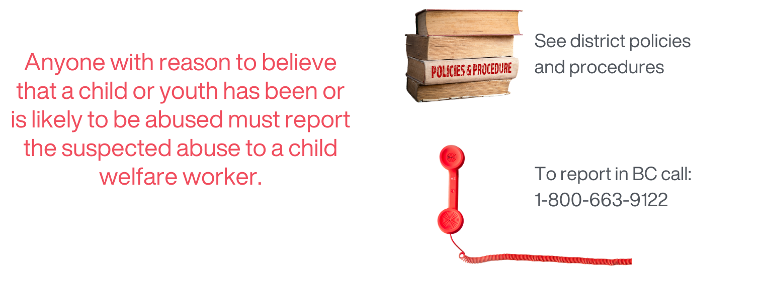
You have a duty to report child abuse & neglect
Source: Supporting_Student_Health_Secondary.pdf (gov.bc.ca)
Public Health
Healthy Sexuality
Notes:
Script
The Child, Family and Community Service Act (CFCSA) legally requires anyone who has reason to believe that a child or youth has been or is likely to be abused or neglected must report the suspected abuse or neglect to a child welfare worker (MCFD).
Check with your district for district policies and procedures
To report child abuse or neglect in BC, call: 1-800-663-9122
Ref
Supporting_Student_Health_Secondary.pdf (gov.bc.ca)
https://www2.gov.bc.ca/assets/gov/public-safety-and-emergency-services/public-safety/protecting-children/childabusepreventionhandbook_serviceprovider.pdf

Slide 54
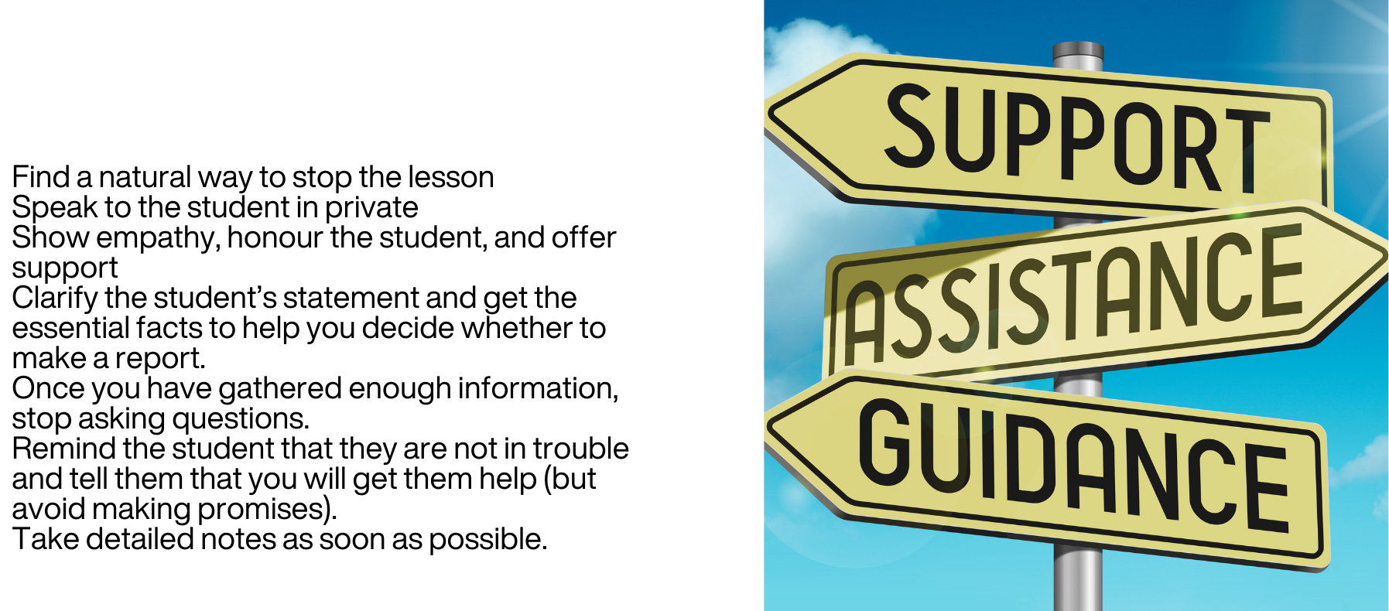
How to respond to a student disclosure
Find a natural way to stop the lesson.
Speak to the student in private.
Show empathy, honour the student, and offer support.
Clarify the statement and get the essential facts to help you decide whether to make a report.
Once you have gathered enough information, stop asking questions.
Remind the student that they are not in trouble.
Tell them you will get them help but avoid promises.
Take detailed notes as soon as possible.
Source: Supporting_Student_Health_Secondary.pdf (gov.bc.ca)
Public Health
Healthy Sexuality
Notes:
Script:
This guidance is from the Ministry of Education’s Supporting Student Health Guide
Read slide
Note: essential facts = how, who, what, and when; avoid why
Ref
Supporting_Student_Health_Secondary.pdf (gov.bc.ca)

Slide 55
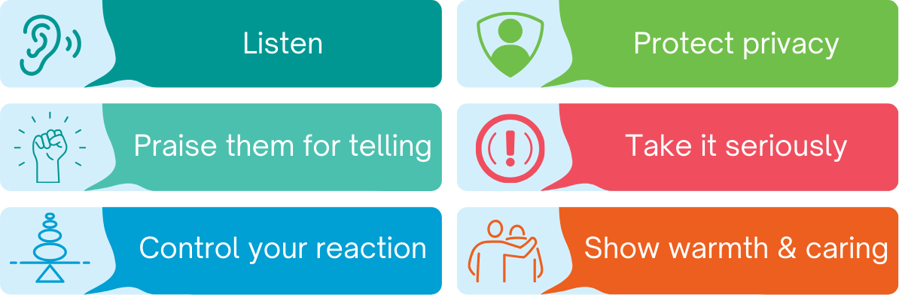
How to support youth during a disclosure
Source: protectchildren.ca/en/order/product/326:en/
Public Health
Healthy Sexuality
Notes:
Script
Listen – Youth fear an adult’s reaction, and not being believed.
Praise them for telling – It takes tremendous courage to disclose sexual abuse, and youth will often assume responsibility for the abuse. Assure the youth it is not their fault and they did the right thing by disclosing.
Control your reaction – If you over react, they may believe they are being judged by you. If you under react, they may think you do not believe them, they will shut down.
Protect their privacy – Make sure no other students are around to hear. Only adults who will be directly involved in taking action should be present.
Take it seriously – Let the youth know what they are telling you is very important to you, and you are going to listen very carefully to what they have to share with you.
Show warmth and caring – Use a calm voice and make eye contact. They need support and understanding.
Ref
Canadian Centre for Child Protection: Kids in the Know Promoting Healthy Relationships, 3rd Ed. Grad 9/10 Digital Lesson
https://protectchildren.ca/en/order/product/326:en/

Slide 56
Parent Notification &
Alternative Delivery Policy
Public Health
Healthy Sexuality
Notes:
Script
Let’s talk a bit about parent/guardian notification and alternative delivery policy

Slide 57
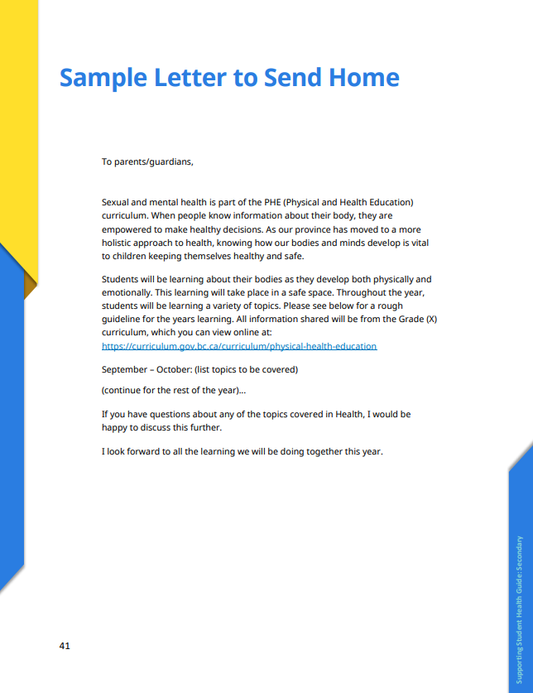
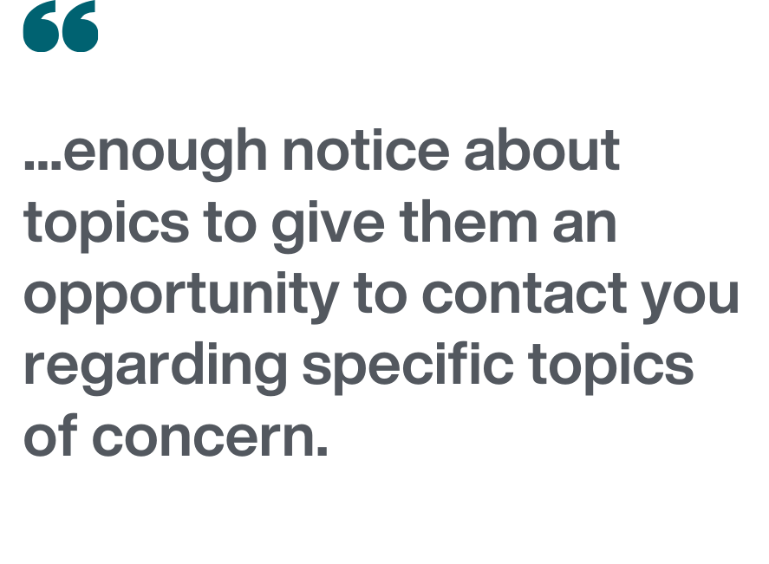
Notify parents or guardians
Sample
Supporting Student Health Guide (Secondary)
Public Health
Healthy Sexuality
Notes:
Script
There are no provincial guidelines regarding how parents are notified about upcoming topics, however, the Supporting Student Health Guide recommends that “parents receive enough notice about topics to give them an opportunity to contact you regarding specific topics of concern. This gives you opportunities to work through potential areas of concern rather than simply remove their children from these lessons.”
It also has a sample template letter on page 41 you can use – here is a screen shot of it on the right.
Our VCH Public Health team has also developed parent/guardian letter highlighting our support for the delivery of sexual health education in schools from a health evidence standpoint. You may use this in addition to your notification letter, if you use them.
Ref:
Supporting_Student_Health_Secondary.pdf (gov.bc.ca)

Slide 58


BC policy allows for alternative delivery of sensitive topics
Parents or Guardians
Must work with their school to ensure their children meet PHE learning standards by alternative means.
Students
Must be able to demonstrate their understanding of PHE topics.
Source: Alternative Delivery in the Physical and Health Education and Planning 10 Curricula - Province of British Columbia
Public Health
Healthy Sexuality
Notes:
Script
While 85% of Canadian parents/guardians state they want sexual health taught in the schools, some parents/guardians or students may feel more comfortable learning about this topic outside of the classroom setting.
BC’s Alternative Delivery in the Physical and Health Education and Planning 10 Curricula Policy applies only to the reproduction and sexuality topics in the grades K-10 PHE. The policy does not allow students to opt-out from learning about PHE Curriculum topics, but does allow parents/guardians to arrange to address learning about reproduction and sexuality by an alternate means agreed upon by the students, their parents or guardians, and the school. School boards are required to have procedures in place to enable students to address and meet these learning standards.
Alternative delivery examples named in the policy include: 1) home instruction using a school-determined package of materials or other agreed-upon materials or 2) self-directed studies.
Ref
Wood, J., McKay, A., Wentland, J. & Byers, S.E. (2021) Attitudes towards sexual health education in schools: A national survey of parents in Canada. Canadian Journal of Human Sexuality, 30, 1. https://doi.org/10.3138/cjhs.2020-0049
Overwhelming Support for Sexual Health Education in U.S. Schools: A Meta-Analysis of 23 Surveys Conducted Between 2000 and 2016
Szucs, L.E., Harper, C.R., Andrzejewski, J., Barrios, L.C., Robin, L. & Hunt, P. Overwhelming Support for Sexual Health Education in U.S. Schools: A Meta-Analysis of 23 Surveys Conducted Between 2000 and 2016. Journal of Adolescent Health, Volume 70, Issue 4, 2022, Pages 598-606. https://doi.org/10.1016/j.jadohealth.2021.05.016

Slide 59
Health Resources for Students
Public Health
Healthy Sexuality
Notes:
Script
As we discussed earlier, one of the key elements of effective school-based sexual health education programs are connections to youth-friendly health care services. Let’s talk about a few!

Slide 60

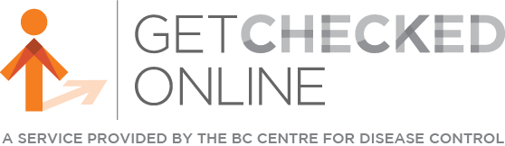


Youth-friendly health clinics
Youth and Sexual Health clinics
vch.ca/en/health-topics/sexual-health
getcheckedonline.com
foundrybc.ca
optionsforsexualhealth.org/care/
Public Health
Healthy Sexuality
Notes:
Script
Here are a few youth-friendly health clinics for you to discuss with your class. We also suggest you post this page in your class or in the school!
VCH Youth and Sexual Health clinics (across the VCH region) and Options for Sexual Health clinics offer sexual and reproductive health care services, including STI testing and contraception.
Foundry offers primary care and mental health counselling services for youth aged 12-24.
Get Checked Online is an easy way to test for STBBIs without visiting a health care provider.

Slide 61

Youth-friendly sexual health information sources
SEX SENSE
1-800-739-7367
optionsforsexualhealth.org/sex-sense
smartsexresource.com
Public Health
Healthy Sexuality
Notes:
Script
And here are two youth-friendly online and telephone sources of health information.
Sex Sense is a resource from Options for Sexual Health. They have great evidence-based information on their website. They also take questions by phone or online through their website. Individuals can call and ask questions or submit a question online.
Smart Sex Resource was developed by the BC Centre for Disease Control. It provides comprehensive sexual health information and links to services for British Columbians of all ages. A large library with more than 1000 questions from the public on various sexual health related topics is also available.

Slide 62

Public Health
Healthy Sexuality
Notes:
Script
Any questions?

Slide 63

Public Health
Healthy Sexuality

