Slide 1


  A note on formatting:
  Each slide comes with key speaking and instructional information for PHNs and teachers in the ‘presenter notes’ part of the powerpoint.
  The font in italics is a script outline- suggestions of words you could say verbally on that slides.
  The “Notes:” unitalicized sections include instructions and tips for the PHN and teacher that are not meant to be read out loud
  Slide background is coloured accordingly: beige = lesson, blue = interactive activity, teal = optional
PILOT: September 2024
School Health Promotion:
Physical Health
Self-Regulation:
Mindful Eating and
Listening to Body Signals
Module #3

Slide 2
PILOT: September 2024
School Health Promotion:
Physical Health
PHN Name, Role
& Fun Fact
Notes:
Introduce yourself as a PHN—Name, Role--Who you are, what you do, why you're here, and a fun fact. Option: add a photo of pet, hobby, or fun fact
Share something with the students that will help build rapport (e.g., mention that you have a cat or dog, or you like to play soccer, or explain why you’re passionate about health promotion).

Slide 3

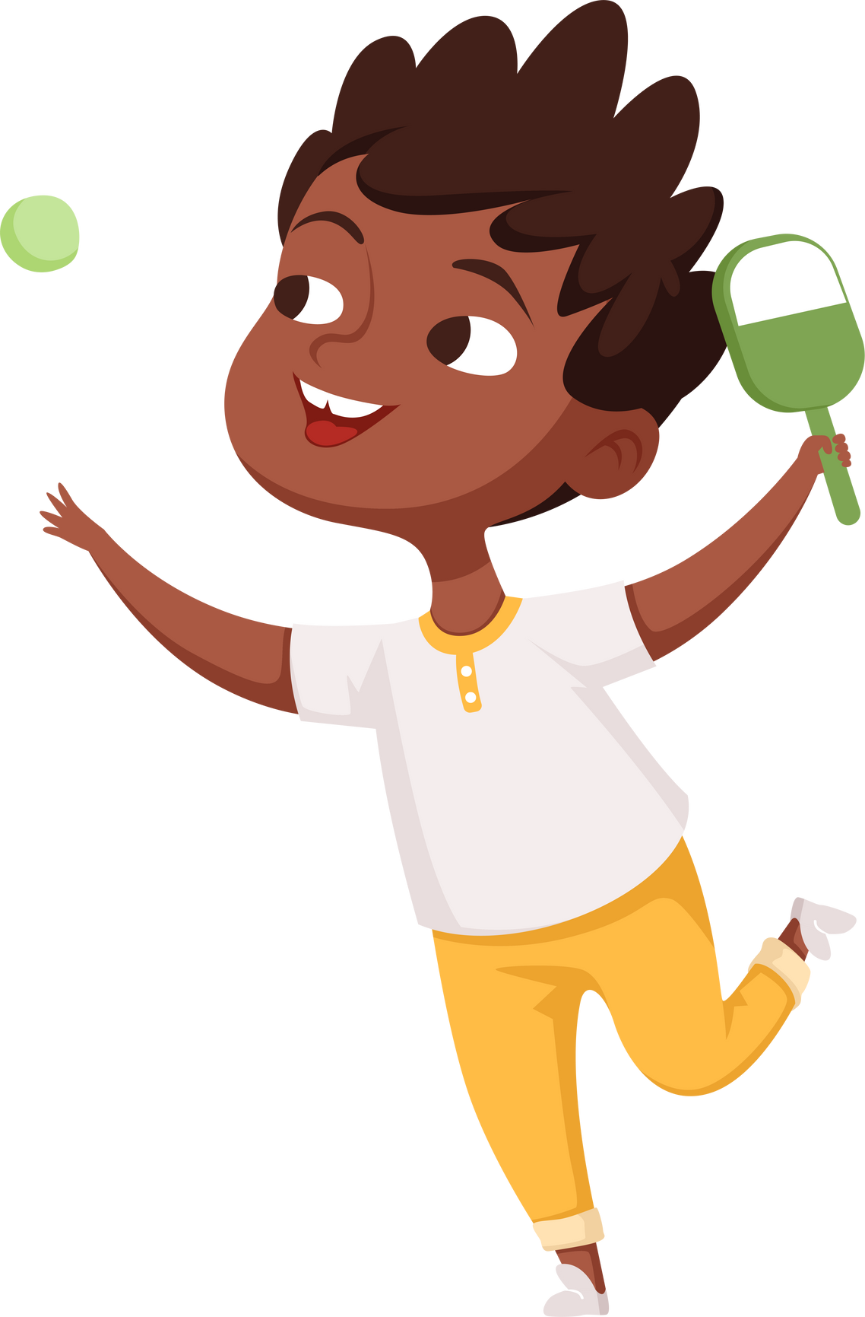

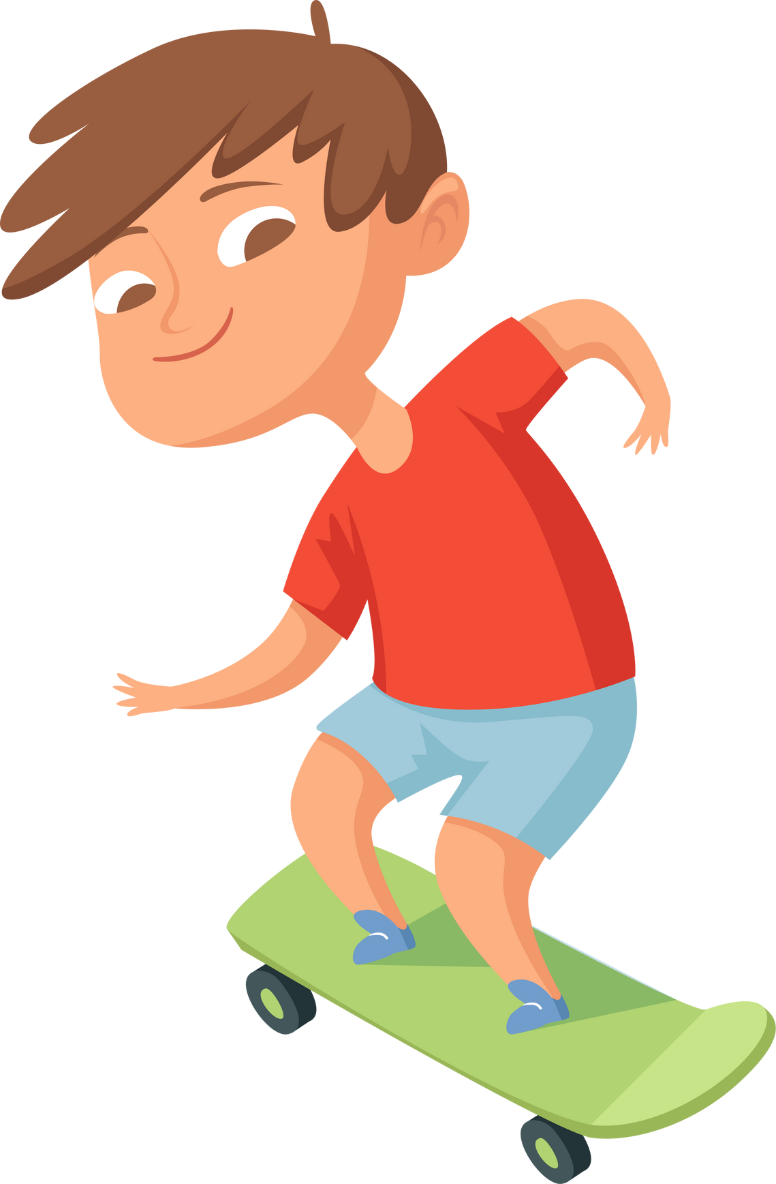
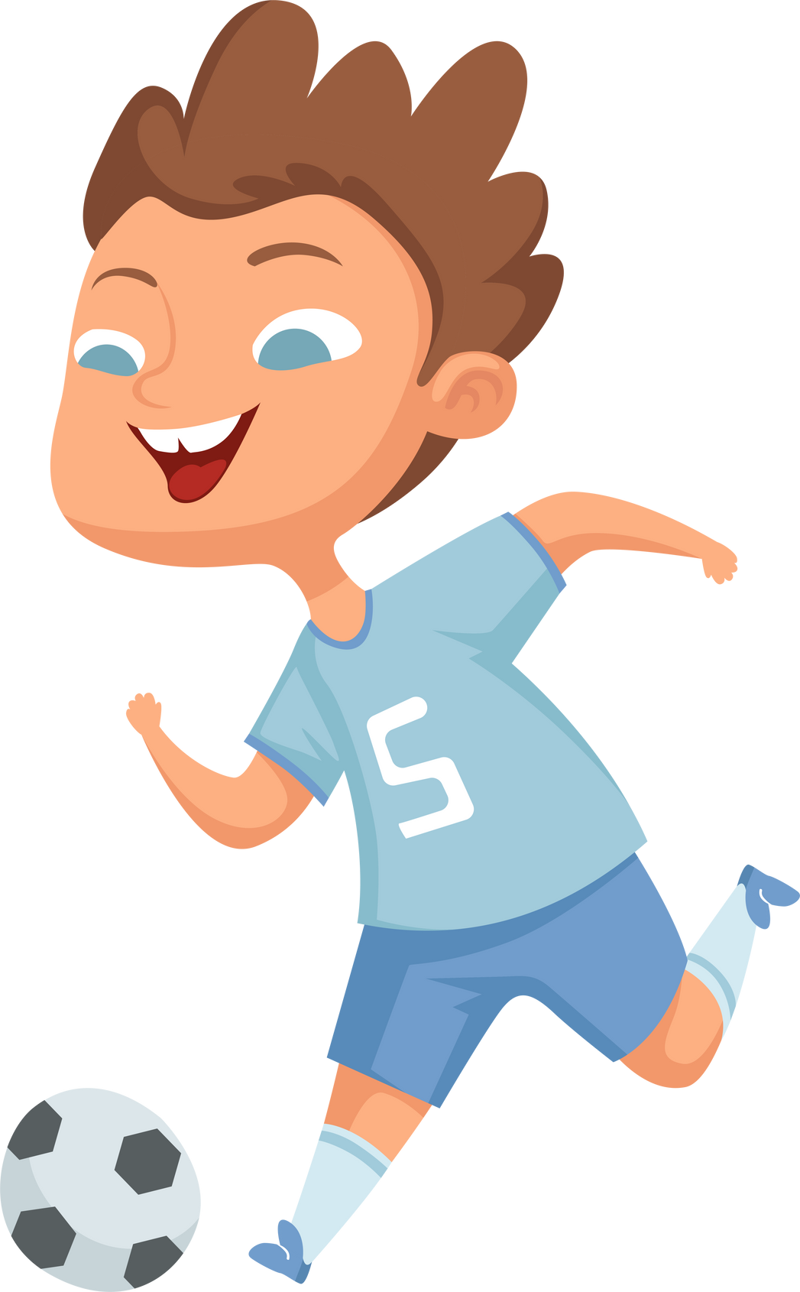


Physical Health
Mindful Eating and
Listening to Body Signals
PILOT: September 2024
Notes:
Notes:
This module complements the self-regulation initiatives that educators are doing already, including social-emotional learning. Mindful eating (which includes “how” we eat) involves noticing the characteristics of the food we are eating, using our 5 senses, noticing the signals in our body, and recognizing what those internal cues are telling us. This lesson teaches students to notice the external appearance, smell, flavour, and textures of food, as well as the internal signals inside their bodies. The goal of this module is to translate information from one’s body into body wisdom–In plain language, students will learn to listen to their bodies, and take steps to meet their needs. Cultivate healthy attitudes and behaviours around food, body image, and self-care (including sleep and physical activity).
Tip: When possible, this lesson could be done outdoors in an outdoor classroom, with the mindful eating activity taking place in your school garden if you have one, with students sampling something grown at school. Feel free to be creative!

Slide 4


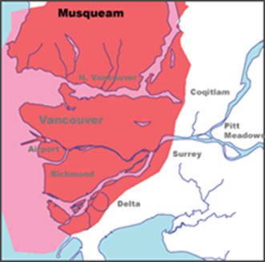

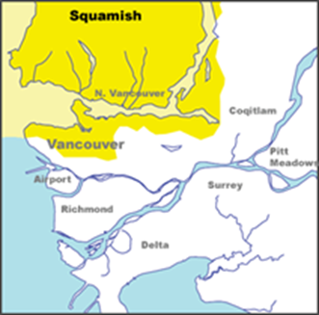
Territorial Acknowledgment
  We wish to acknowledge that the land on which we gather is the traditional and unceded territory of the Coast Salish Peoples, including the Musqueam, Squamish, and Tsleil-Waututh Nations.
Vancouver Coastal Health is committed to delivering exceptional care to 1.2 million people, including the First Nations, Métis and Inuit, within the traditional territories of the Heiltsuk, Kitasoo-Xai'xais, Lil'wat, Musqueam, N'Quatqua, Nuxalk, Samahquam, shíshálh, Skatin, Squamish, Tla'amin, Tsleil-Waututh, Wuikinuxv, and Xa'xtsa.
Notes:
Notes:
A territory acknowledgement is a relational process. This means that the meaning and purpose changes across time and space, and with the specific context in which it takes place. Take some time to learn about the territory on which the school you are in is situated and connect the honouring to the context of the classroom and module concepts. We encourage you to expand upon your territory acknowledgements in a meaningful way.
Suggestion: Make your land acknowledgement personal and specific to the traditional land the school is on. Emphasize the importance of connecting to culture for well-being, and connect the concepts to be covered in the module to the land and Indigenous culture (e.g. In Indigenous culture, food is considered medicine that nourishes your mind, body and soul, or share about a traditional Indigenous game that comes from this territory, etc.).

Slide 5


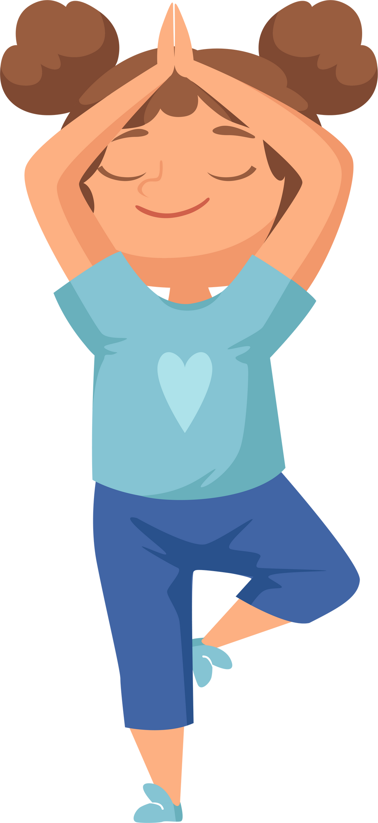

Check in:
How are you feeling
right now?
  Let's find out!
Notes:
Ask the class:
How are you feeling right now?
Notes:
When asking the class how they’re feeling, connect it to physical, emotional and social state
If the class seems keen to listen, can introduce the “body scan” technique, scanning from head-to-toe
Ask the class: how is my brain (thoughts), how is my throat and mouth feeling (thirst), how is my stomach (hunger, stress), and down to the toes (do I feel stiff? Does my body need some movement?)
If the class looks they need a movement break, you can name specific feelings (e.g. hungry, excited, tired, etc) and invite students to do a star jump if they are feeling what you describe
I.e. “Do a star jump if you are…..” (thirsty, tired, awake, excited, hungry, happy)
Pay attention to students that seem to be having a hard time and follow up with the student or teacher after the class as appropriate

Slide 6



Move to the Wall
One side of the classroom is designated as the YES zone
Other side of the classroom is designate as the NO zone
Move to the ZONE that matches how you feel right now….
Does your body feel like it has lots of energy?
Do you feel tired?
Does your body feel calm?
Do you feel thirsty?
Does your brain feel ready to learn?
Do you feel happy?
NO
YES
Notes:
Movement Activity
Place a large YES sticky note on one side of the classroom; Place another large NO sticky note on the other side
This allows the students to not only get up and move, but also allows the teacher to check in with the students to see how they are feeling
If the students feel the question is a YES, they move to ‘that’ side of the room; if not, the NO side of the room
Let them know there are no wrong answers and that they walk (not talk) when participating;
Other Notes:
Have the students complete a number of jumping jacks; toe touches; squats; running on the spot to add further activity before moving to the next question.
Once students are standing at each side of the room, you could use this as a teachable moment e.g., why getting enough sleep is important; if stressed about something (like an unwell puppy dog at home) your body may not be calm & happy, etc.
Doing this first thing in the morning and/or throughout the day can provide very good information for the teacher (e.g., how does the body feel after activity; after having something to eat; after having some water, etc.)

Slide 7





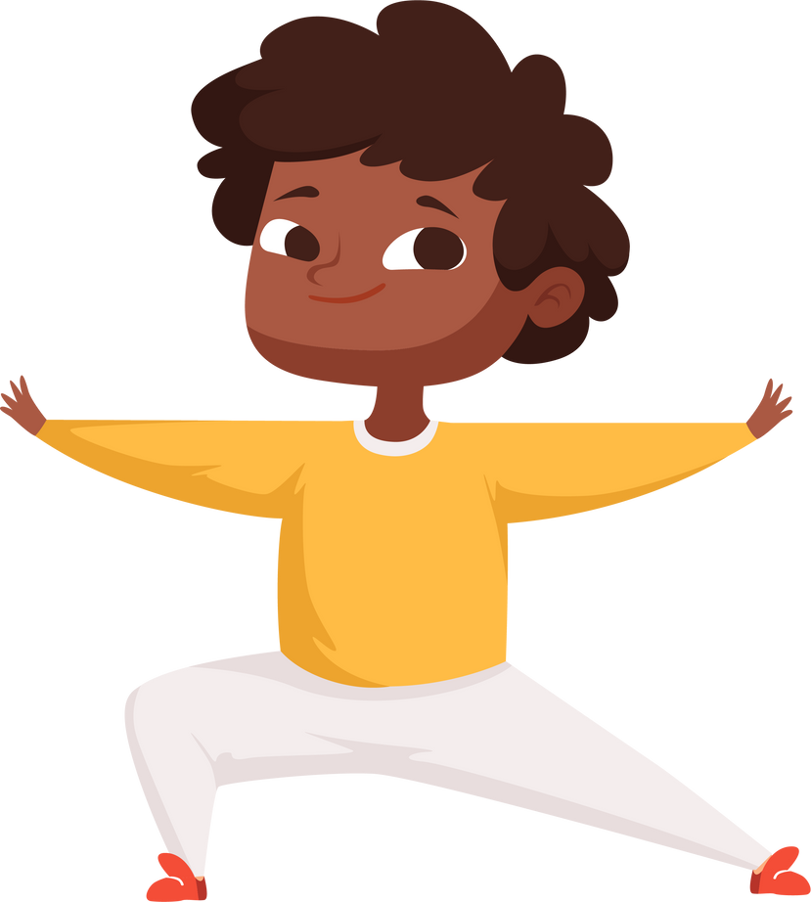
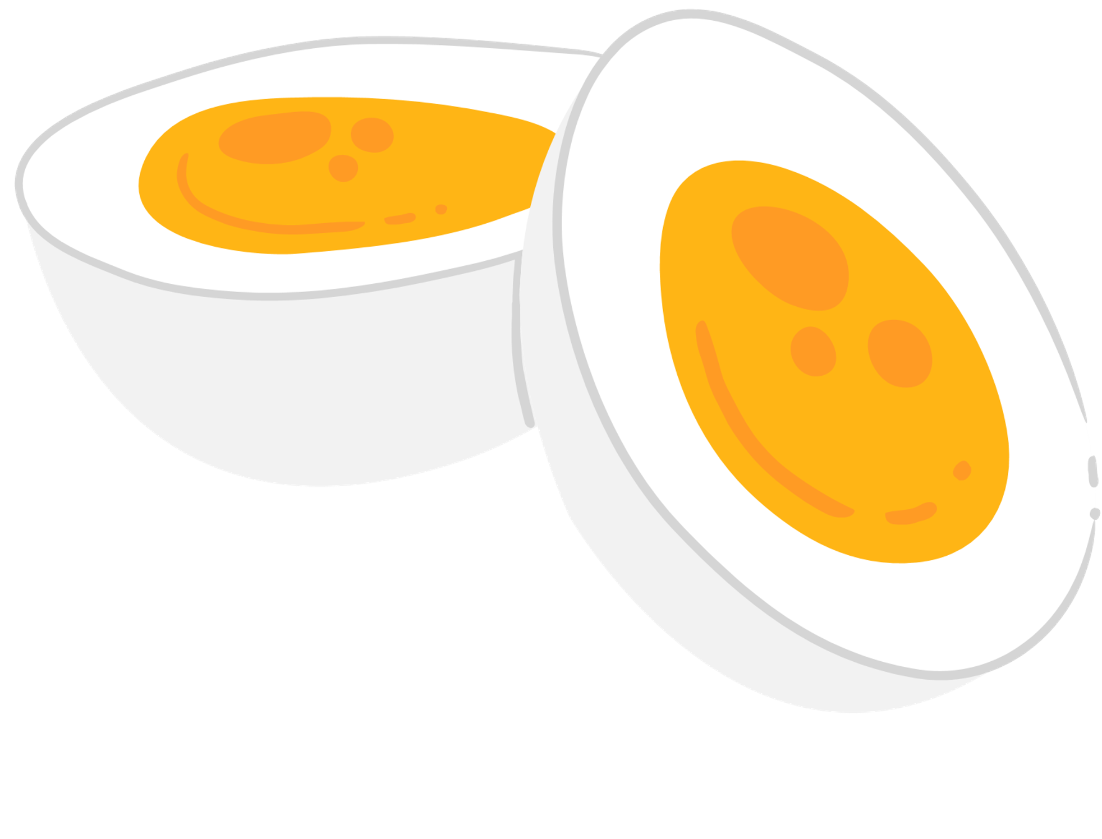







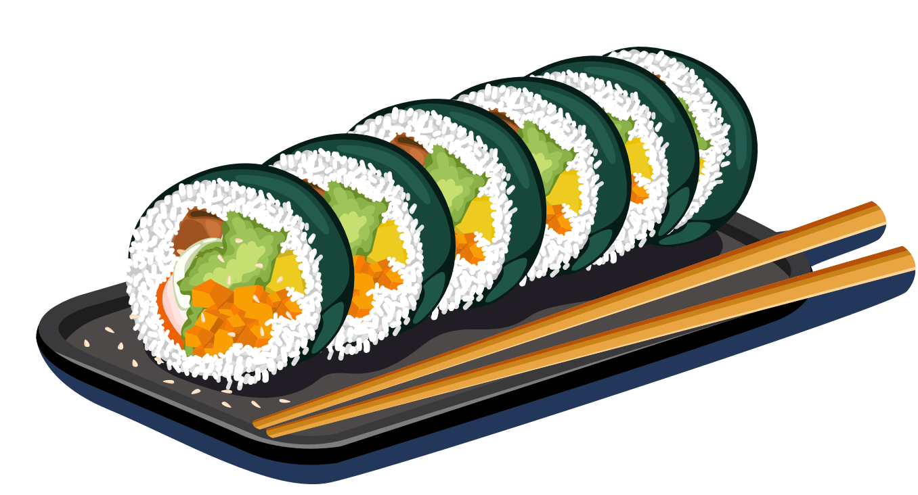


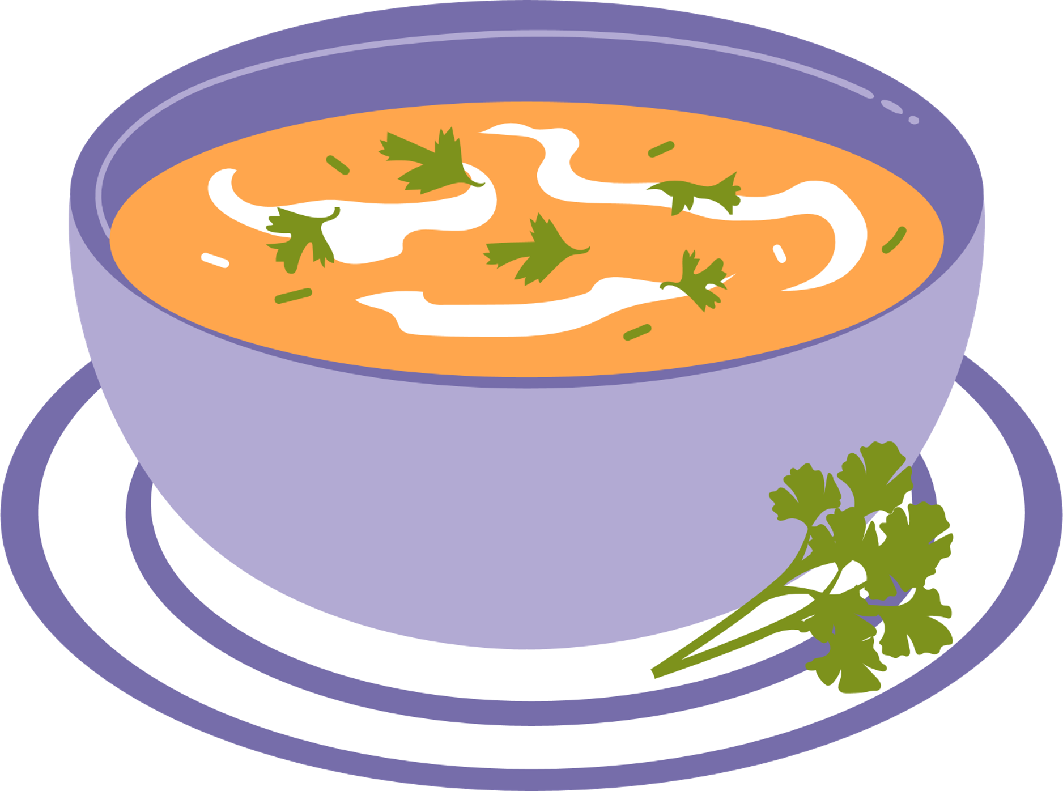
WHAT DOES PHYSICAL
HEALTH MEAN TO YOU?
Notes:
Note: This is a review of what was covered in previous sessions (i.e. what is physical health? What are the key components and how do they connect?). It is also a transition to focusing on self-regulation and understanding body’s signals (to talk about food, and water)
In the last two sessions, learned about what physical literacy is, that movement makes us happy and healthy, and we’ve been practicing those physical literacy skills so that we can be more confident and have more fun while moving.
Dr. Seuss told us that “we have brains in our heads, and feet in our shoes, and we can steer ourselves in any direction we choose!” We choose to be happy and healthy so that we can have fun with our friends and family!
Ask the class: What are some other things we can do in a day to help us be happy and healthy?
Notes: Alternate ideas if few responses from the class:
Setting a routine for regular meals/snacks, physical activity, brushing teeth, and sleep helps with self-regulation and overall health and wellbeing.
Good nutrition supports mental health and well-being, giving your body and brain the power and nourishment it needs.
Eating well can improve mood, concentration, and energy throughout the day. Mindful eating allows us to meet our needs. Eating well includes having healthy attitudes and behaviours about food and eating.
Today we’re going to spend some time learning a bit more about what nourishes our bodies and helps it to function well!

Slide 8


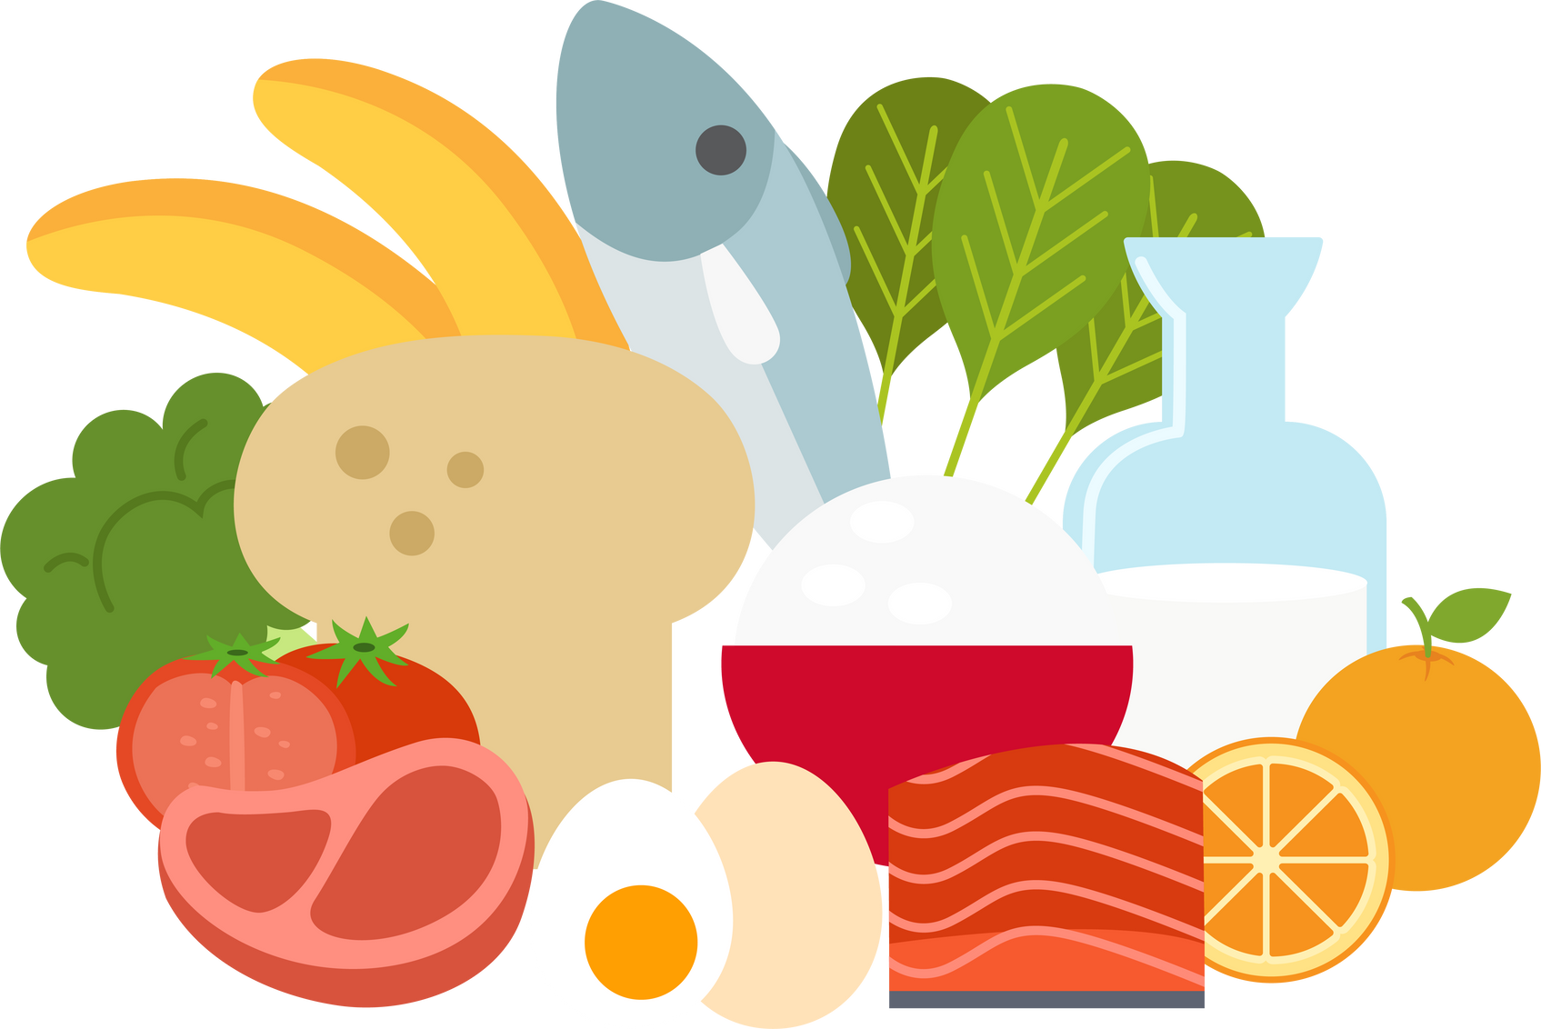


Food is fuel
for our brain and body
We are now going to watch a little video clip that will tell us why we need to eat a variety of foods.​
Notes:
In this video, we’re going to learn why food is fuel for our brain. Healthy eating includes eating a variety of foods, and also includes how you eat (which we will discuss during this lesson).
Note that this video is optional to the lesson--you may wish to omit this video.
(Video embedded on the following slide)

Slide 9

Notes:
In this video, we’re going to learn why food is fuel for our brain, and why eating a variety of foods is important.
If the teacher wishes to provide a nutrition handout to families/parents/caregivers, then "Lunches to Go" or Canada's Food Guide Snapshot can be sent to parents or caregivers.

Slide 10



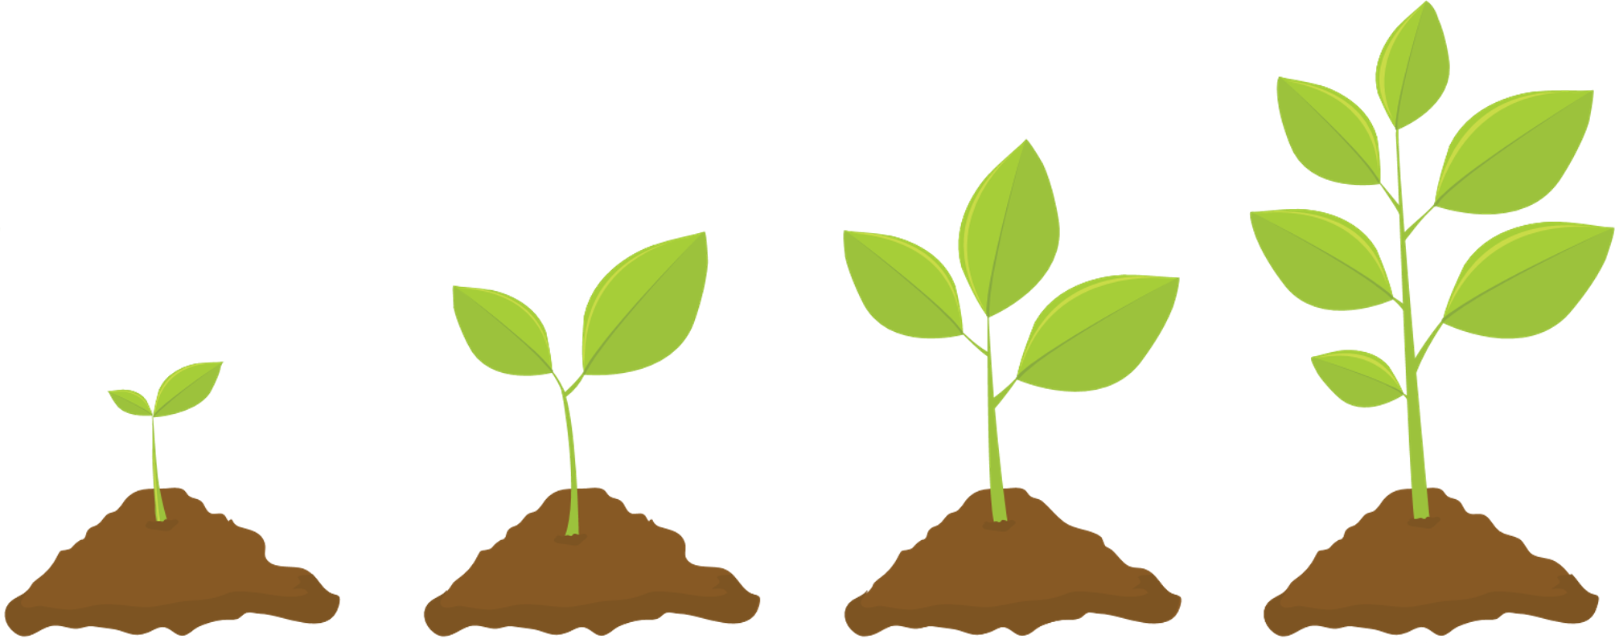
Eating a Variety of Foods
Helps You...
Grow
Learn
Improve mood and overall mental health
Do all the things you love to do
Notes:
Note: Help students understand: Why is healthy eating important?
Ask the class: What does food do for us?
Thank you for the great answers! Food is fuel for your brain and body. Healthy eating helps you do things related to everyday living.
Eating well helps you grow, learn, play and do the activities important to you.
Our body relies on energy to function properly, like a car needs fuel to work.
Through the process of digestion, our body breaks down food into energy we can use.
Without food, we our bodies cannot function properly. We cannot grow, learn and play well.
We feel tired and uncomfortable, maybe even upset! Our stomachs sometimes grumble….
Notes:
If students respond to “Why is healthy eating important?” with: “So you don’t get fat”, redirect and emphasize function. Eating well has many benefits (like building strong muscles, strong bones), ability to concentrate, learn, remember, improved mood, and allows us to participate in learning, playing with our friends, being a good friend and family member, etc. Can also connect back to Module 1’s Dr. Seuss Lesson about how “a person’s a person, no matter how small” (OR BIG), and that it is normal that bodies are different shapes and sizes, it does not mean one shape or size is better than the other.
The question around what activities are important to you, gets students to think about “what is your why?”. As you listen to students’ responses, try to help them connect it to everyday living, community, and culture! Focus on the 5 F’s - fun, future, friends, function and fitness!

Slide 11

How to Eat More Mindfully – Introducing the topic
How to Eat More Mindfully | The Science of Happiness (youtube.com)
Add in visual and hyperlink to YouTube video
How to Eat More Mindfully | The Science of Happiness (youtube.com)
Notes:
How to Eat More Mindfully | The Science of Happiness (youtube.com) - 1 ½ minute video
Try engaging all your senses and paying full attention when you eat something delicious. Let these students guide you through it.

Slide 12

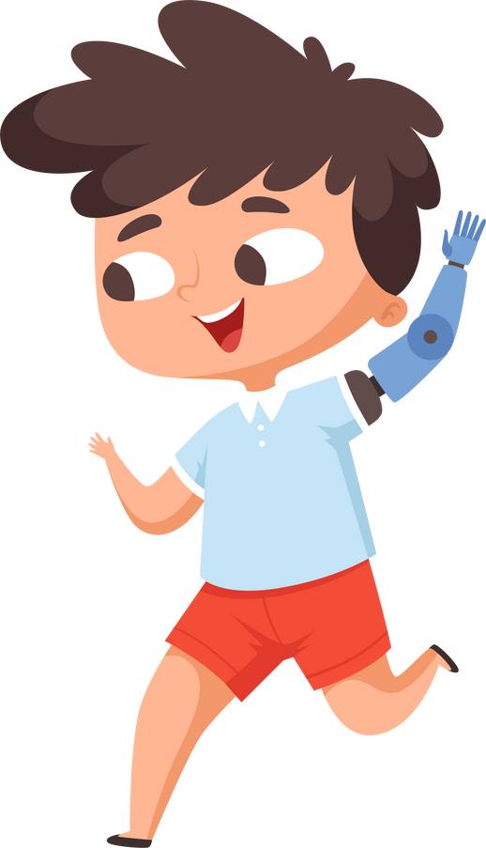
Mindful Eating
Pay attention to your food
Slow down when eating
Focus only on eating and not
on other things
Use all your senses when eating
your food
Listen to your body's internal cues
Try! Try! Try!
Notes:
When eating, sometimes we do not really pay attention to how food feels and tastes once it is in our mouths. This could mean that we miss out on experiencing food to the max! When we pay attention, we may notice flavours, textures and tastes of food that we didn’t notice before – and we might find it to be more enjoyable too!
We are going to do a mindful eating activity that helps our brains practice to be aware of how we eat and the sensations that we experience. This means being focused on the present.
Mindful eating: Paying attention, on purpose, in the present moment, to your food and eating, without judgement.
Note: Mindful eating is more about the “How” of eating, not the “what”.
Offer opportunities for students to experience and describe the flavours, colours, appearance, textures, smells, and sounds of food. Talk about the job of taste buds and that their purpose is to detect sweet, sour, bitter, and salty flavours.
You could use a raisin, a fruit, or vegetable. An alternative could be a food item from a student's lunch if they do not want to eat the food provided.
Mindful eating may not work well for all situations or everyone. For example, for individuals with active eating disorders. Concepts of mindful eating can be inaccessible to neurodivergent people. Nevertheless, mindfulness principles can be valuable building blocks for fostering a positive relationship with food and body and can be a way we teach about healthy eating without being hyperfocused on “what”. Focusing too much on “what” can inadvertently perpetuate judgement about foods. We focus on the “how” of eating here given that is more within the student’s influence than the “what”, which is more likely determined by factors outside of the student (e.g. adult’s decisions, household income or access, seasonal availability, culture and traditions, and other determinants of health).

Slide 13







The 5 Senses
We are going to use our 5 senses today​
​
Let’s review them​
touch
taste
smell
hear
see
Notes:
Mindful eating is using our 5 senses to experience the characteristics of food–notice what you can see, smell, taste, feel, and hear.
Note: Use this slide to introduce the 5 senses to kids as you are getting them to taste and smell their raisin.
Prepare the students for the activity before giving out the food. They are likely to want to eat the food right way.
We are going to do an activity. This activity will include using our 5 senses. Try not to eat it yet! Once we hand out the food, you will have to wait a few minutes before you can eat it- we are going to use our 5 senses to investigate it first.
With Mindful Eating, be aware and present during the eating experience, without judgement.

Slide 14

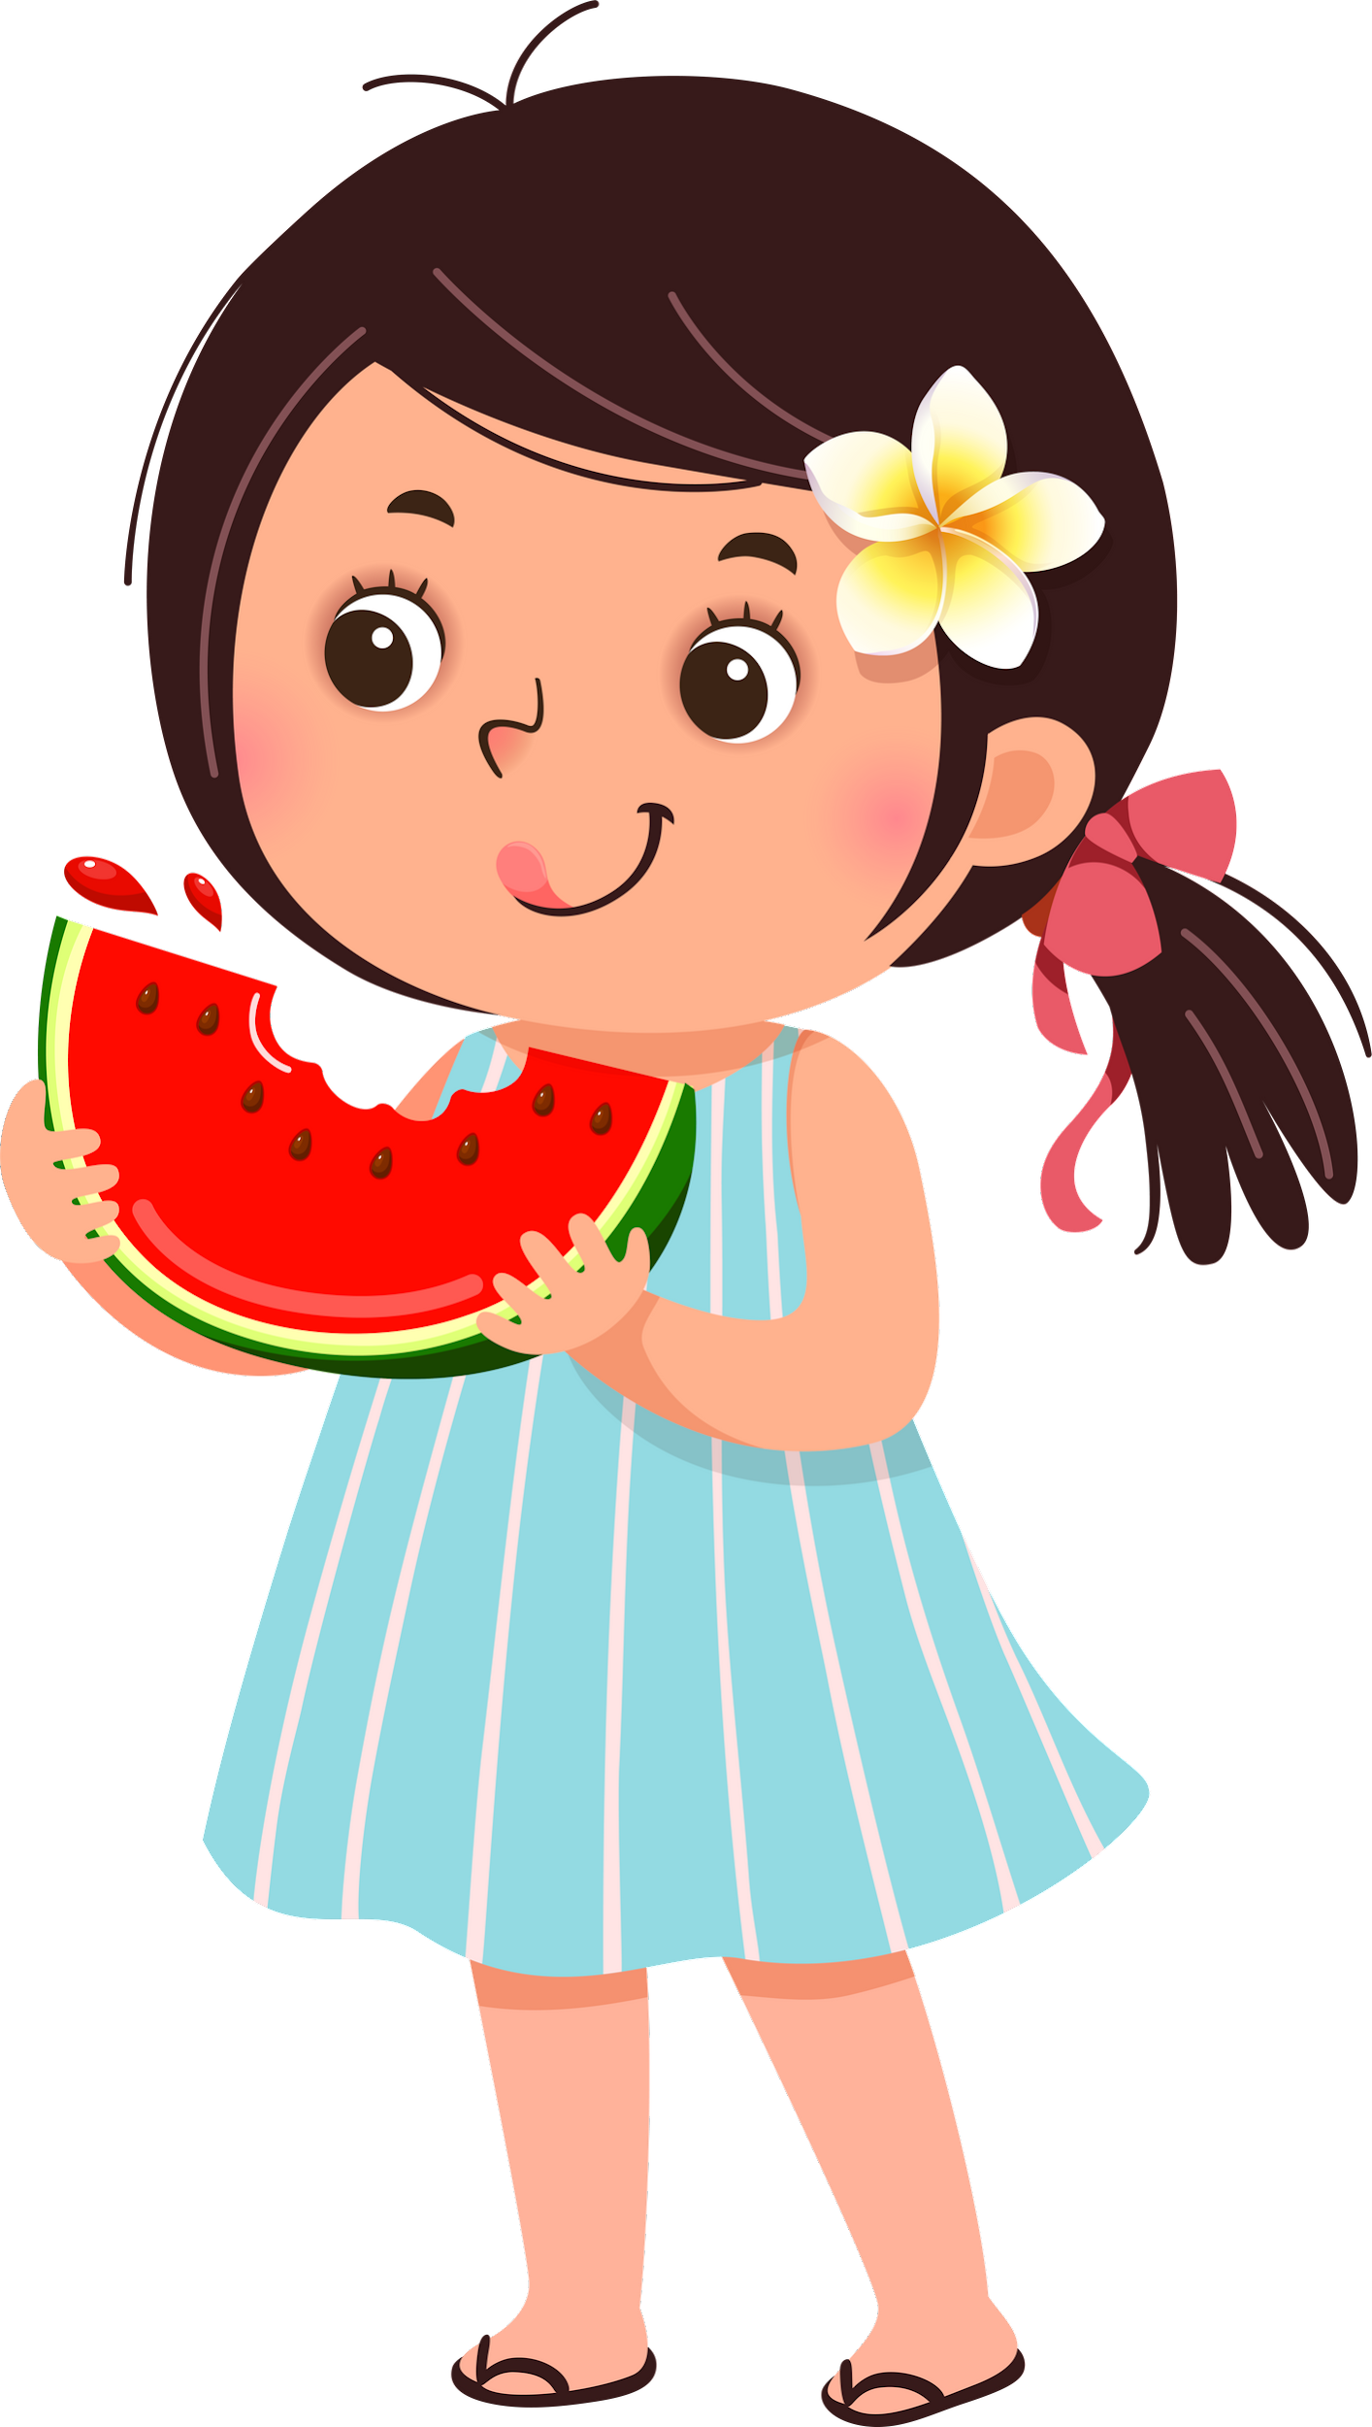
Mindful Eating Activity
Wash/sanitize hands
Receive a food item
Touch, Look (see), Smell
Then we are going to slowly Taste
….and Listen (hear) the sounds when you bite or chew the food item
Notes:
Activity!
Note: Use this slide once you are ready to hand out the raisins.
We’ve included a raisin in your kit as it is non-perishable. When possible, work with the classroom educator to choose something that is seasonal and accessible to the school (through the BC Fruit and Vegetable program or from the school garden!) Apples, pears, cucumbers, and baby carrots are options that require little preparation and tend to be allergy-friendly. Bonus: a local (BC) food promotes environmental sustainability too!
Note: Prepare the students for the activity before giving out the food.
We are going to do an activity. This activity will include using our 5 senses. Try not to eat it yet! Once we hand out the food, you will have to wait a few minutes before you can eat it- we are going to use our 5 senses to investigate it first. We are going to walk through the following steps together.
Talk the students through the mindful eating exercise: Using Your 5 Senses think about:
Sight: What does it look like? - shape, colour, size
Smell: Aroma
Touch: Describe the texture : in your hand, on your tongue, while chewing
Taste: Does it taste sweet, sour, salty, bitter?
Sound: what sounds do you hear when you chew?
Mindful: where does this food come from? Where does the food waste go after we finish eating?
*Option: to do this activity twice if possible. Once with the raisin, once with a school fruit or vegetable, and then compare the experience.

Slide 15


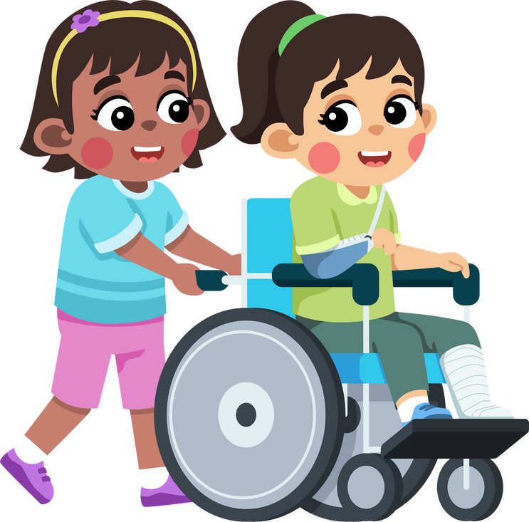

Walk & Talk
In partners:
Student A talks first
Student B then talks second
Some Ideas to Talk About
What did you think about the food item?
Had you ever tried it before?
When did you eat it before?
Would you be willing to try it again?
If not, why not?
Notes:
Note: After doing the mindful eating activity, children reflect on what they noticed/what was new about the raisin that they hadn’t noticed before.
Walk and Talk is an accessible activity for all students that gets the class moving and practicing building connections with others. Talking while walking has been shown to make it easier to talk and share feelings, ideas and thoughts. Use it to have students share ideas, brainstorm or problem solve - and watch the connections AND creative thinking grow!
Time to Complete : about 10 minutes
Ingredients: A topic to discuss or share ideas about & clear classroom perimeter
Method
1. Pair students up and give them the following directions:
Walk the perimeter of the classroom. An option would be to walk outside, if appropriate.
On lap #1 partner A shares what on what they noticed/what was new about the raisin that they hadn’t noticed before, and on lap #2 partner B shares their response on what they noticed/what was new about the raisin.
Once 2 laps are completed - return to your seats.
2. Open a discussion by asking if anyone wants to share what they noticed about the raisin or how this activity was different to how they normally eat.
3. Reflect as a class- Mindful eating includes using our 5 senses to notice the colour, smell, texture, sound, and taste of a food. In your discussion with your partner, did you notice that the two of you discussed the 5 senses? Mindful eating also includes noticing our INTERNAL hunger cues.

Slide 16
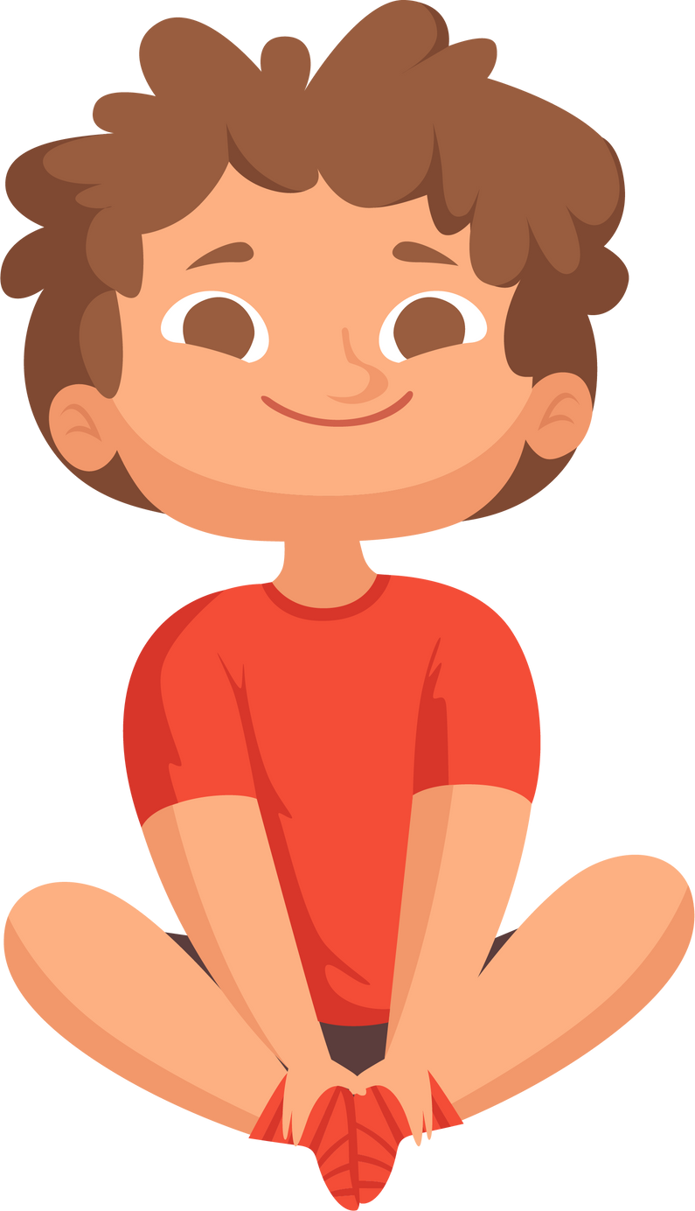


Listening to
Your Body
Notes:
Our body is incredible and has the ability to tell us what we need. It does this through signals all without us trying. The key is learning to recognize what it’s trying to tell us. Sometimes these signals are obvious, and other times it takes a bit of practice to understand what our body needs.
In addition to hunger, other internal body signals include sensations such as thirst and being tired. Extension: https://gabigarciabooks.com/products/listening-to-my-body-activity-guide

Slide 17
Difficulty focusing
Stomach feels empty
Lower energy
How do you know when you’re hungry?
Headache
Stomach Growls
Feel grumpy
Notes:
As an example, let’s think about when our bodies need more fuel. We usually call this signal hunger.
Note: Some questions for discussion with the class (Have students raise their hands, and toss them a beanbag when it’s their turn to answer):
How do you know when you’re hungry? (e.g., can’t concentrate, headache. As one gets hungrier, there can be increased grumpiness and thoughts of food, then a growling stomach.)
When you’re hungry and you start eating food, how do those signals change? (e.g., happier, better mood, can think better, no stomach pain) - Hunger and fullness occur on a continuum.
How do you know when you’re thirsty? (e.g., dry mouth, dry lips, grumpy, headache, can’t think well–after drinking water, you feel better). As you drink water, how do these signals change?
Hunger and fullness occur on a continuum. How can you tell when you’re hungry, satisfied, full?
Sometimes we feel hunger, thirst, and emotional upset all at the same time. Your body gives you signals or cues about what is going on in your body. Sensations such as being cold, hungry, thirsty, or needing to go to the bathroom tell you that you need something.
What are some reasons we might feel uncomfortable, and what might our bodies be saying that we need? These needs could be physical or emotional.
Note: Self-regulation—includes managing physical (biological) needs and emotional needs.
When you feel some of these signals, check in and ask yourself: “what is my body saying that it needs right now?” This can be done anywhere, at any time. You will feel better when you take steps to meet your needs—physical and emotional.

Slide 18


How to respond to your body’s signals
Signal
Tired
Hungry
Thirsty
Emotional Upset (e.g. sadness, disappointment, hurt feelings)
How to Respond
More sleep or rest
Eat Food
Drink Water
Talk to someone, or other action
Notes:
One way to take care of ourselves is to respond to our body’s signals that tell us what it needs! When we respond according to our body’s signals, we often feel better.
For example, when we feel tired, our body is usually telling us that it needs sleep or rest!
However, sometimes we can have these signals mixed up. For example, we may eat when in fact we are dehydrated or tired.
In order to understand our signals correctly - we need enough food and good sleep and physical activity!
Sometimes we feel hunger, thirst, and emotional upset all at the same time.
When we are experiencing difficult emotions, sometimes we feel better by talking about it or getting a hug.
Note: The first 3 examples of uncomfortable sensations that we talked about are physical needs (hunger, thirst, fatigue). The last one is emotional–what are some coping strategies you use when you are sad, angry, upset? E.g., talk to a trusted adult or friend; draw; listen to music; get fresh air.
Neurodivergence and food insecurity can affect how attuned people are to internal cues.
It can be hard for grade 2s to understand their body signals. But you can equate some of these more complex signals (hungry, full, emotional upset) to what grade 2s understand already: knowing when you’re too hot/too cold or when you have to go to the bathroom.

Slide 19
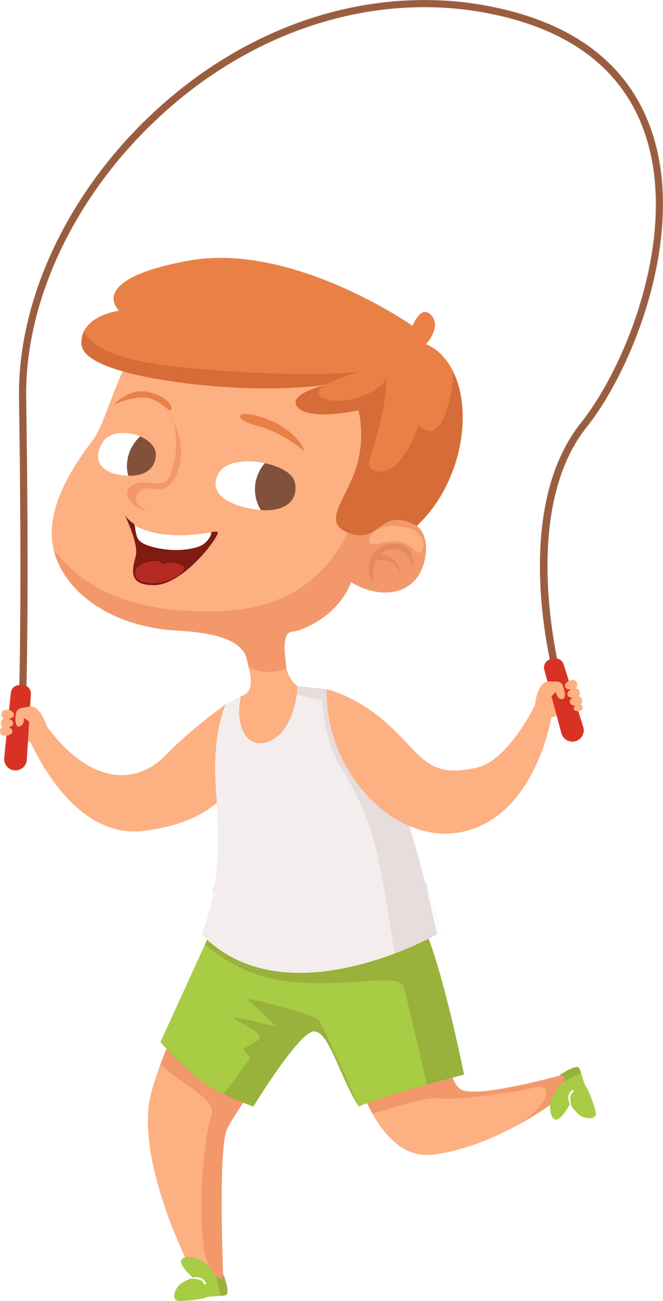

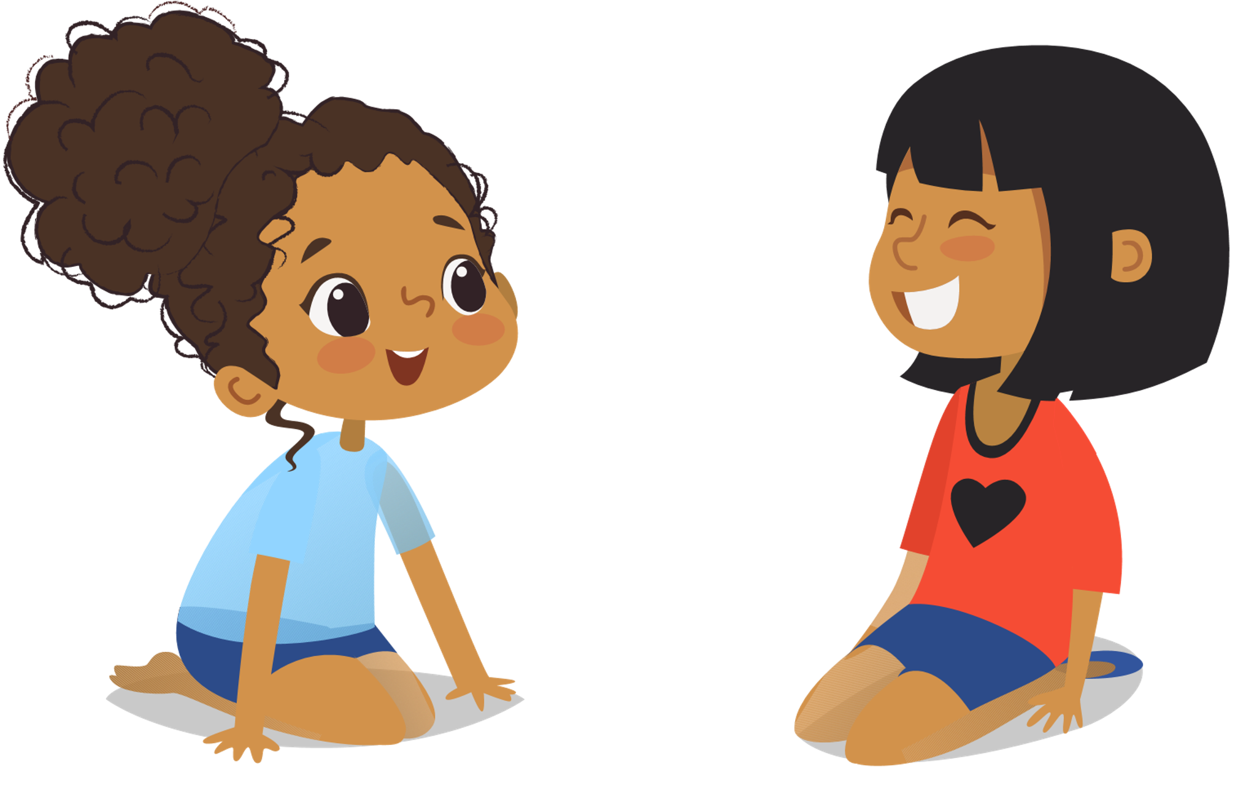
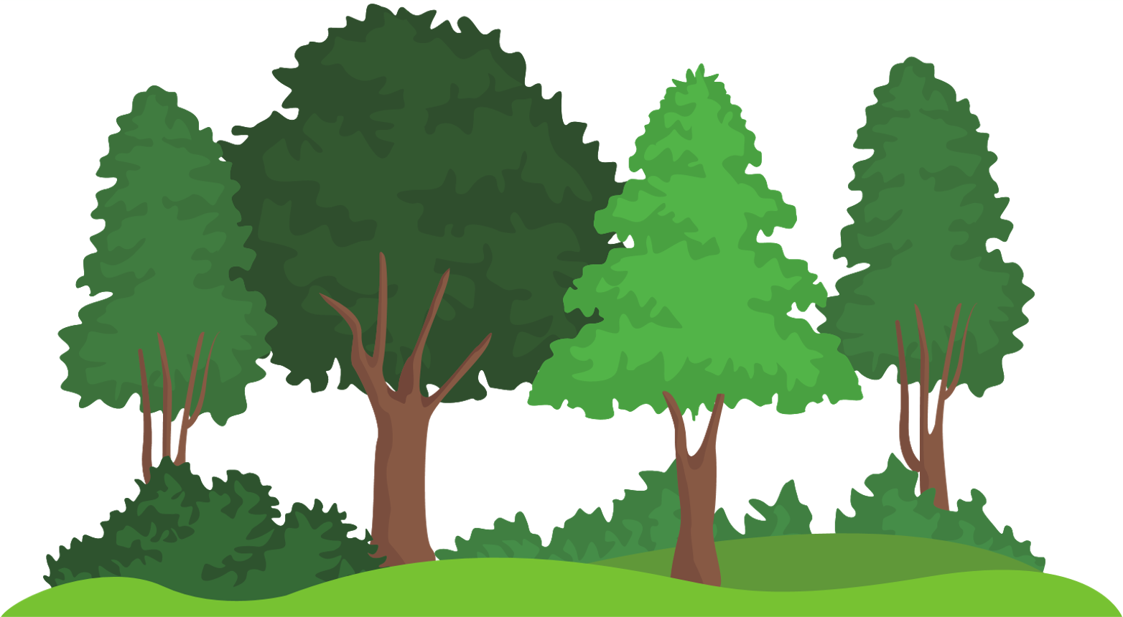

Here are other ways to respond to emotional upset
(like sadness, hurt feelings, or disappointment)
Time
outdoors
Play Music
Moving
your body
Talk to Someone
Snuggles and Cuddles
Notes:
Engage the class:
What are some other ways you can take care of yourself when these big emotions come your way?
Great ideas class! As we learned from each other today, there are so many things that can help us feel better when we are not feeling great.
Sometimes it’s by moving our bodies, or doing something we enjoy, or spending time with people we care about and care about us.
These are great ideas to keep in mind! Checking in with ourselves – How am I feeling? What is my body telling me? And what can I do to take care of myself right now? – can be powerful things to help us feel happy and healthy!
Notes: not everyone has a pet to snuggle, providing a few options would make it more inclusive (e.g. “someone special”, “a stuffy”, or “a pet”). Emphasize here that everyone has different strategies that work for them- we are all diverse!

Slide 20
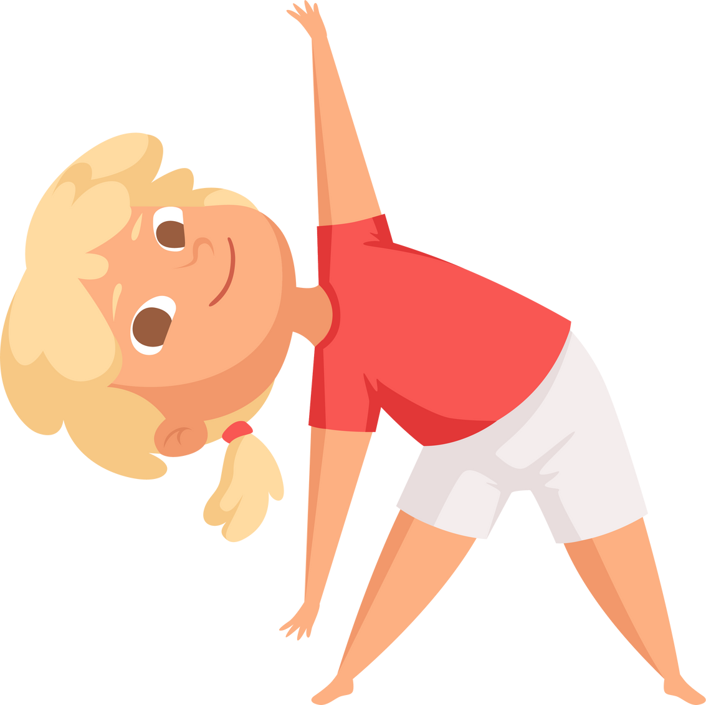
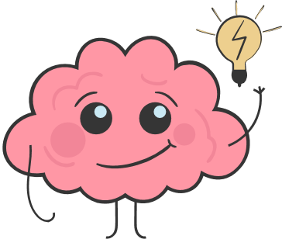
Movement and Eating Well Makes...
Our bodies
  healthier
  Our brains learn better
Our bodies
  calmer and happier
Notes:
Notes: Have students say this message with you.
Movement makes:
Our bodies healthier!
Our brains better learners!
Our bodies calmer and happier!
Note: Thank the class for their engagement and sharing. Let them know that their teacher may continue to bring some of the fun activities into their classrooms.
The module manual accompanying these lecture slides can be left with the teacher as a reminder of the key concepts and as a tool to confidently bring these lessons into their classroom. Follow up with the teacher on sending them any lesson plans or supportive material.

Slide 21
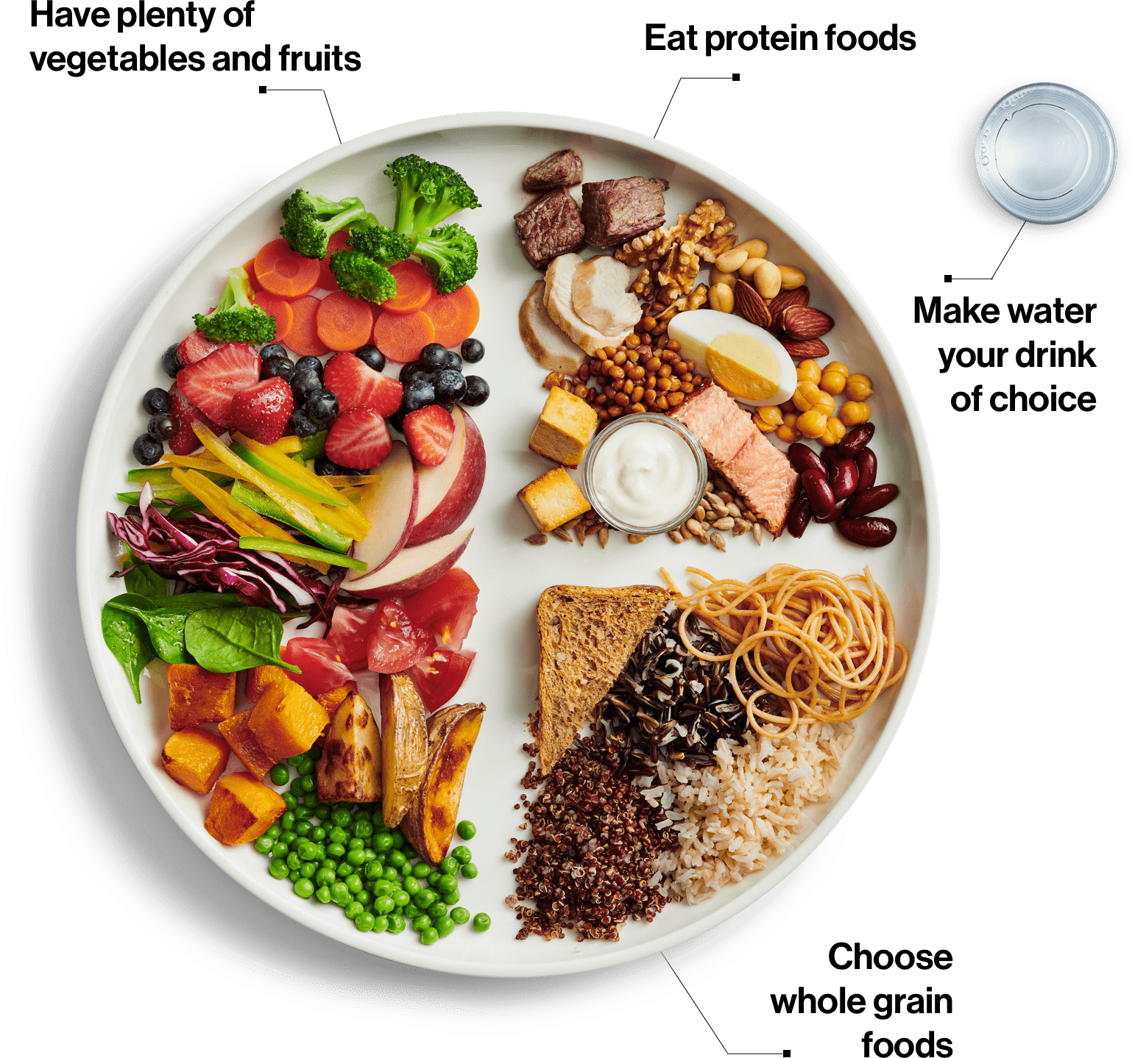
Canada's Food Guide Snapshot -This handout can be provided to parents and caregivers,
Canada.ca/foodguide
Notes:
To bridge the learning between classroom and home, the educator/PHN can provide a copy of "Lunches to Go" https://vch.eduhealth.ca/en/viewer?file=%2fmedia%2fVCH%2fBB%2fBB.203.L86.pdf which has ideas of food to pack for school, and a link to Canada's Food Guide Snapshot,
https://food-guide.canada.ca/en/
Alternatively, educators may order printed copies of CFG Snapshot to give to students to bring home to parents/caregivers. Google "Order Canada's Food Guide" to find the online order form, https://www.hc-publication-sc.hc-sc.gc.ca/paccb-dgapcc/cmcd-dcmc/webpubs.nsf/7?ReadForm=&cat=00030&lang=eng

Slide 22








Thank you to our contributors!

